Slide 1
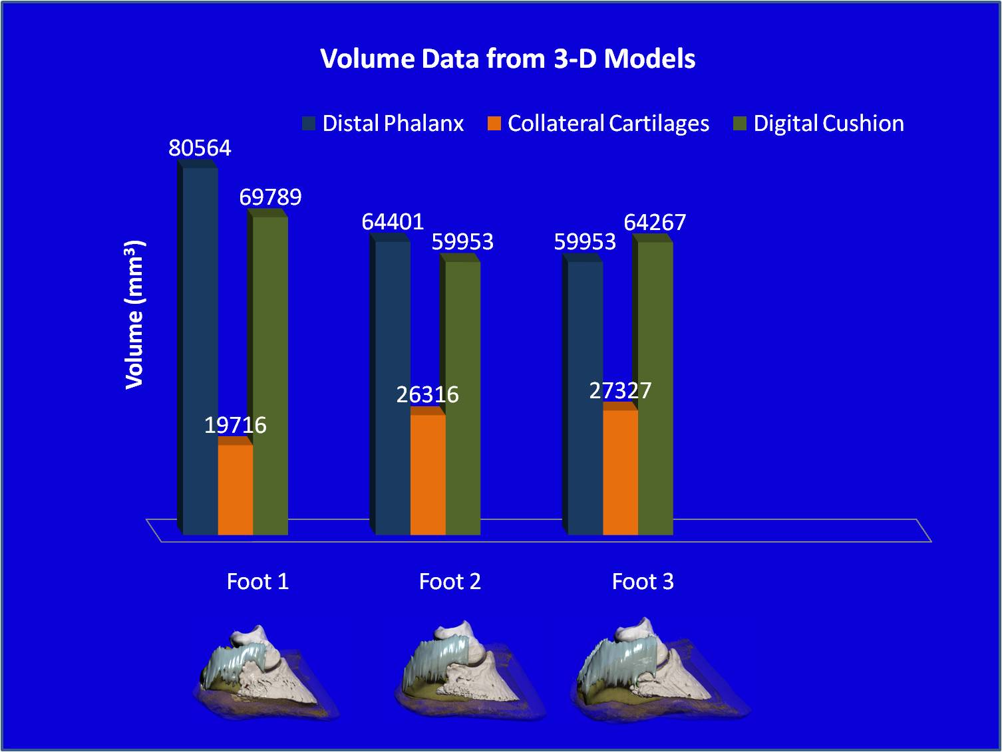
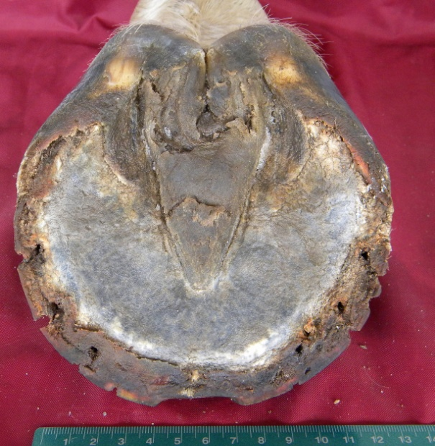
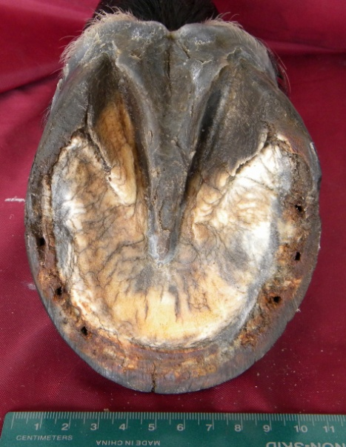
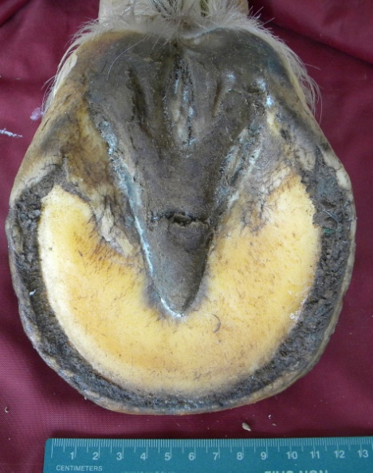
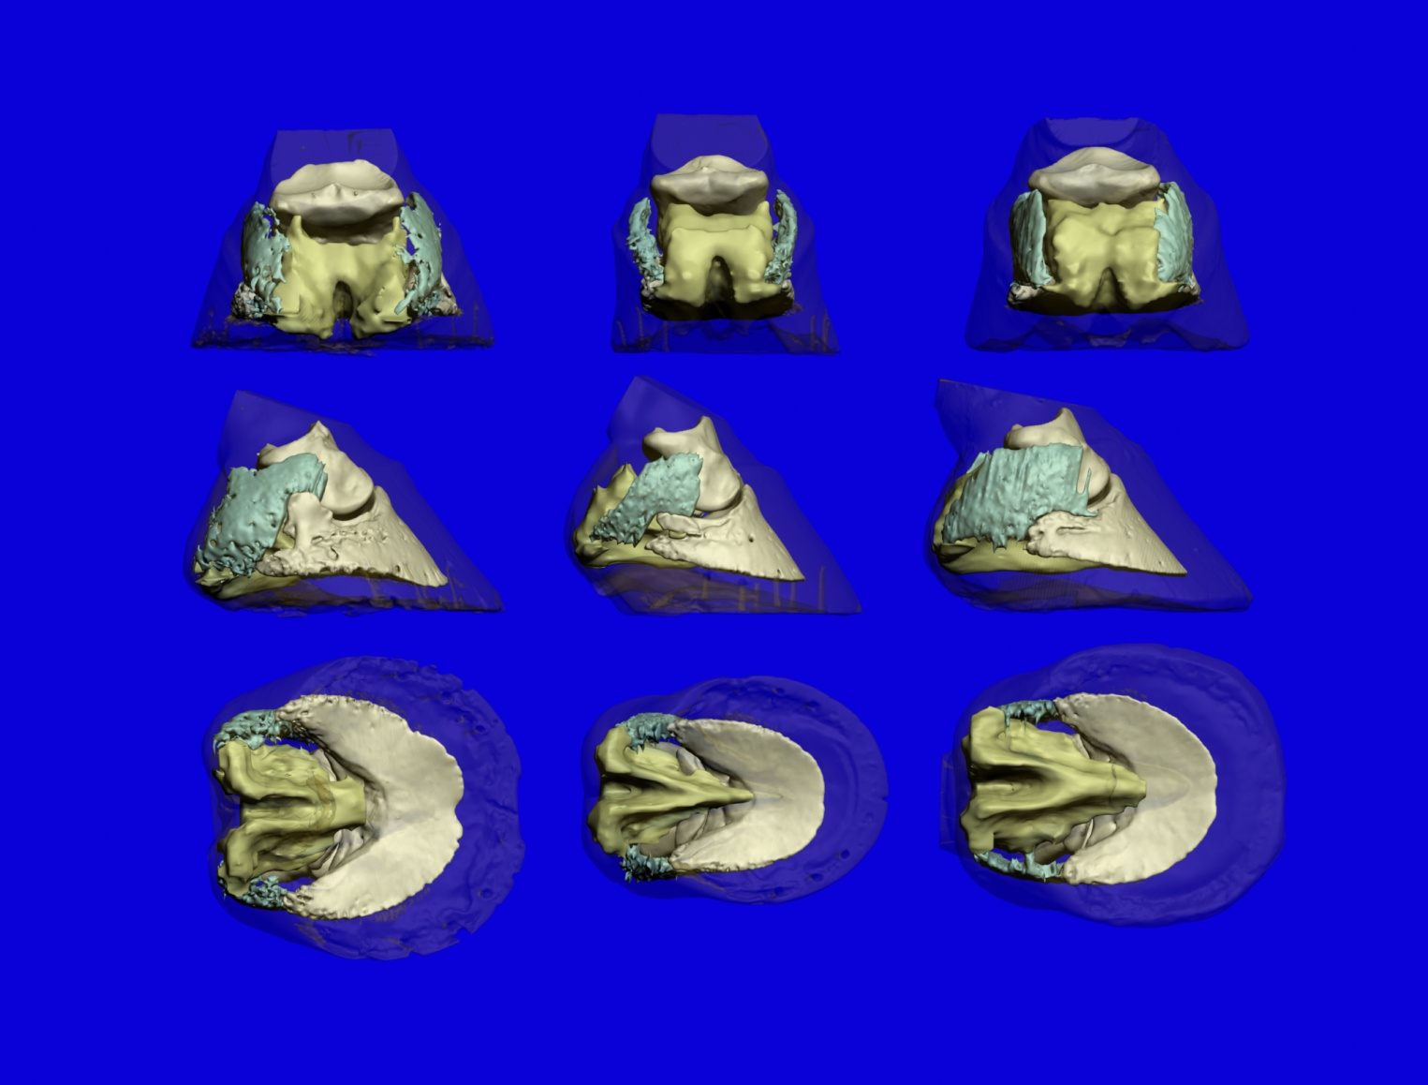
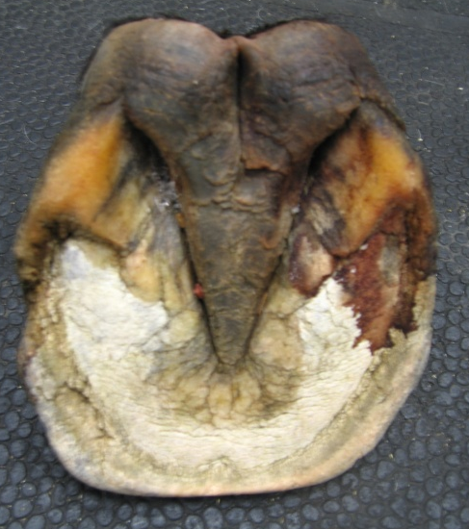
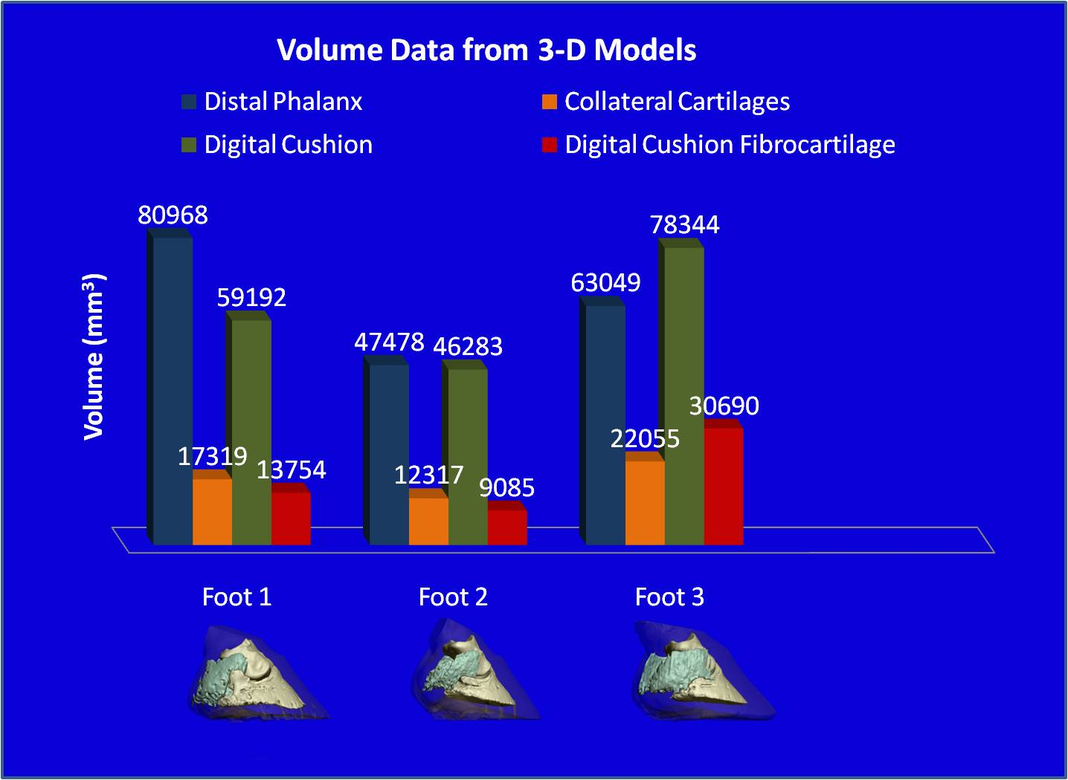
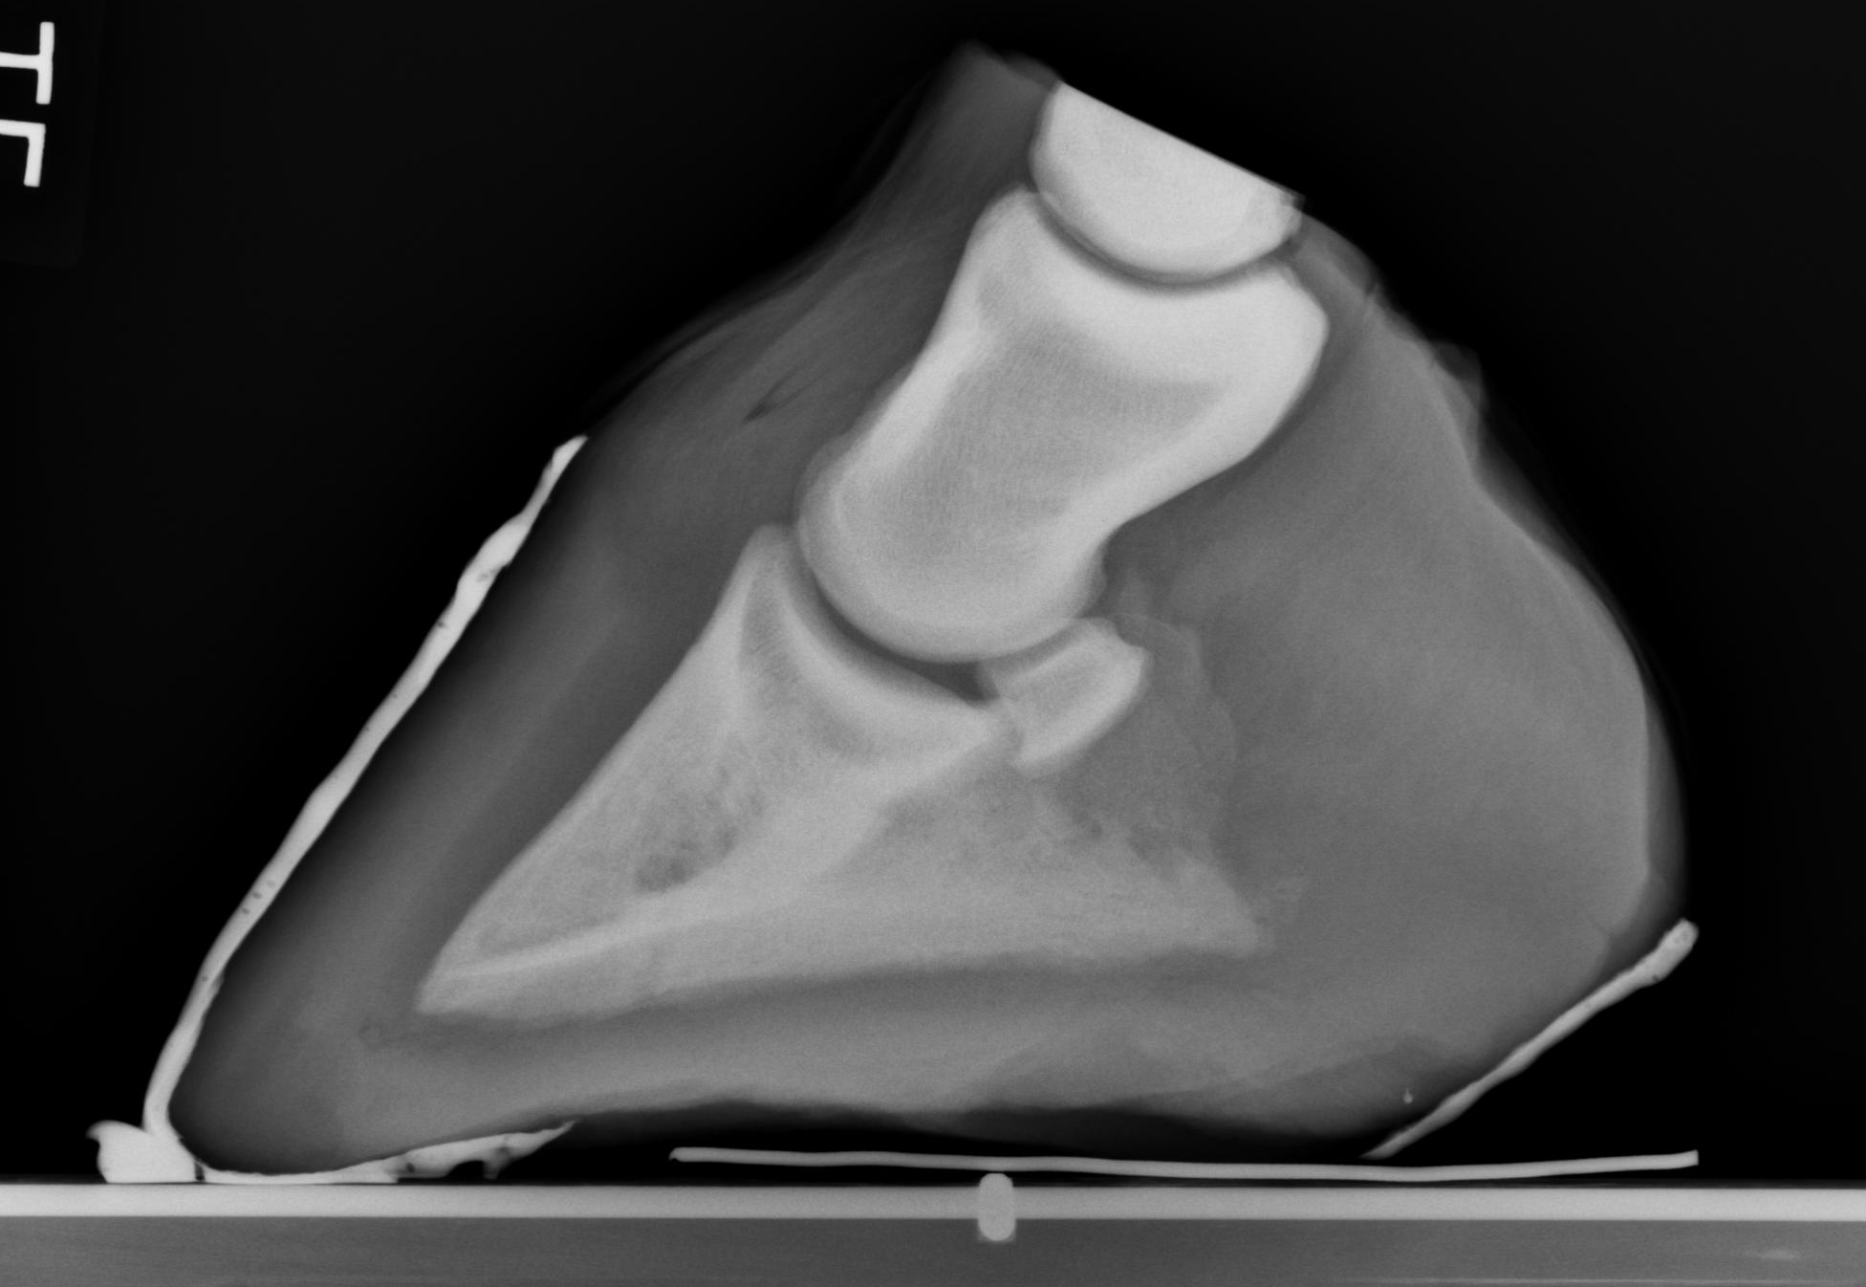
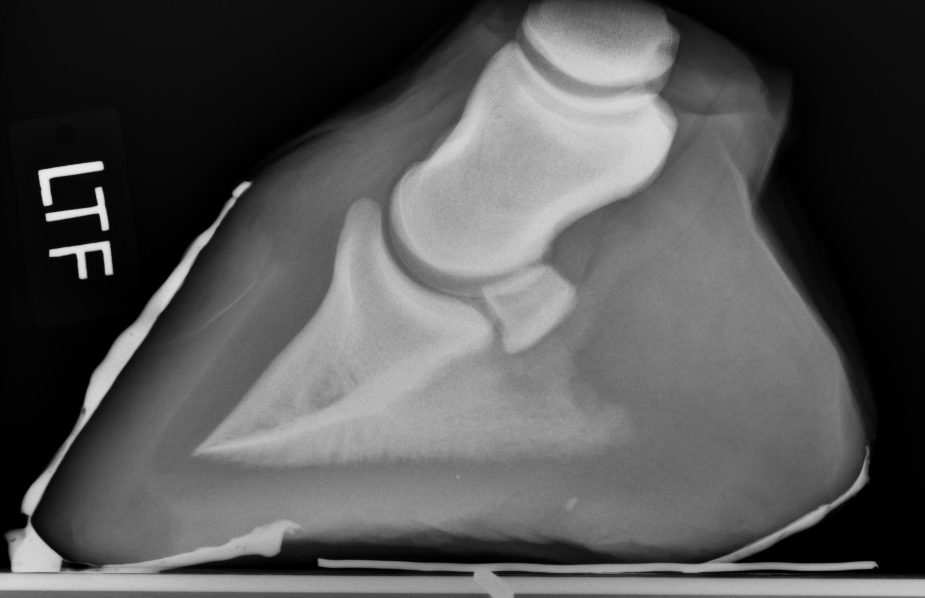
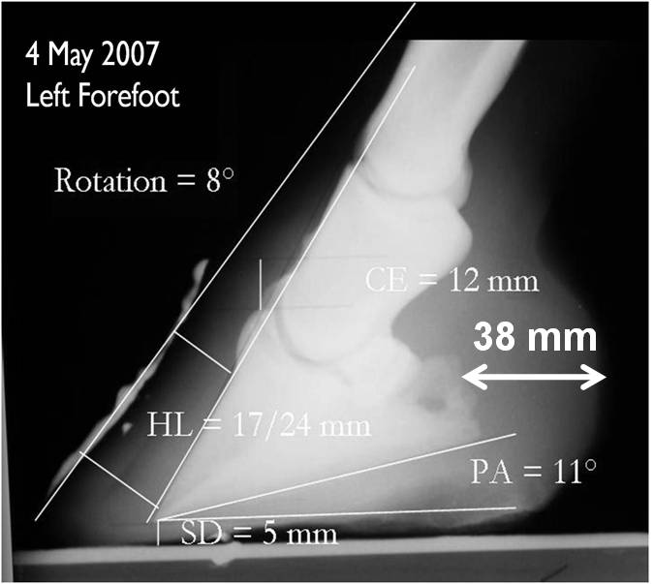
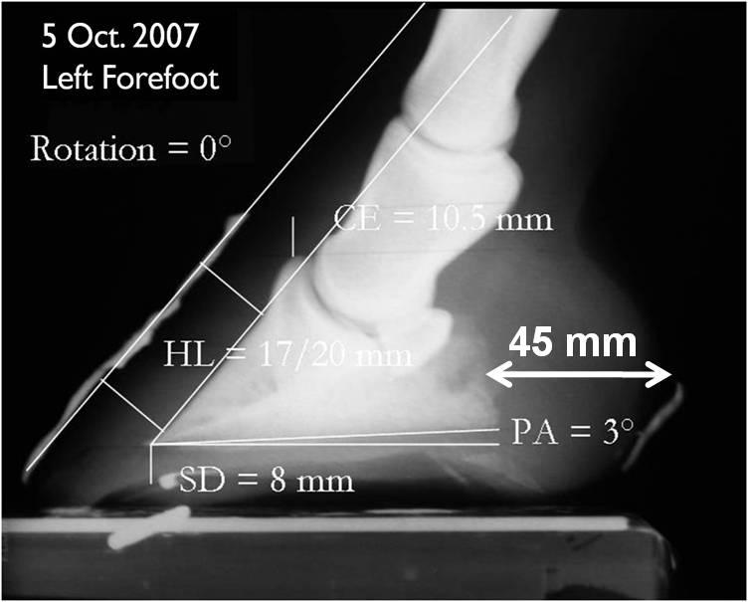
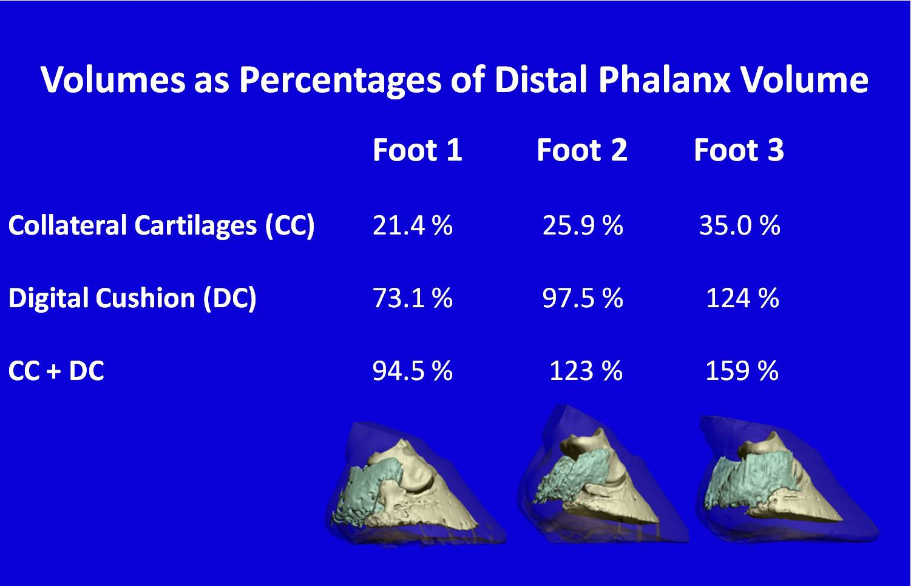
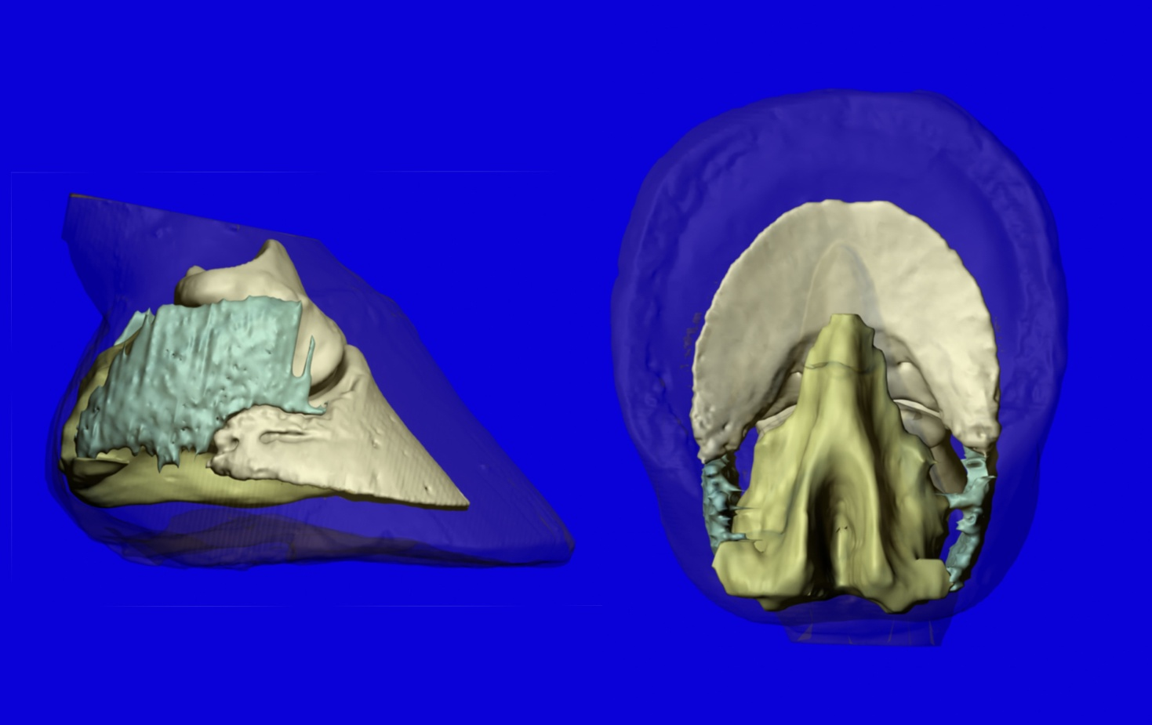
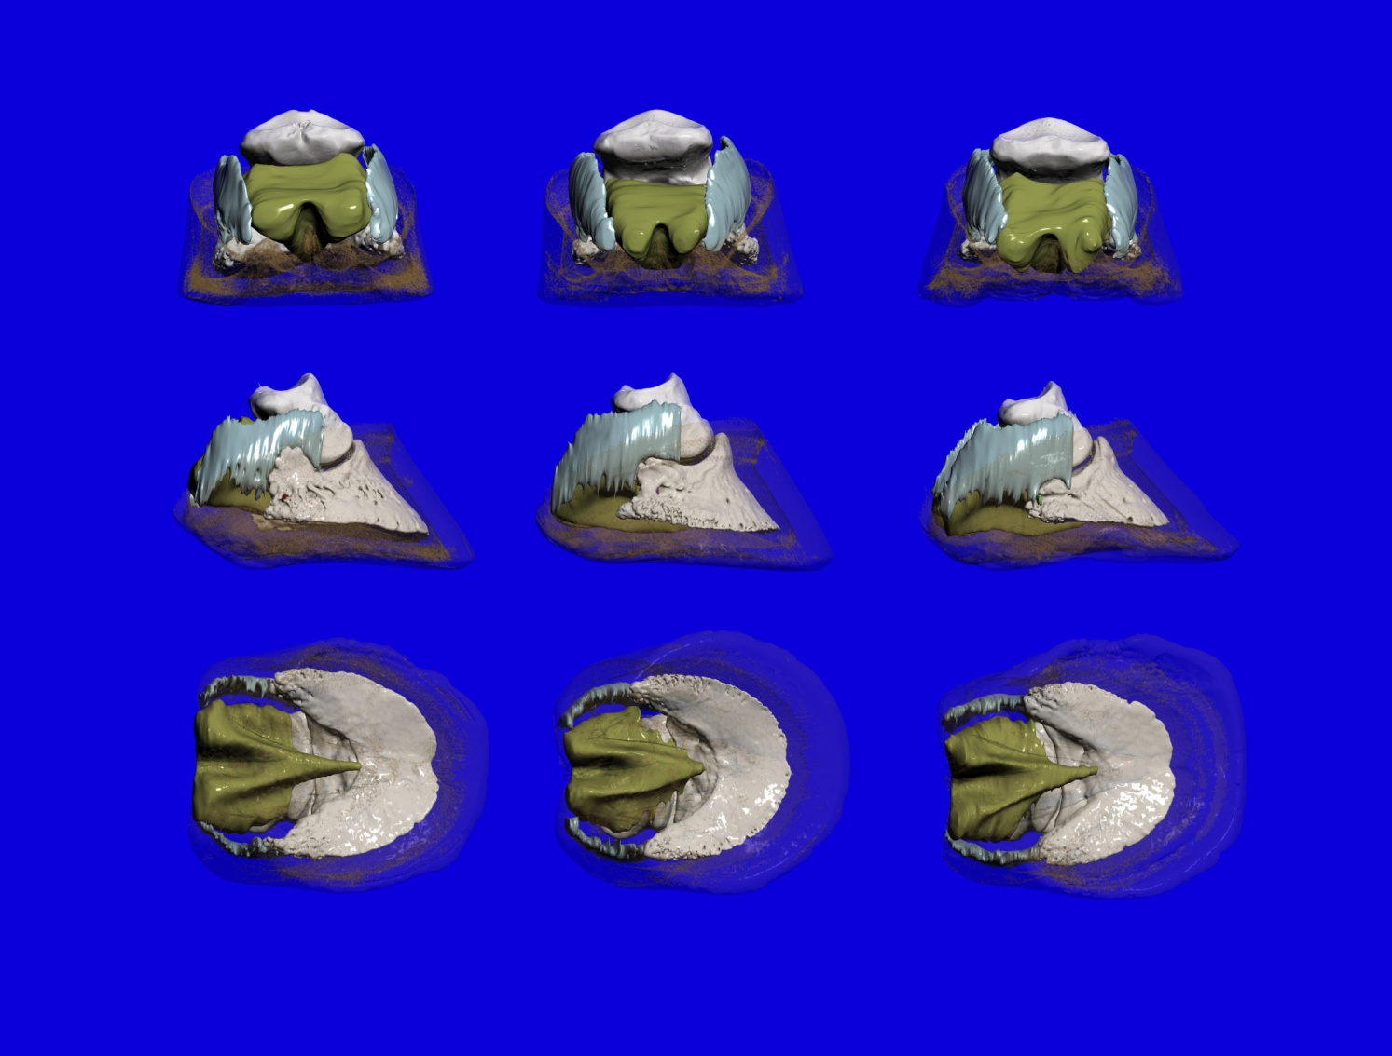
Evaluating Soft Tissue Composition of the Equine Palmar Foot with Computed Tomography, Magnetic Resonance Imaging, and 3-D Image Reconstruction
Adam Cooner¹, D. Ray Wilhite², Debra Taylor¹, Brian Hampson³, Kent Sanders⁴, Pete Ramey⁵, Ivy Ramey⁵ and John Hathcock¹ Departments of Clinical Sciences¹ and Anatomy, Physiology, and Pharmacology², Auburn University College of Veterinary Medicine, Auburn, Alabama
School of Veterinary Science³, University of Queensland, Brisbane, Queensland
University of Utah School of Medicine ⁴, Salt Lake City, Utah
Hoof Rehab, Inc.⁵, Longmont, Georgia
Abstract
a.
b.
c.
Results
Previous histological studies of the equine foot have shown that the soft tissue composition of the palmar foot shows a significant degree of variation among horses¹. This variability in composition is closely correlated to differences in foot health. Palmar foot health is vital for soundness, athletic capability, and the treatment of laminitis and navicular syndrome. Radiography is inadequate for evaluating soft tissues². We hypothesized that computed tomography (CT) and magnetic resonance (MR) imaging of the equine palmar foot, combined with three-dimensional image reconstruction technology, could be used to evaluate the contrasting soft tissue compositions that exist between feet with varying degrees of development. We collected three cadaver forefeet: a reasonably developed foot and two feet in different stages of underdevelopment. Digital photographs and lateral radiographs were taken of each foot. MR and high-resolution CT images of each foot were obtained in a transverse plane perpendicular to the palmar angle of the distal phalanx. Using Mimics® medical imaging software, the collateral cartilages and digital cushion were manually extracted from each CT and MR image, respectively, to build three-dimensional models from which volume measurements could be made. Using this method of quantifying soft tissue structures revealed that the collateral cartilages and digital cushion contributed a large amount of volume to the foot, with markedly greater contribution seen in the reasonably developed foot.
a.
b.
c.
d.
e.
f.
d.
Figure 2. Digital photographs of Cadaver Feet
a. Domestic Foot 1 (left fore) b. Domestic Foot 2 (right fore) c. Domestic Foot 3 (right fore)
d. Brumby Foot 1 (left fore) e. Brumby Foot 2 (left fore) f. Brumby Foot 3 (left fore)
Figure 8. 3-D Models of Domestic Feet
Column (a) Foot 1, Column (b) Foot 2,
Column (c) Foot 3
Figure 9. Volume Data from Brumby Feet
a.
b.
c.
d.
e.
f.
Introduction
Years of treating laminitis and navicular syndrome cases with a natural hoof care system³ has revealed a pattern: as soundness increases, heel depth, as observed on lateral radiographs, also increases (Fig. 1).
Knowing that foot health has previously been correlated to the soft tissue composition of the palmar foot¹, we dedicated ourselves to developing a method of quantifying this soft tissue without gross dissection.
Figure 10. Volumes as Percentages of Distal Phalanx Volume for Brumby Feet
Figure 3. Digital radiographs of Experimental Cadaver Feet
a-f. Follow Figure 2 legend
a.
b.
Each foot was thawed before MR imaging⁵. MR images for the domestic feet were obtained with a 1.0 Tesla magnet⁶. MR images for the Brumby feet were obtained with a 3.0 Tesla magnet.
Discussion
Figure 9. Volume Data from Domestic Feet
Figures 9 and 10 illustrate that, in our study, the collateral cartilages and digital cushion contributed a large amount of volume to the foot, from 94.5 % to 159 % as much volume as the distal phalanx.
Using Mimics® imaging software, the collateral cartilages and digital cushion were manually isolated from each CT and MR image, respectively, to build 3-D models
(Figs. 7 8). The distal phalanx was isolated using the program’s bone algorithm. For
each foot, volume data was recorded from the distal phalanx, collateral cartilage,
digital cushion, and digital cushion fibrocartilage models. These models were then imported to Autodesk 3ds Max 9 Sp2® for rendering. The CT and MR data for each
foot was merged by aligning the foramen of the palmar processes.
Conclusion
Figure 1. An acute laminitis case treated with a natural hoof care system.
Lateral radiograph taken pre-treatment, showing a heel depth of 38 mm.
Lateral radiograph taken five months post-treatment, showing a heel depth of 45 mm.
In these 3 feet, the soft tissue volumes show variation and further study, with a larger number of feet, is warranted to establish whether degree of development is, in fact, correlated with the volume of soft tissue structures in the palmar foot. While we cannot yet claim statistical significance from such a limited data set, we have developed a unique methodology for quantifying soft tissue structures in the equine palmar foot, one that, hopefully, can soon be put to use in live horses.
Figure 10. Volumes as Percentages of Distal Phalanx Volume for Domestic Feet
Materials and Methods
b.
a.
c.
a.
b.
c.
Acknowledgements
We obtained three cadaver forefeet from domestic horses that had been euthanized for reasons unrelated to this study: two feet in differing stages of underdevelopment (Foot 1 and Foot 2) and one reasonably developed foot (Foot 3). Digital photographs (Fig. 2) and lateral radiographs⁴ (Fig. 3) were taken of each foot. High-resolution CT images were obtained in a transverse plane perpendicular to the palmar angle of the distal phalanx .The same protocol was followed for three Brumby forefeet (Figs. 2,3).
I would like to thank my research mentors for their time, patience, and encouragement throughout this process. Thank you, Pete and Ivy, for enlightening me with your vast knowledge of all things hoof. Thank you, AUCVM Radiology and AU MRI Center. Thank you, Drs. Boudreaux and Pinkert, for organizing the Summer Scholars Program. Thank you, AUCVM, Merck-Merial, and EasyCare, Inc., for the financial support to make this research possible.
Figure 7. Labeled 3-D Reconstruction of Domestic Foot 3
a. Distal phalanx
b. Lateral collateral cartilage
c. Digital cushion
References
Figure 11. 3-D Models of Brumby Feet
Column (a) Foot 1, Column (b) Foot 2,
Column (c) Foot 3
1. Bowker RM. Contrasting structural morphologies of “good” and “bad” footed horses. In: Proceedings of the49th Annu Am Assoc Equine Pract Conv 2003; 186-209.
2. Dyson S, Murray R, Schramme M, Branch M. Magnetic resonance imaging of the foot: 15 horses. Equine Vet J 2003; 35 (1): 18-26.
3. Ramey P, Ramey I, Taylor DR. Hoof rehabilitation protocol. <http://hoofrehab.com/HoofRehabProtocol.htm> 2009.
4. Redden RF. Clinical and radiographic examination of the equine foot. In: Proceedings of the 49th Annu Am Assoc Equine Pract Conv 2003; 169-185.
5. Widmer WR, Buckwalter KA, Hill MA, et al. A technique for magnetic resonance imaging of equine cadaver specimens. Vet Radiol Ultrasoun 1999; 40 (1): 10-14.
6. Kleiter M, Kneissl S, Stanek CH, et al. Evaluation of magnetic resonance imaging techniques in the equine digit. Vet Radiol Ultrasoun 1999; 40 (1): 15-22.
7. Murray R, Dyson S, Branch M, Schramme M. Validation of Magnetic Resonance Imaging Use in Equine Limbs. Clin Tech Equine Pract 2007; 6: 26-36.

