Slide 1
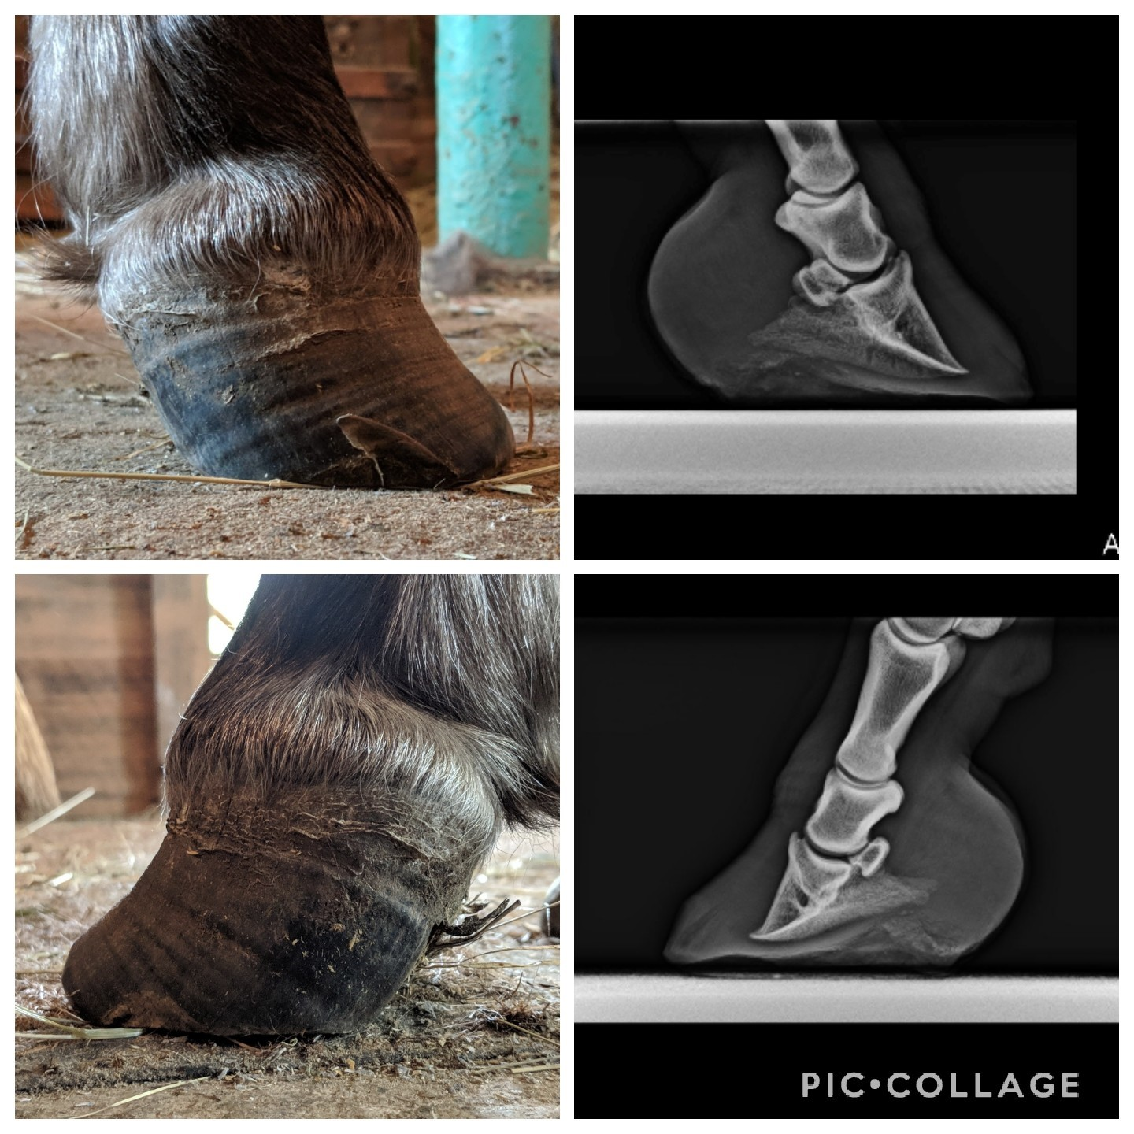
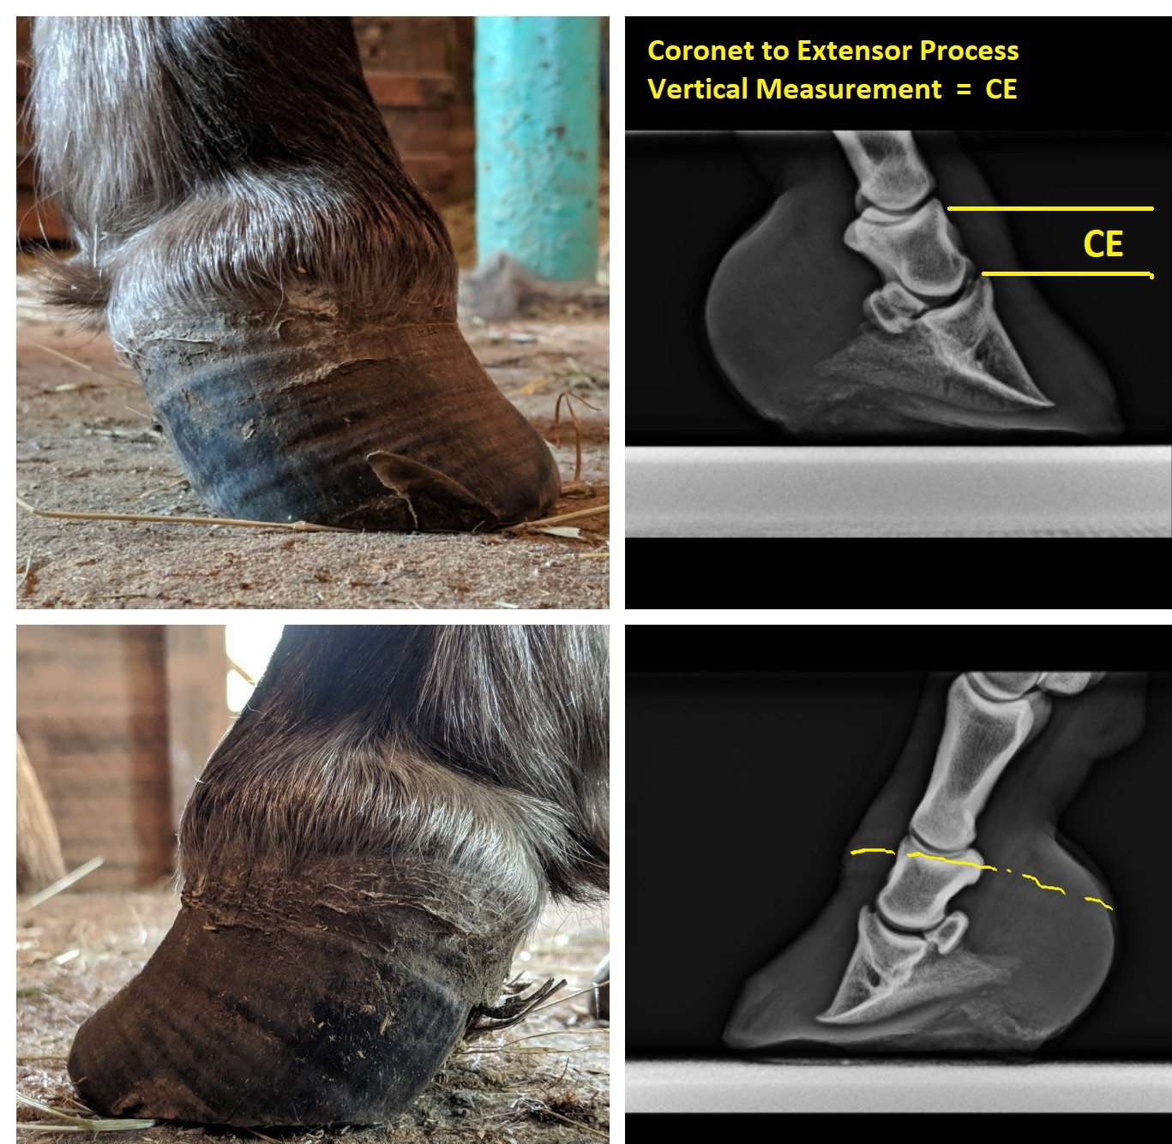
Reading the Foot
Thinking Vertically
Pete Ramey
Mark and measure to base of hair follicles at center of toe.
Alicia Harlov Files

Slide 2
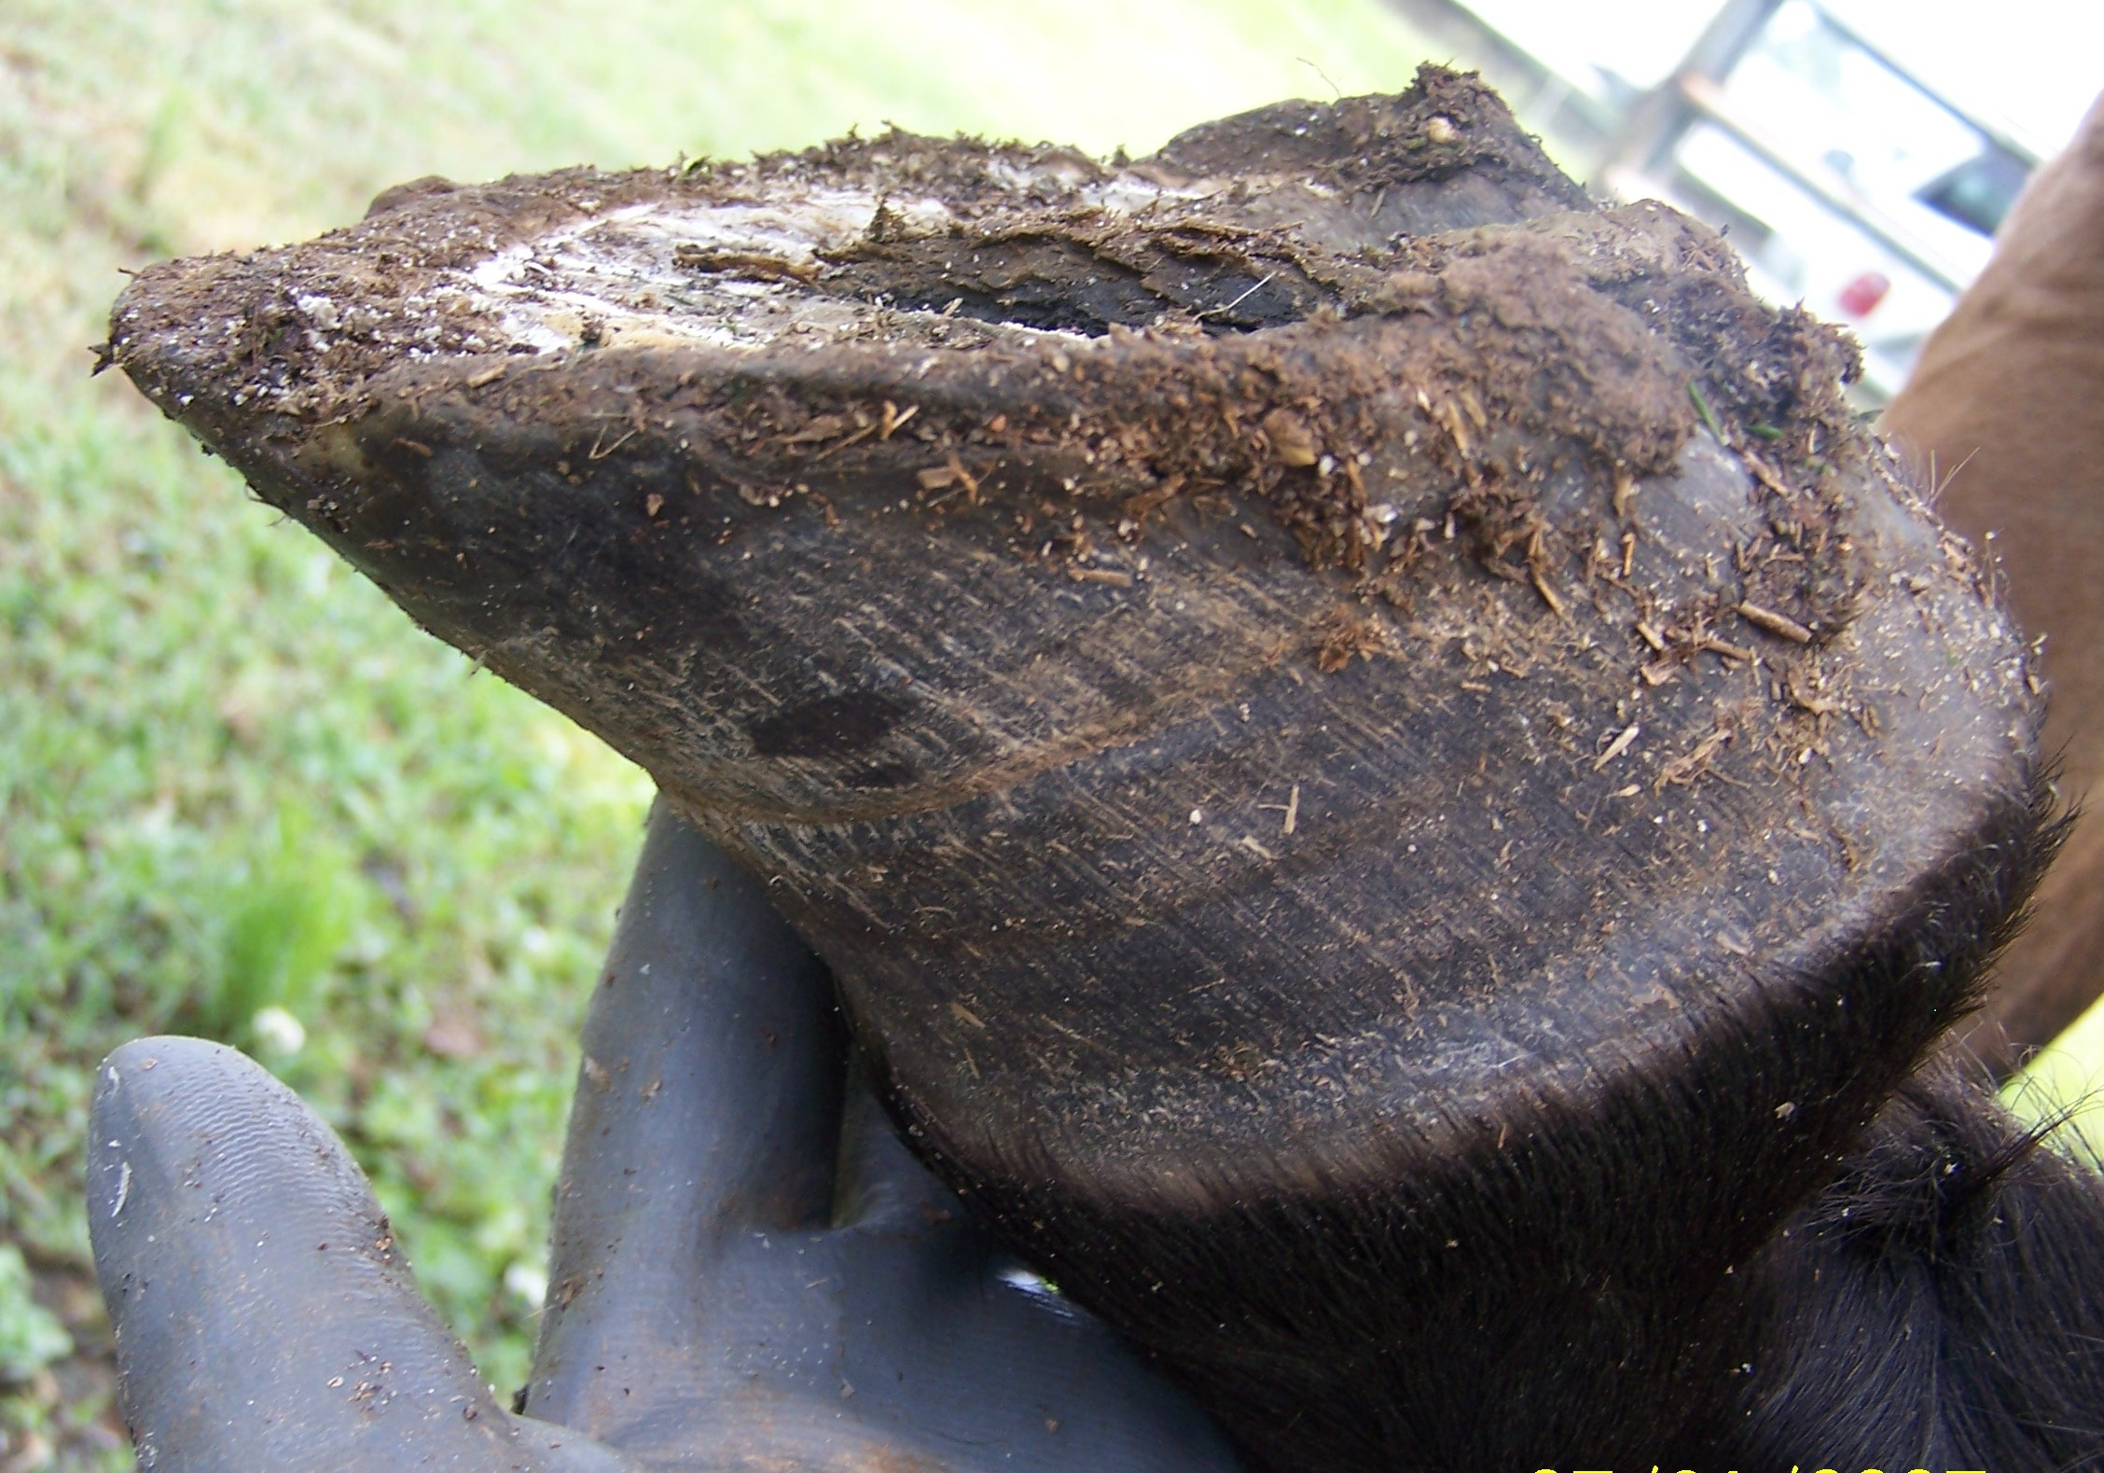
Pete Ramey Files

Slide 3
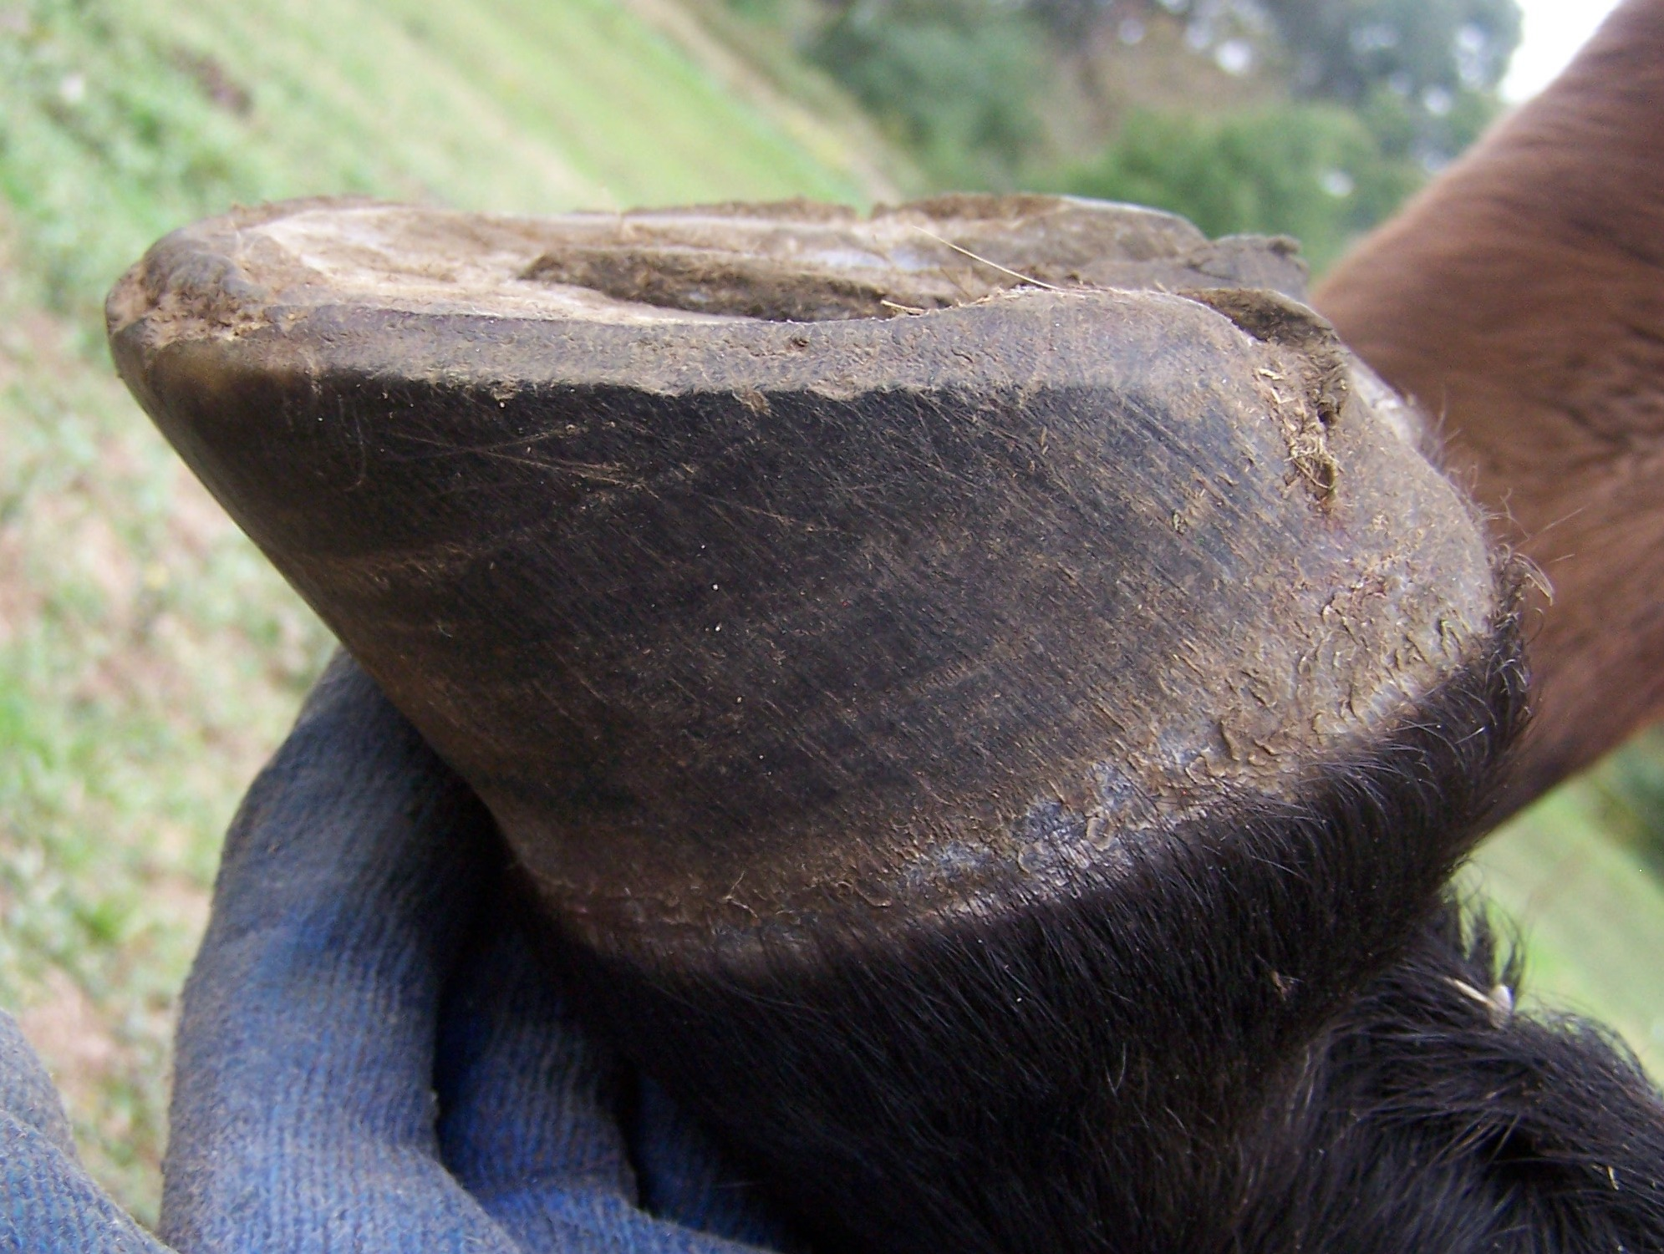
6 months later
Pete Ramey Files

Slide 4
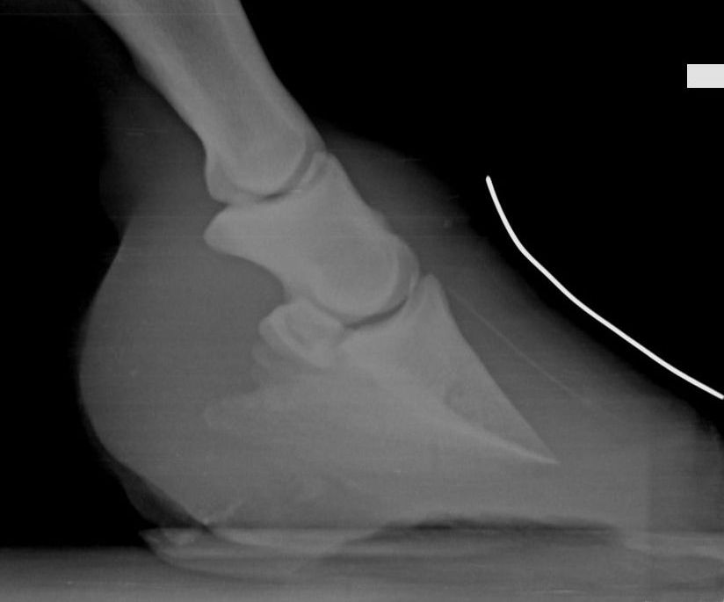
Cornelia Veterinary Hospital

Slide 5
Cornelia Veterinary Hospital

Slide 6
CC ???
Pete Ramey Files

Slide 7
CC ???
6 months later
Pete Ramey Files

Slide 8
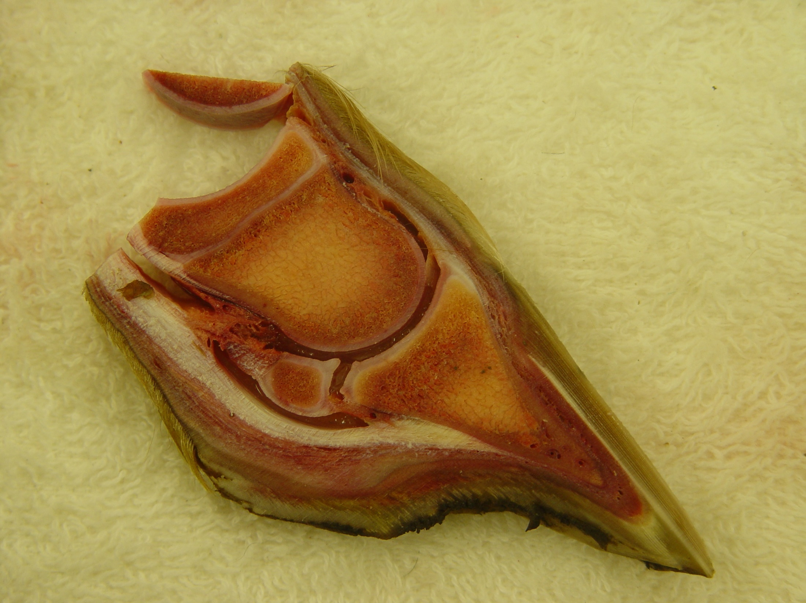
Stillborn foal – CE near zero
RM Bowker, VMD, PhD
Care and Rehabilitation of the Equine Foot

Slide 9
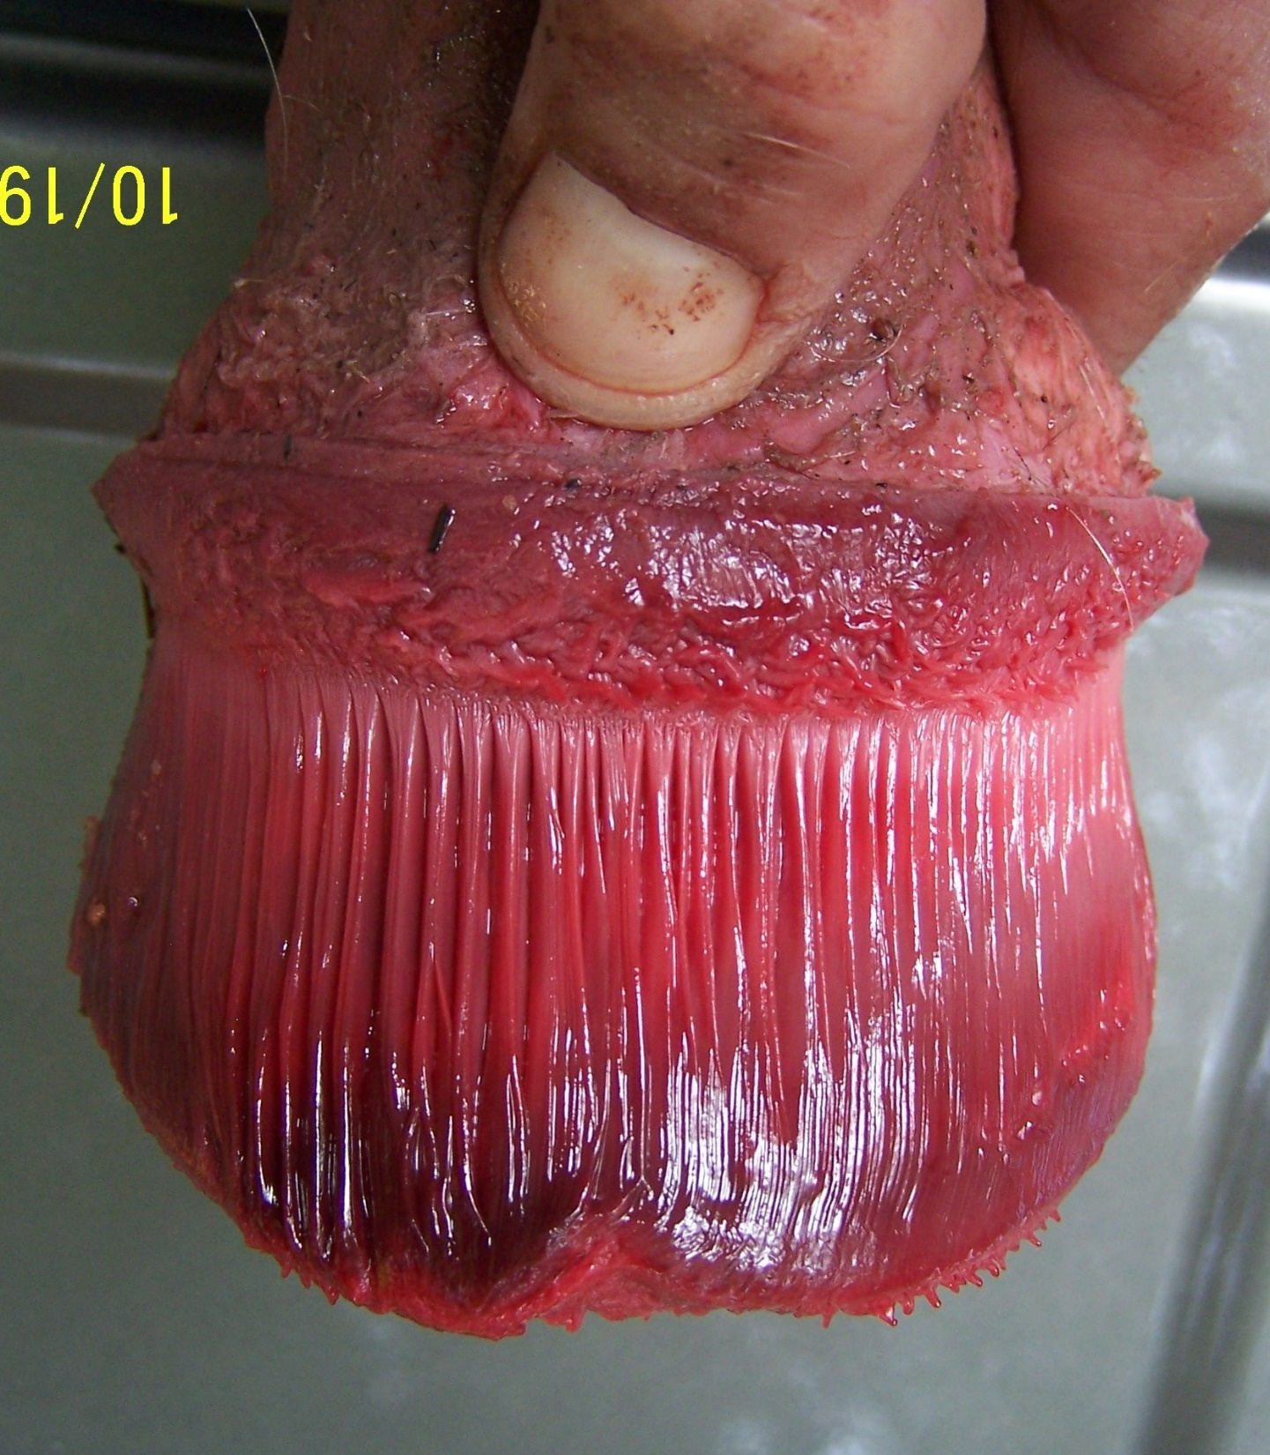
Pete Ramey Files

Slide 10
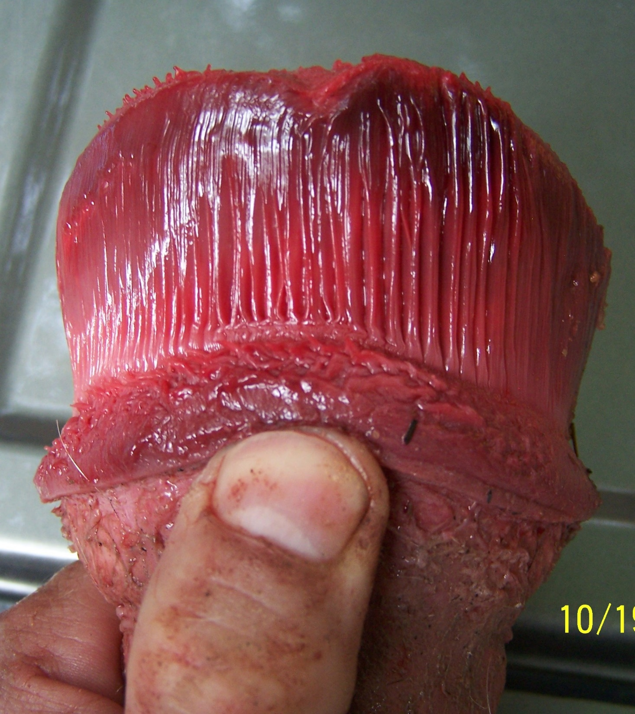
Pete Ramey Files

Slide 11
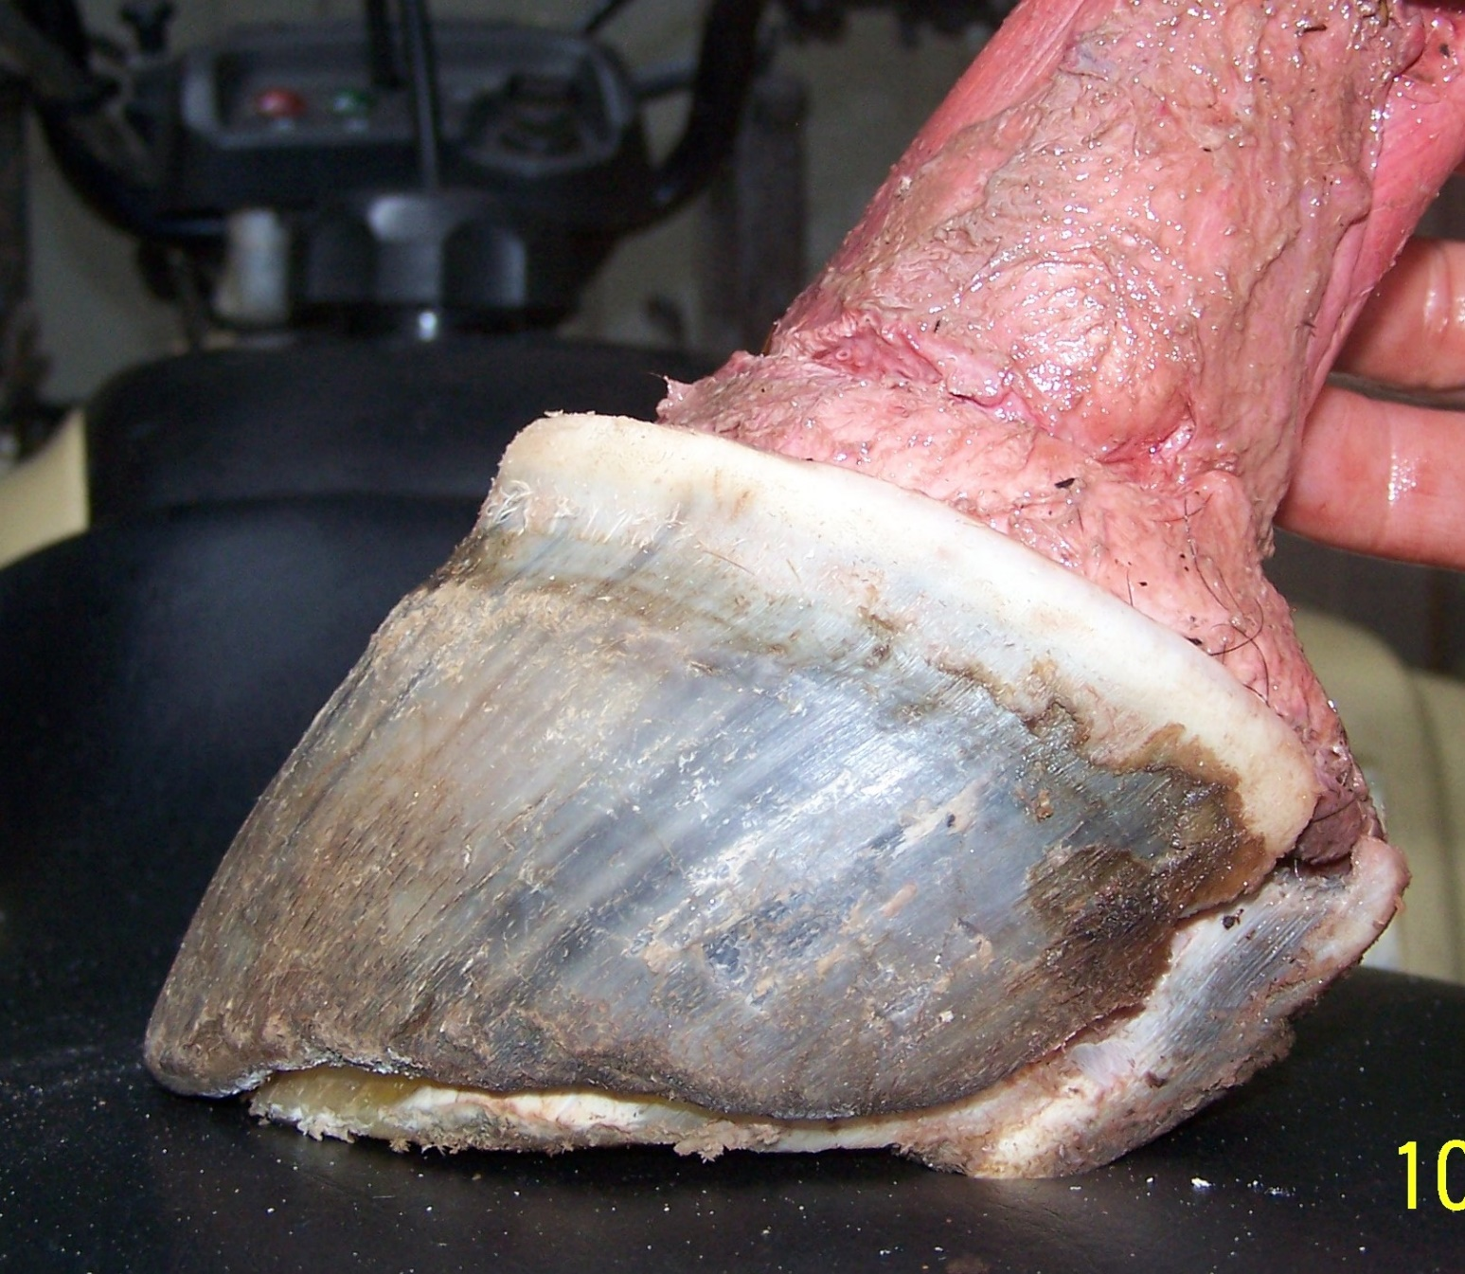
Pete Ramey Files

Slide 12
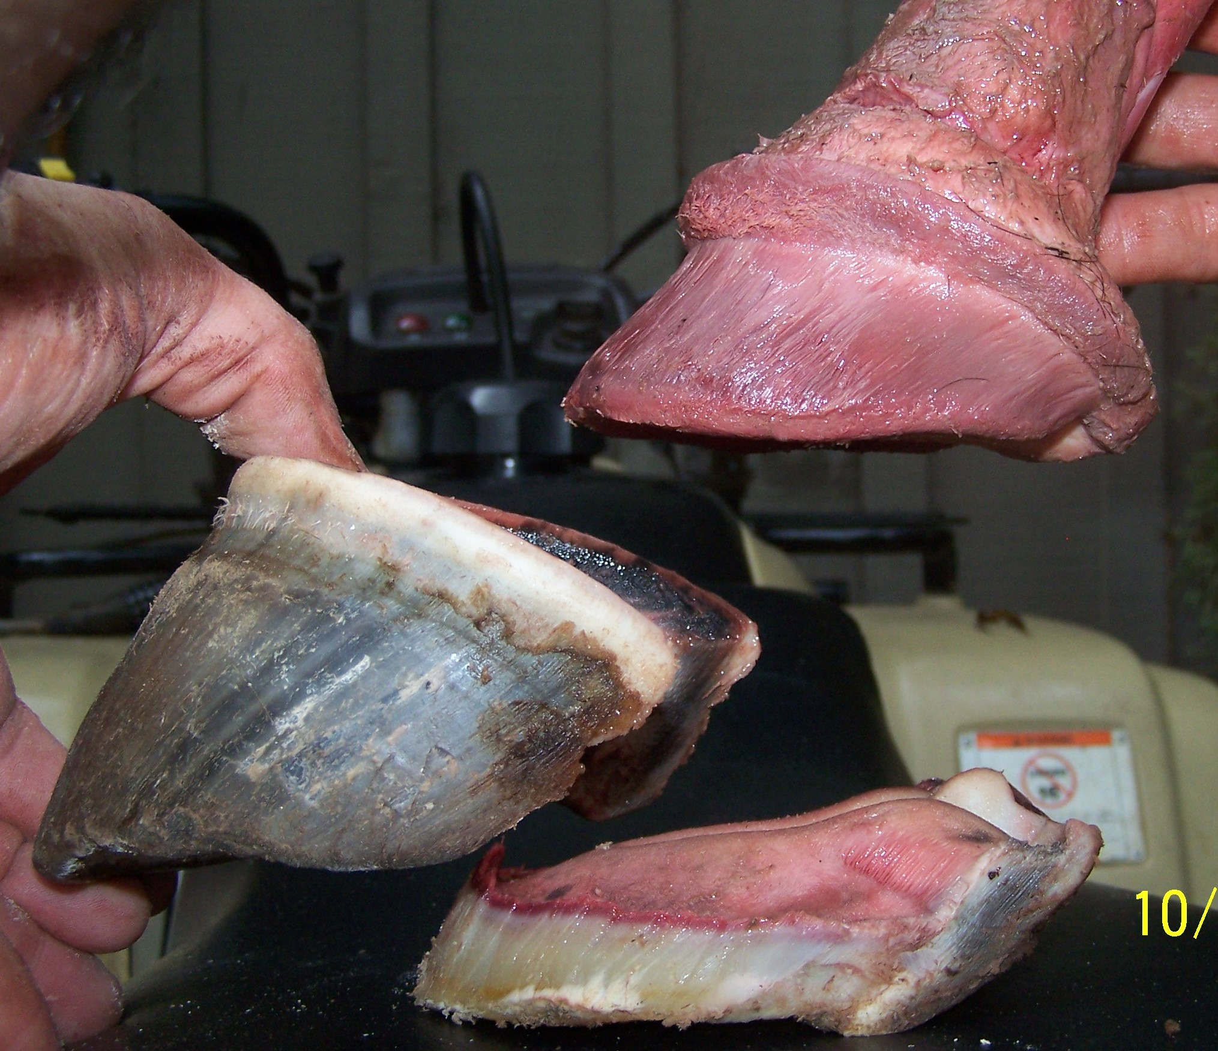
Pete Ramey Files

Slide 13
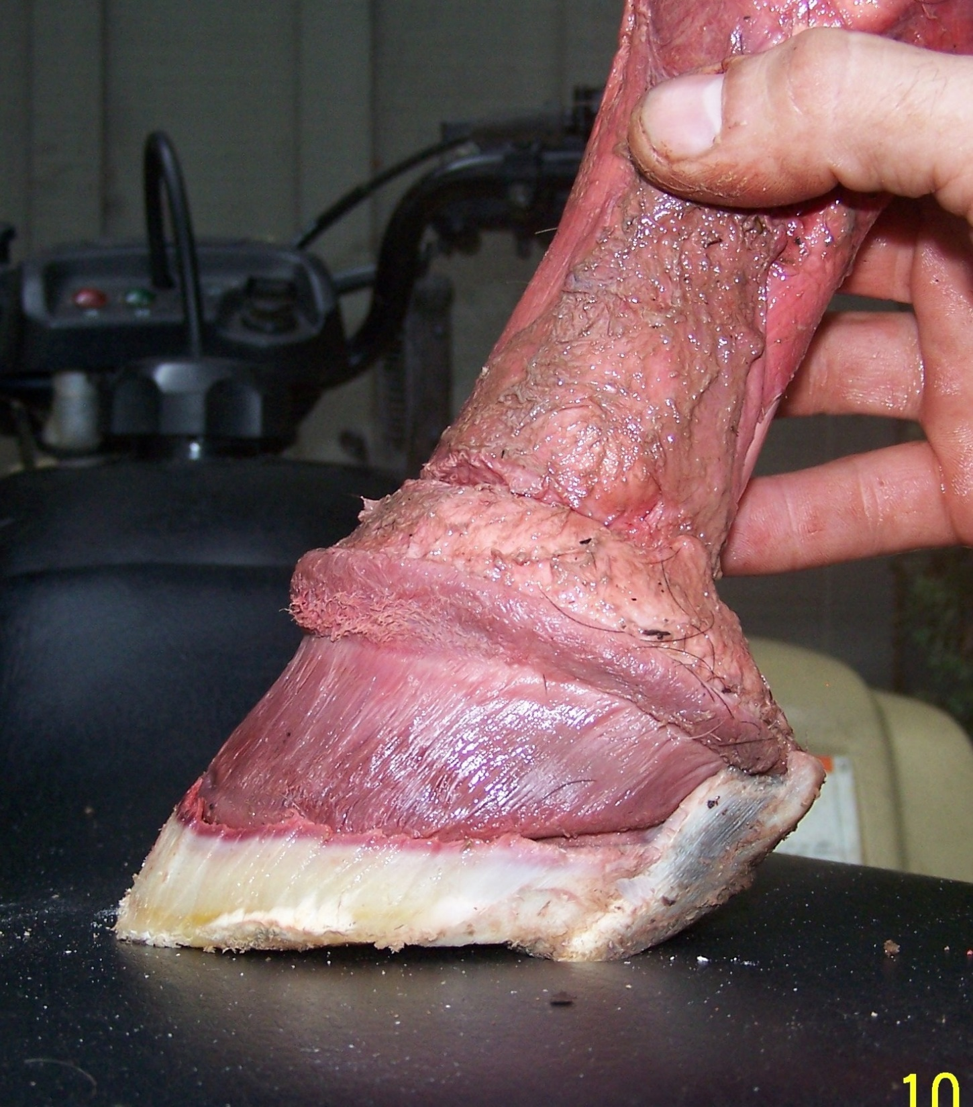
“You’ve got to stand for something, or you’ll fall for anything.”
– Aaron Tippin
Care and Rehabilitation of the Equine Foot

Slide 14
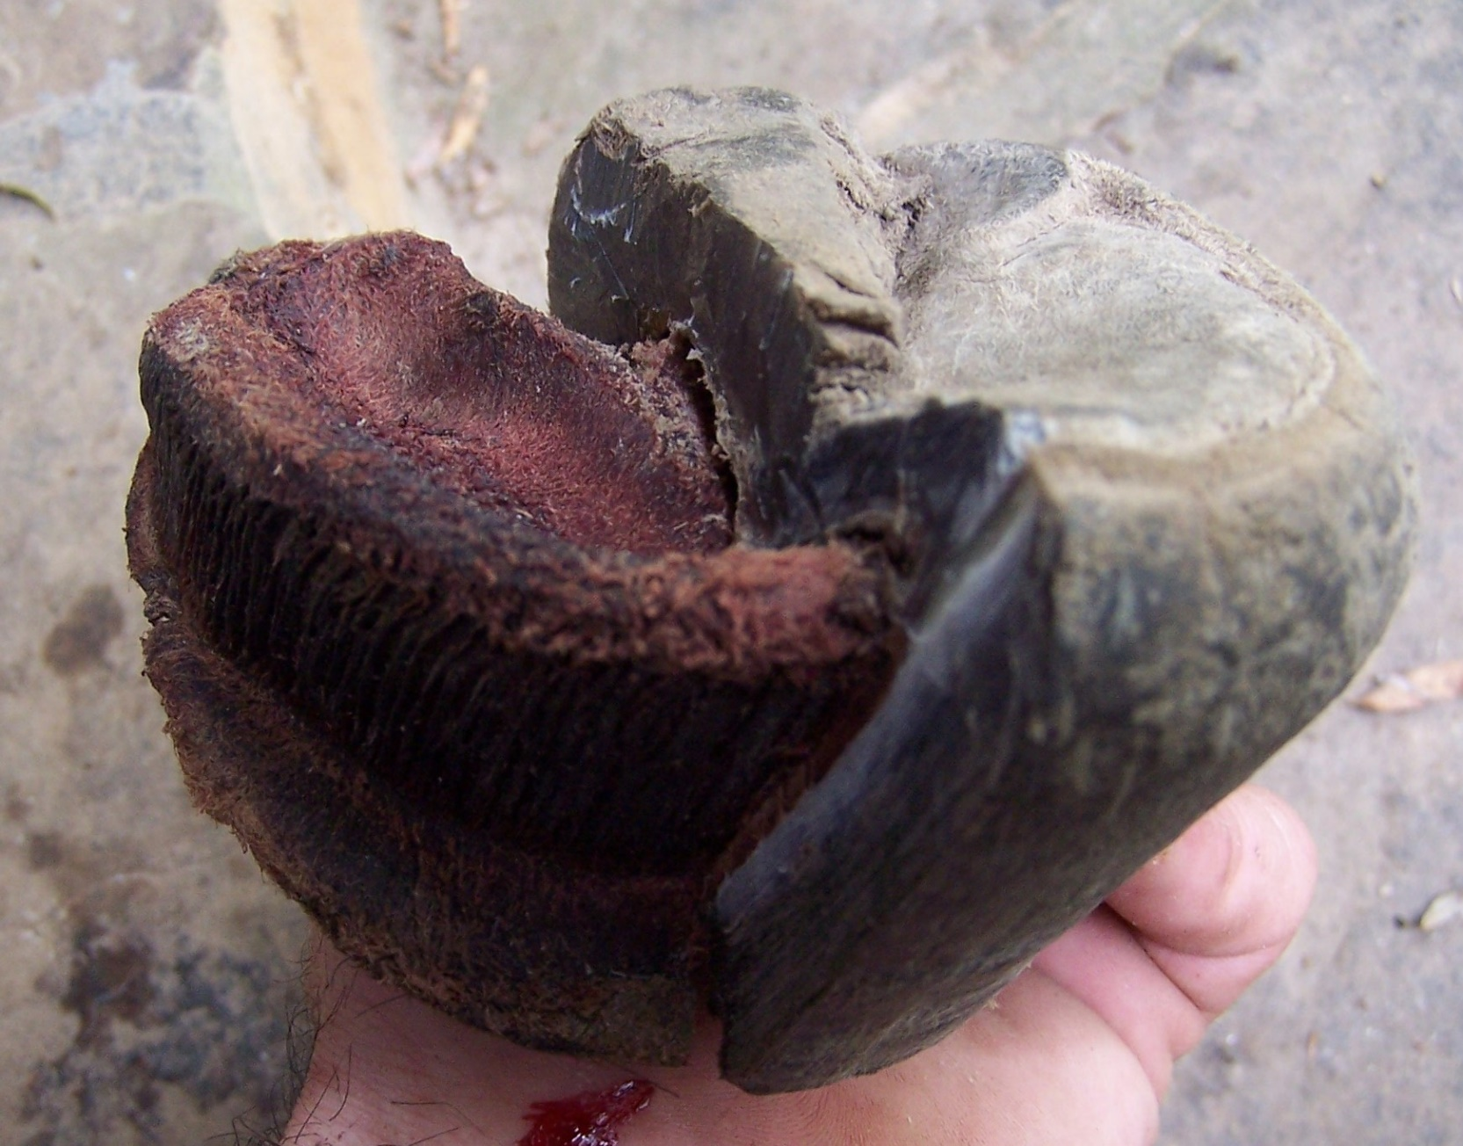
Top priority:
Maintain 1/2”-5/8” thickness of wall, sole, bar material, and sole.
All other hopes and dreams for the foot are secondary.
I believe this is a primary need, whether protecting the corium from the ground, from a boot, or from a shoe.
Care and Rehabilitation of the Equine Foot

Slide 15
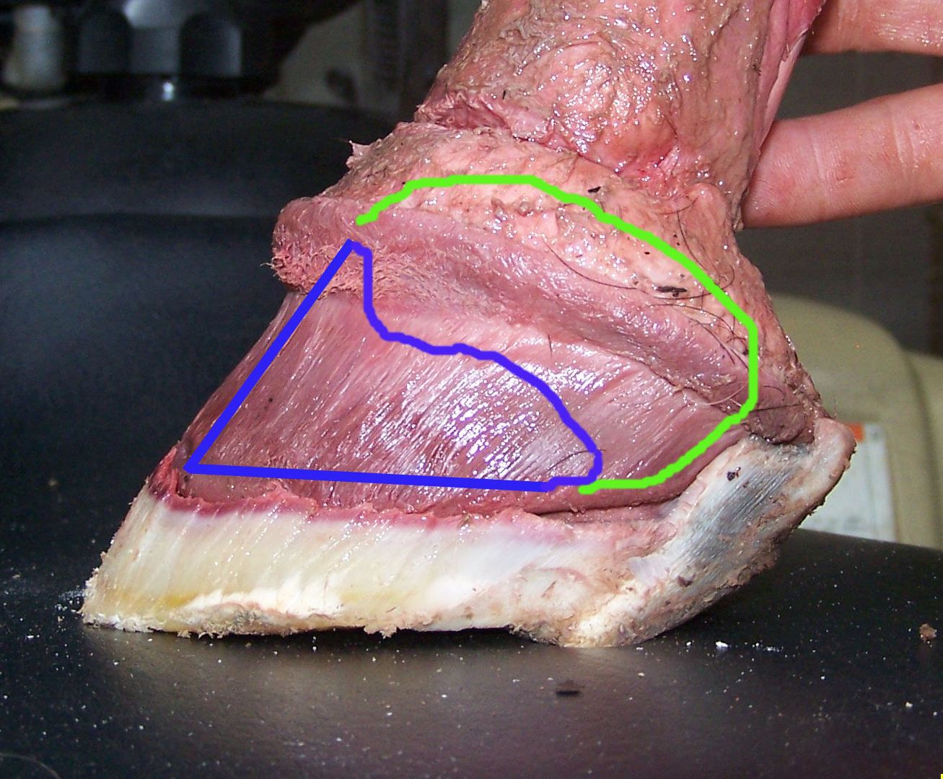
Pete Ramey Files

Slide 16
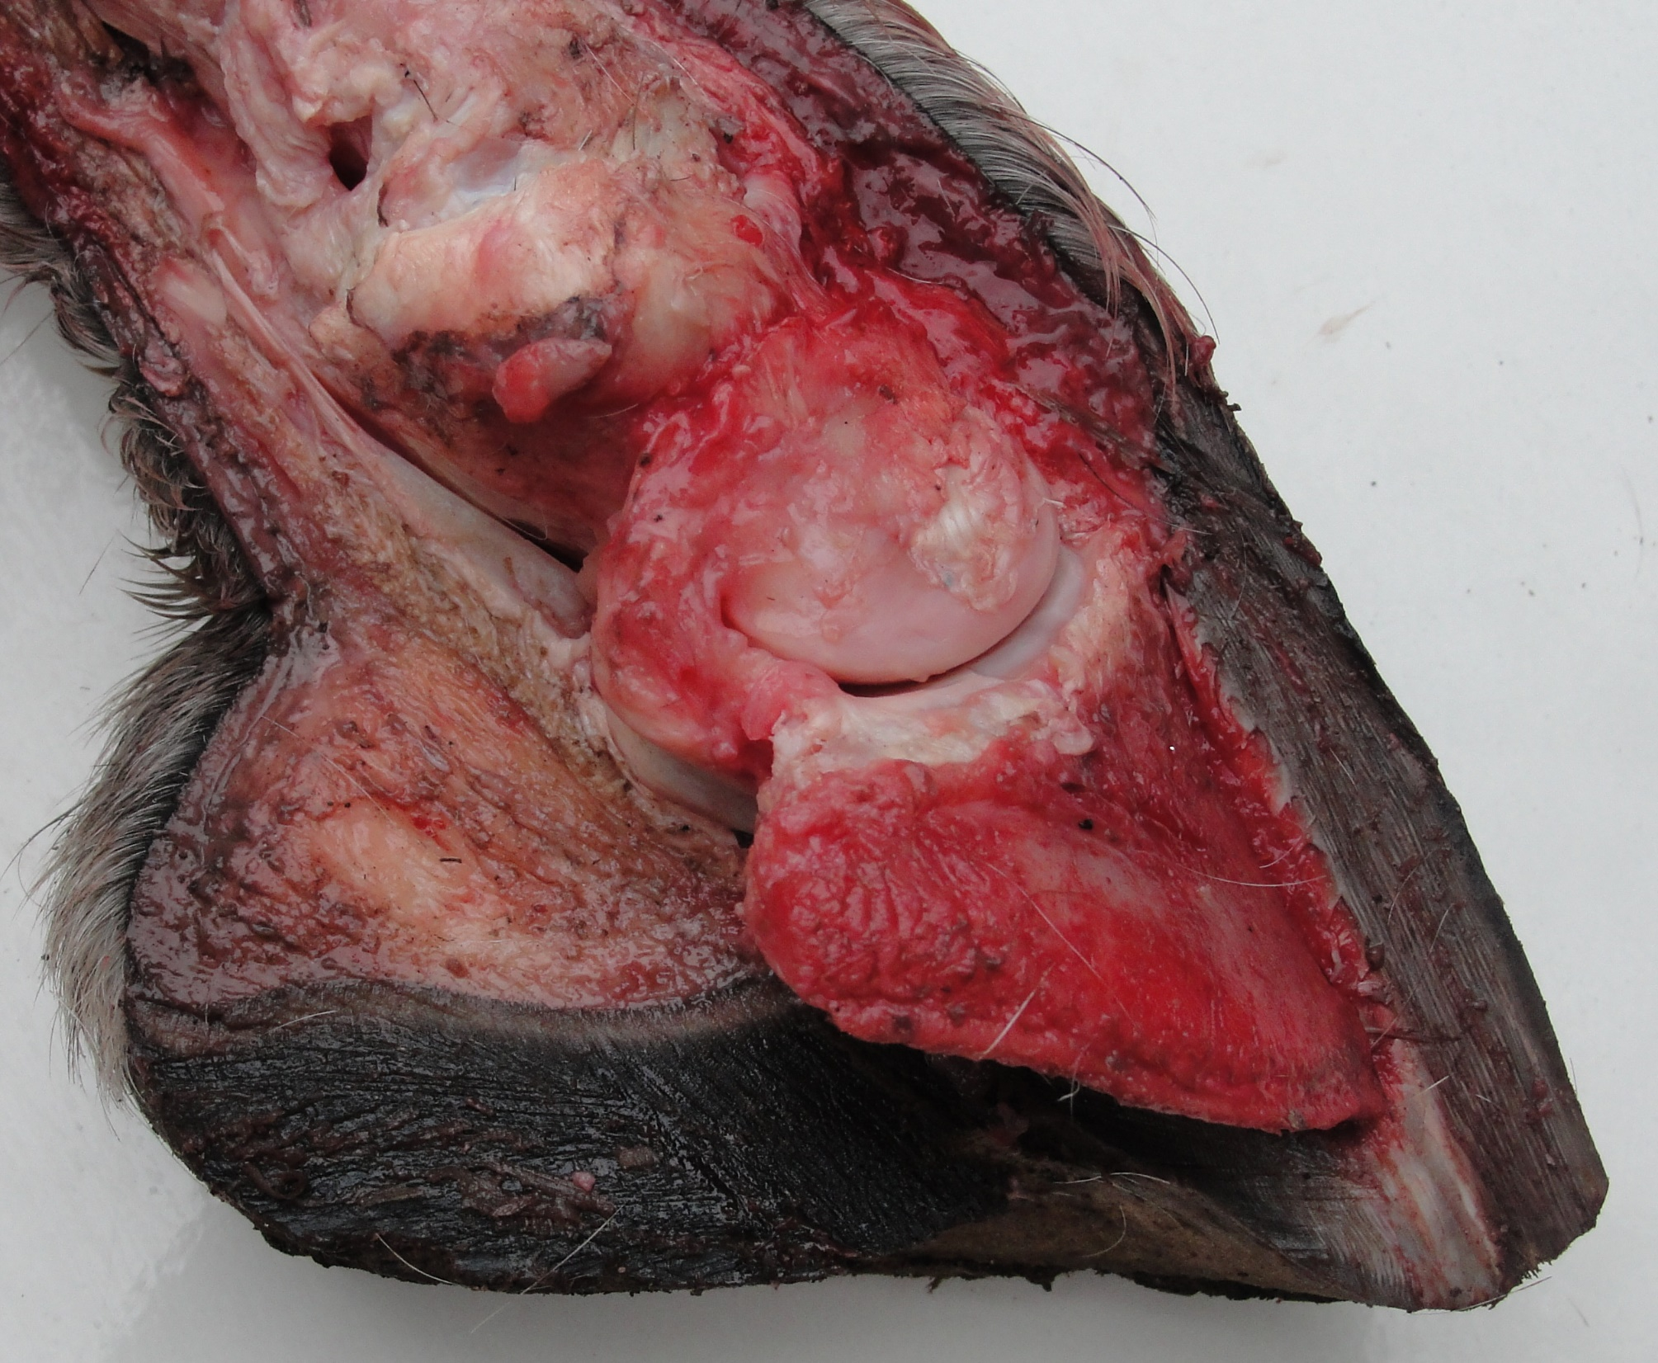
Care and Rehabilitation of the Equine Foot

Slide 17
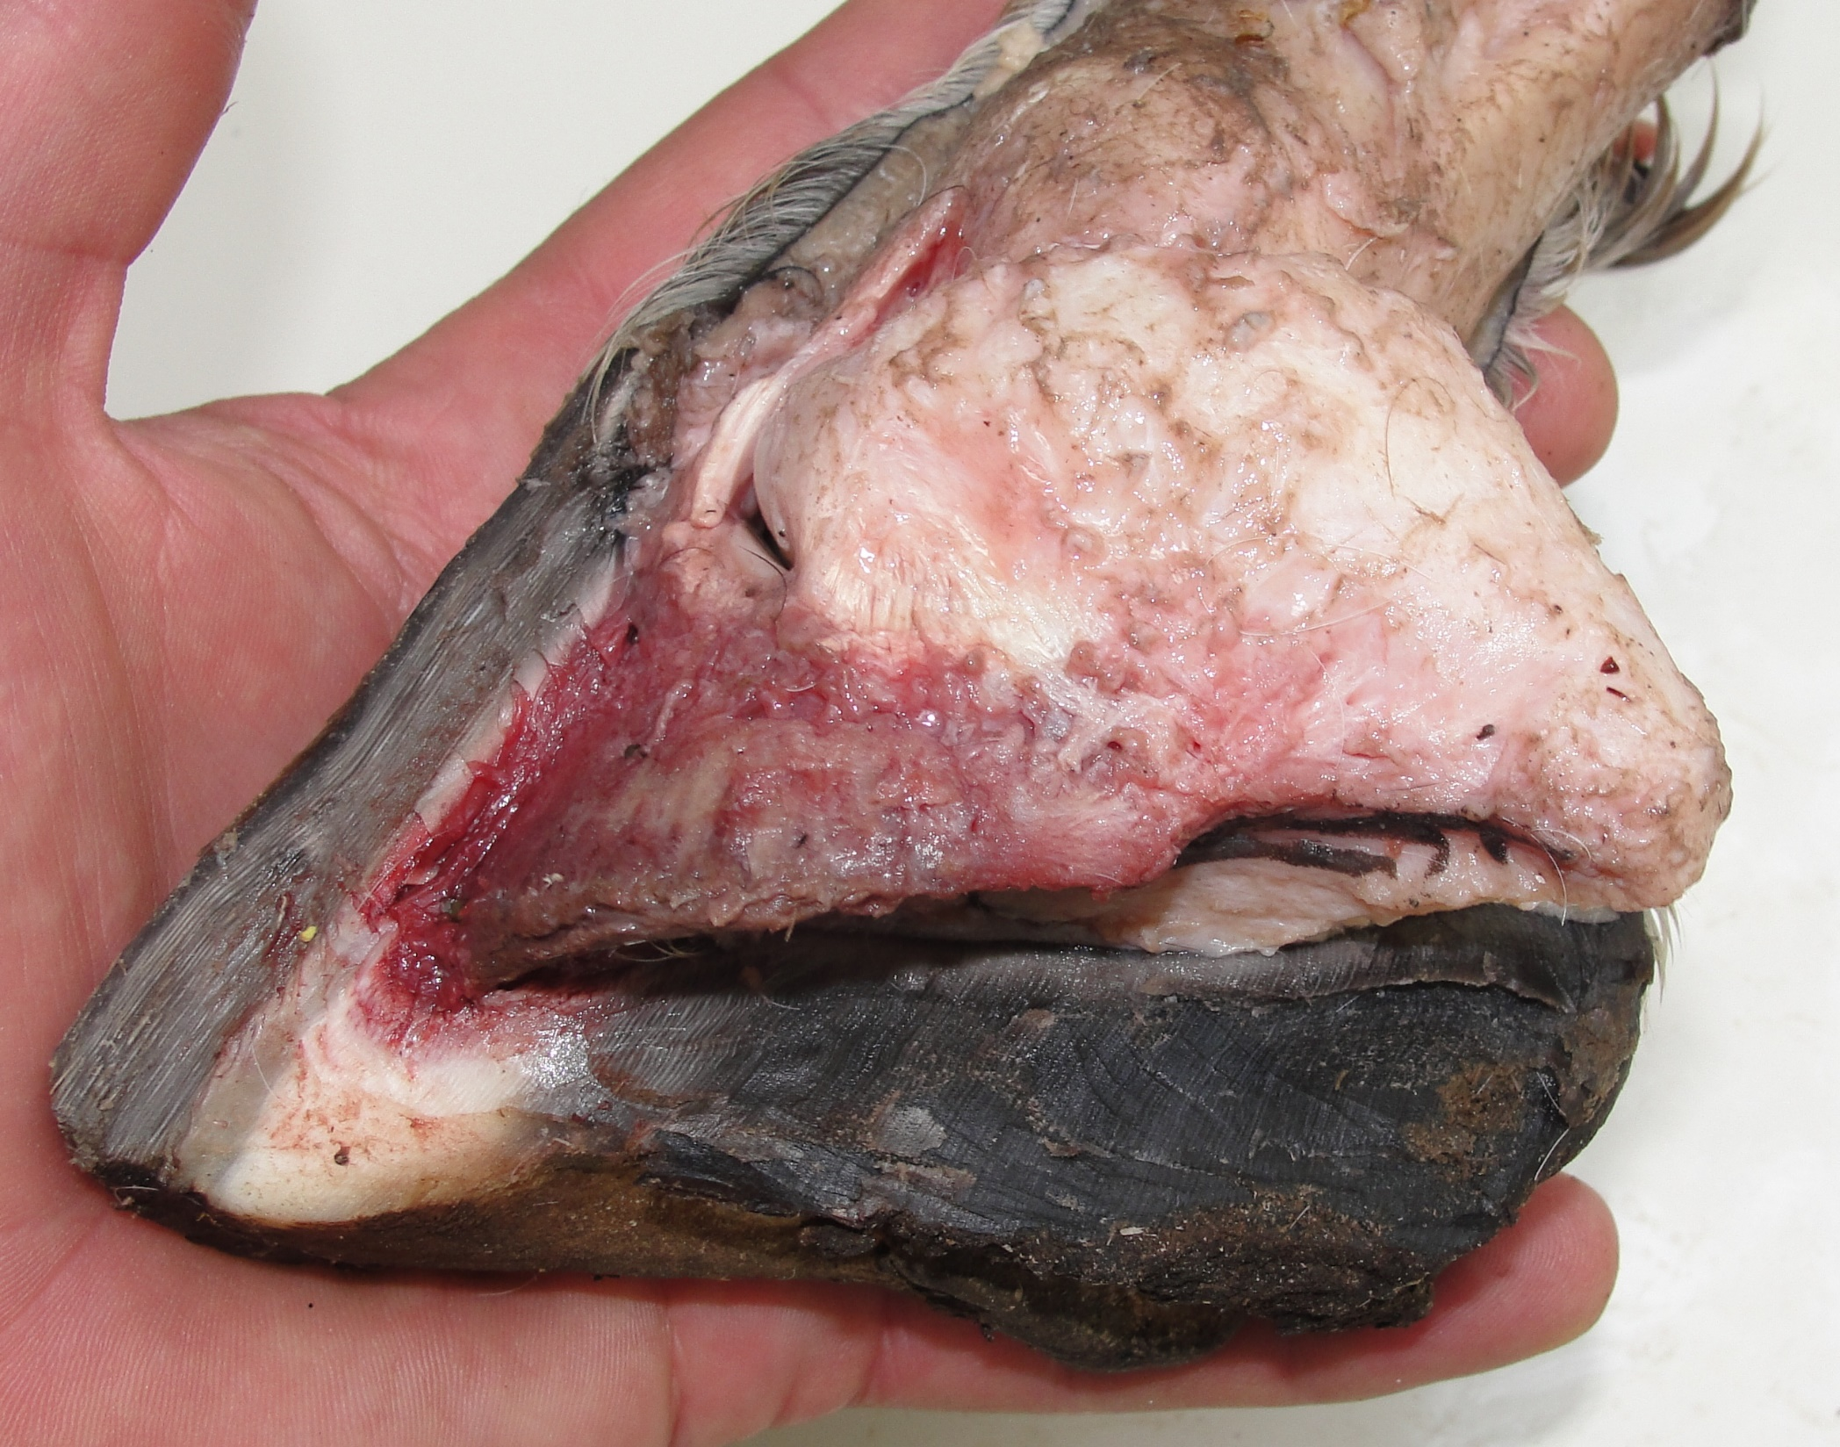
Care and Rehabilitation of the Equine Foot

Slide 18
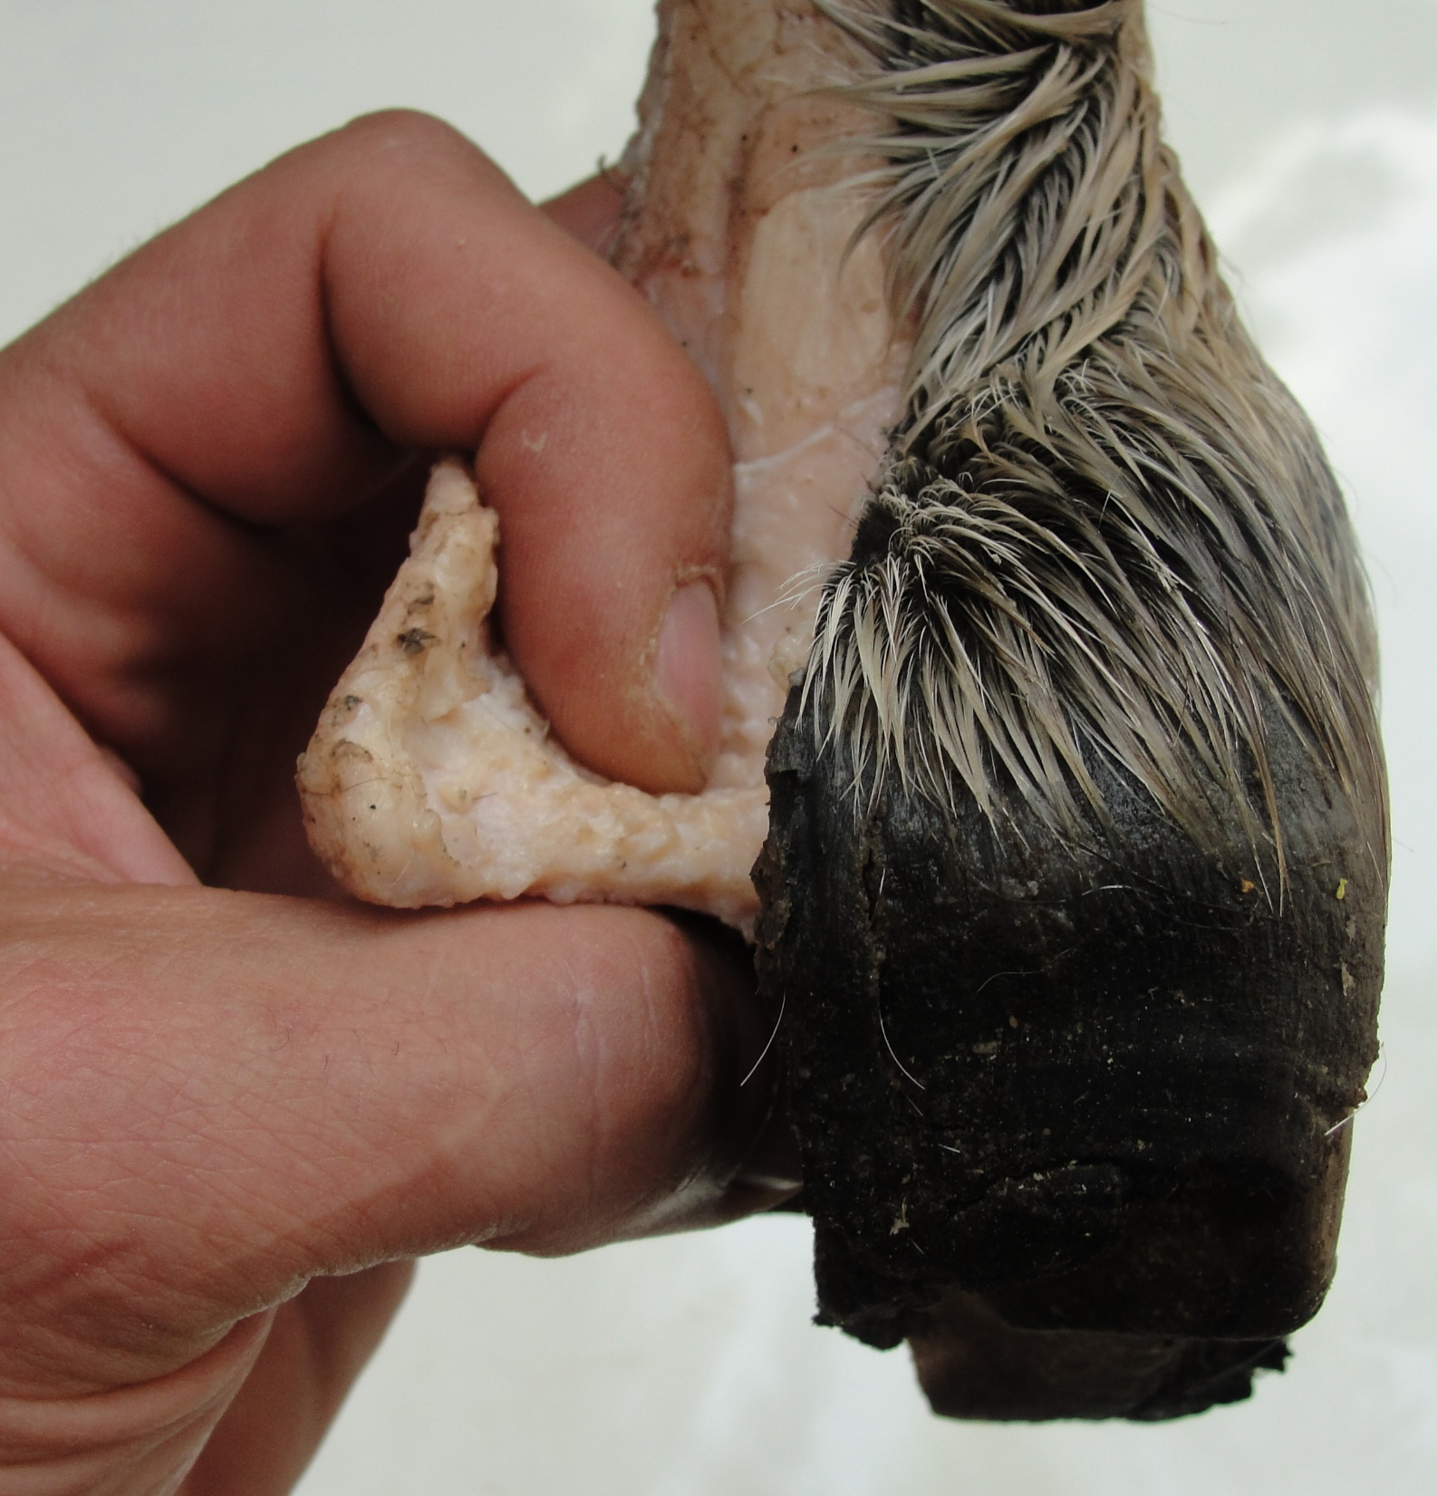
Care and Rehabilitation of the Equine Foot

Slide 19
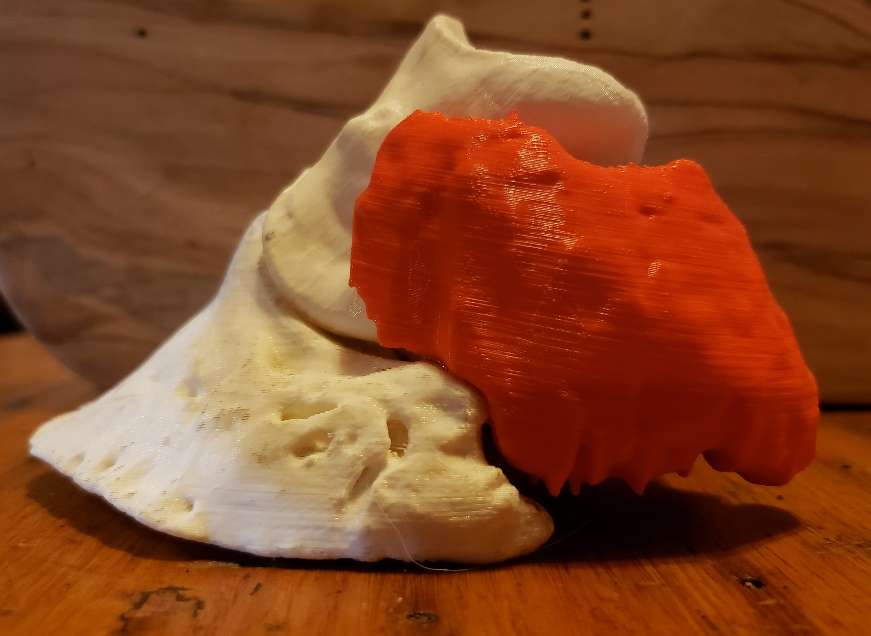
Debra Taylor, DVM, MS, DACVIM

Slide 20
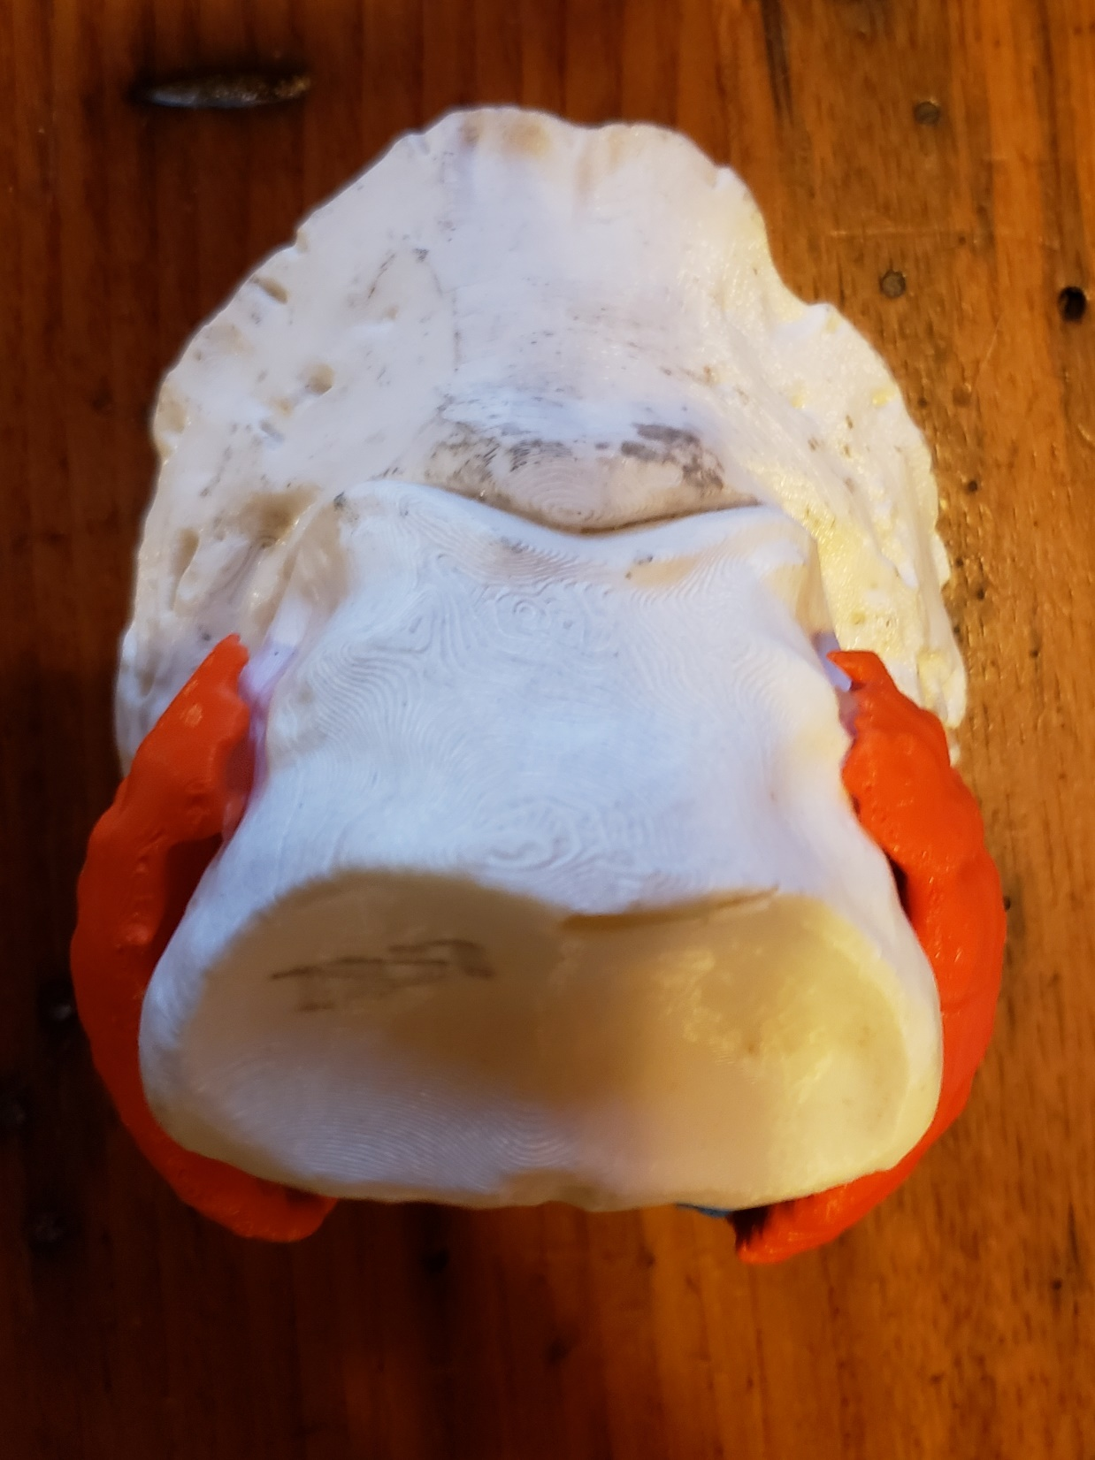
Debra Taylor, DVM, MS, DACVIM

Slide 21
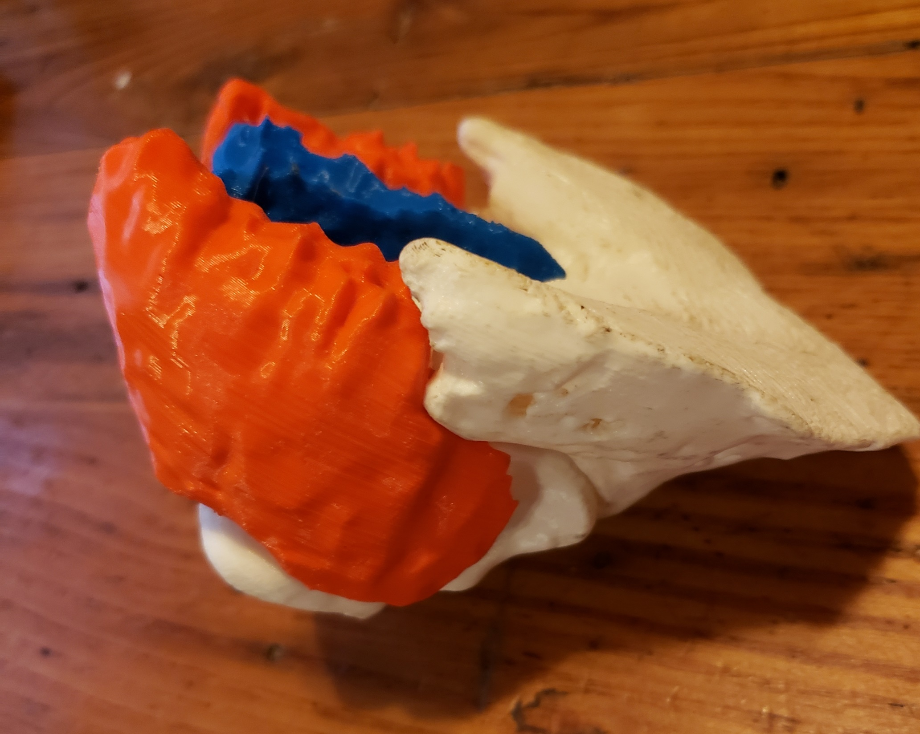
Debra Taylor, DVM, MS, DACVIM

Slide 22
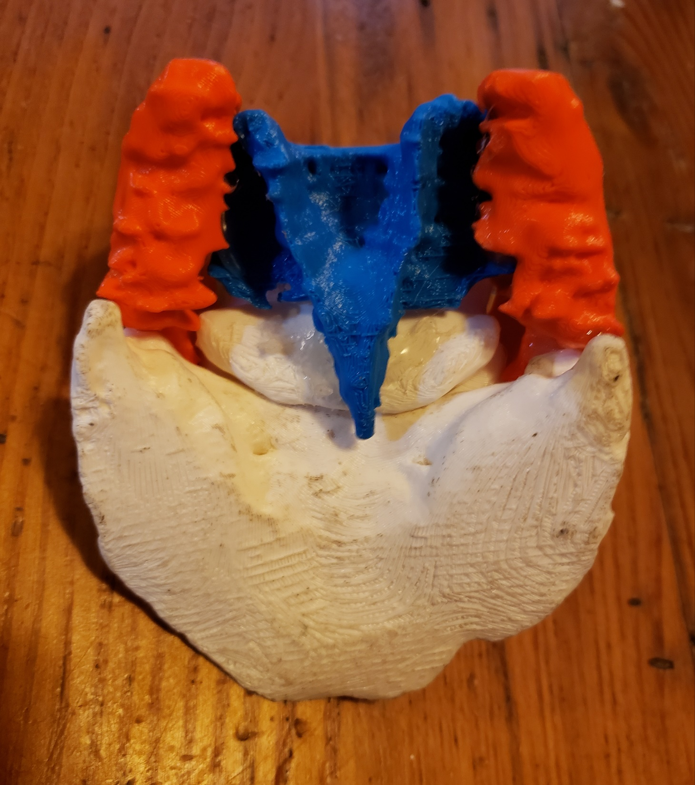
Debra Taylor, DVM, MS, DACVIM

Slide 23
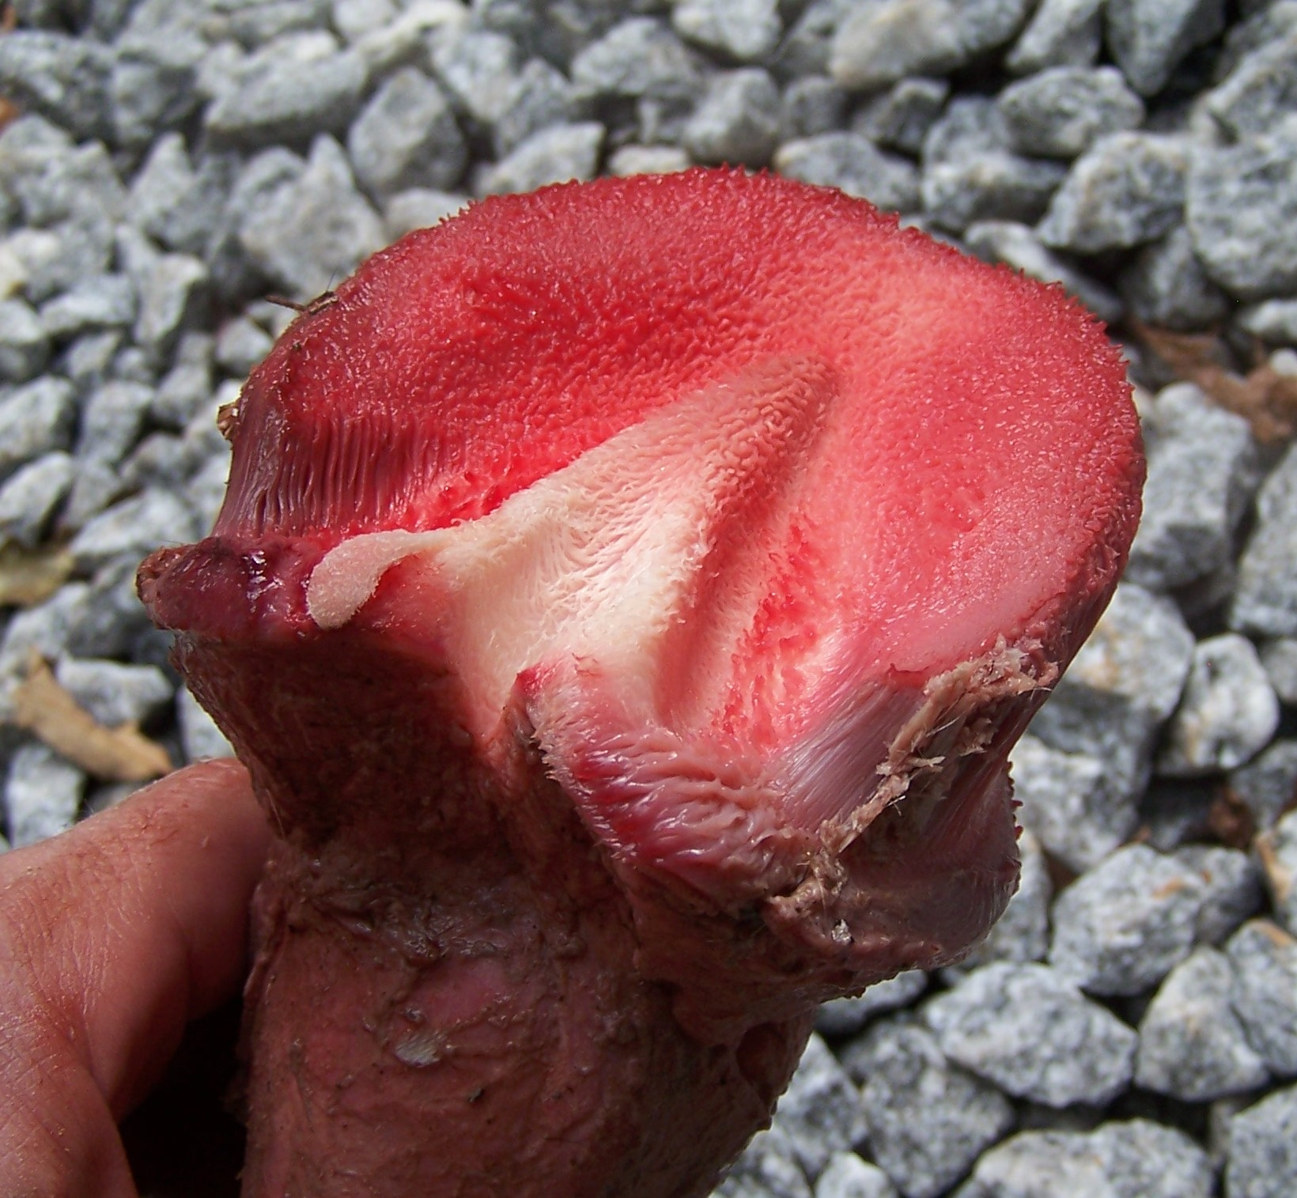

Slide 24
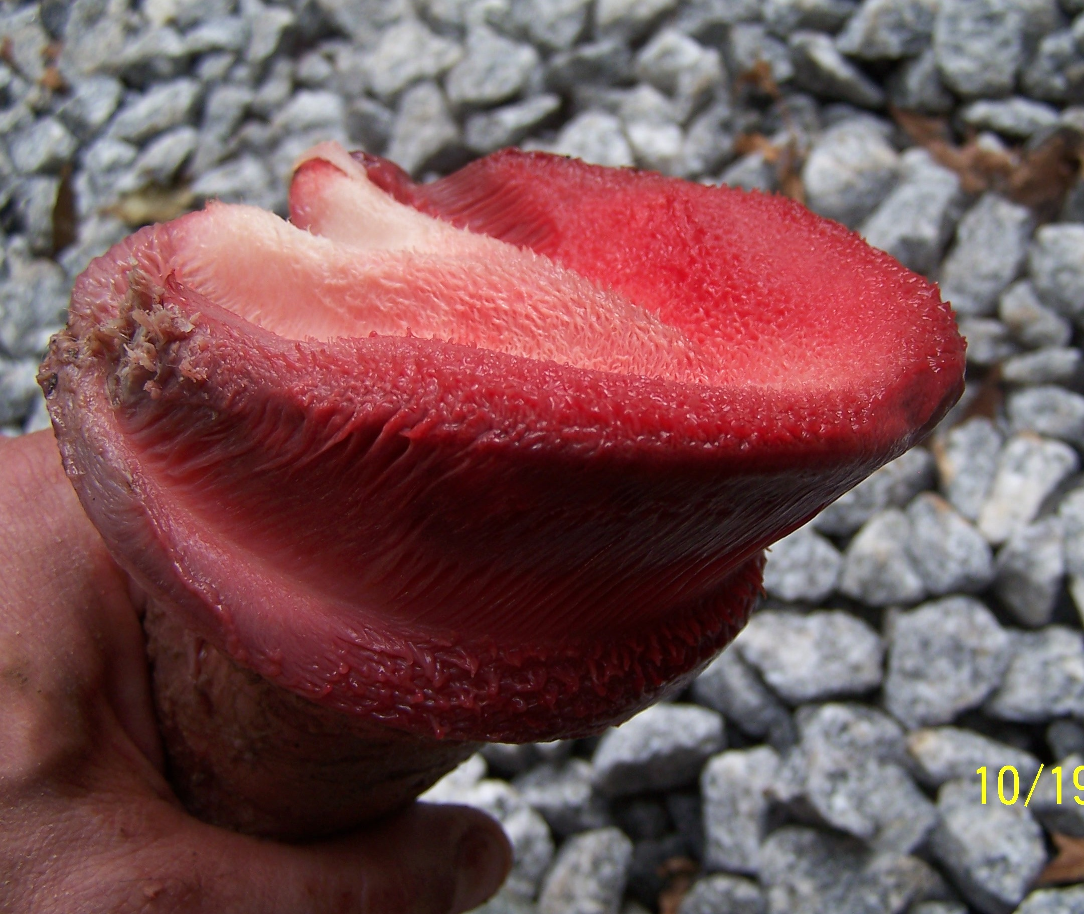
Care and Rehabilitation of the Equine Foot

Slide 25
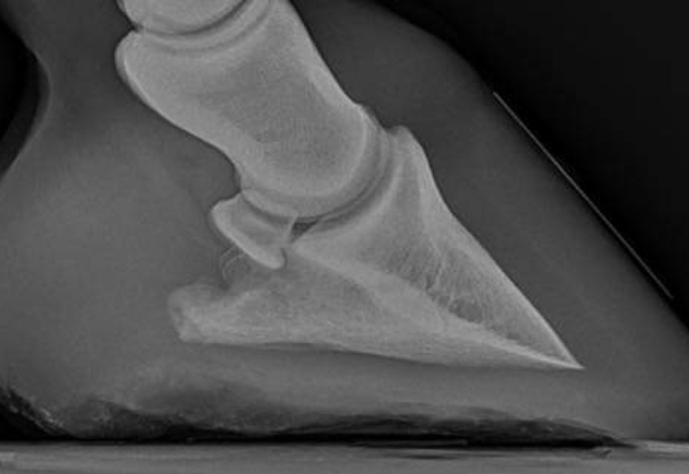

Slide 26
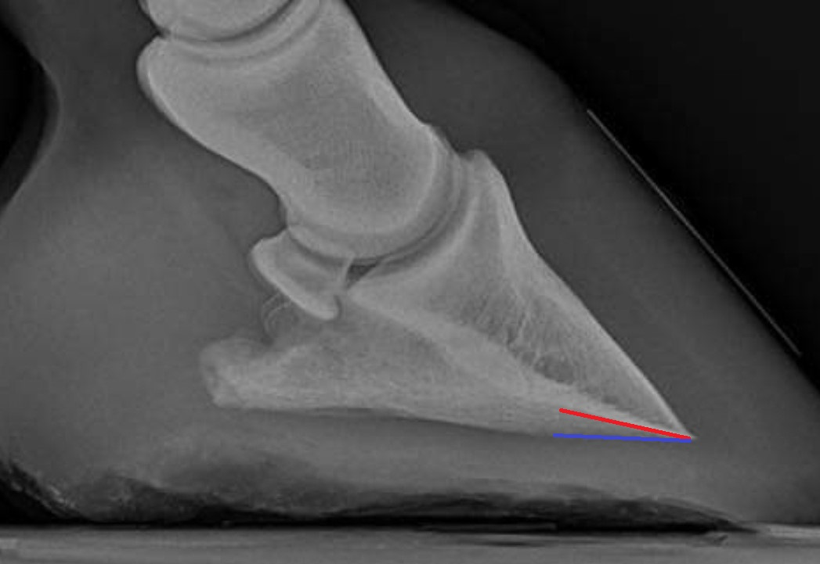

Slide 27
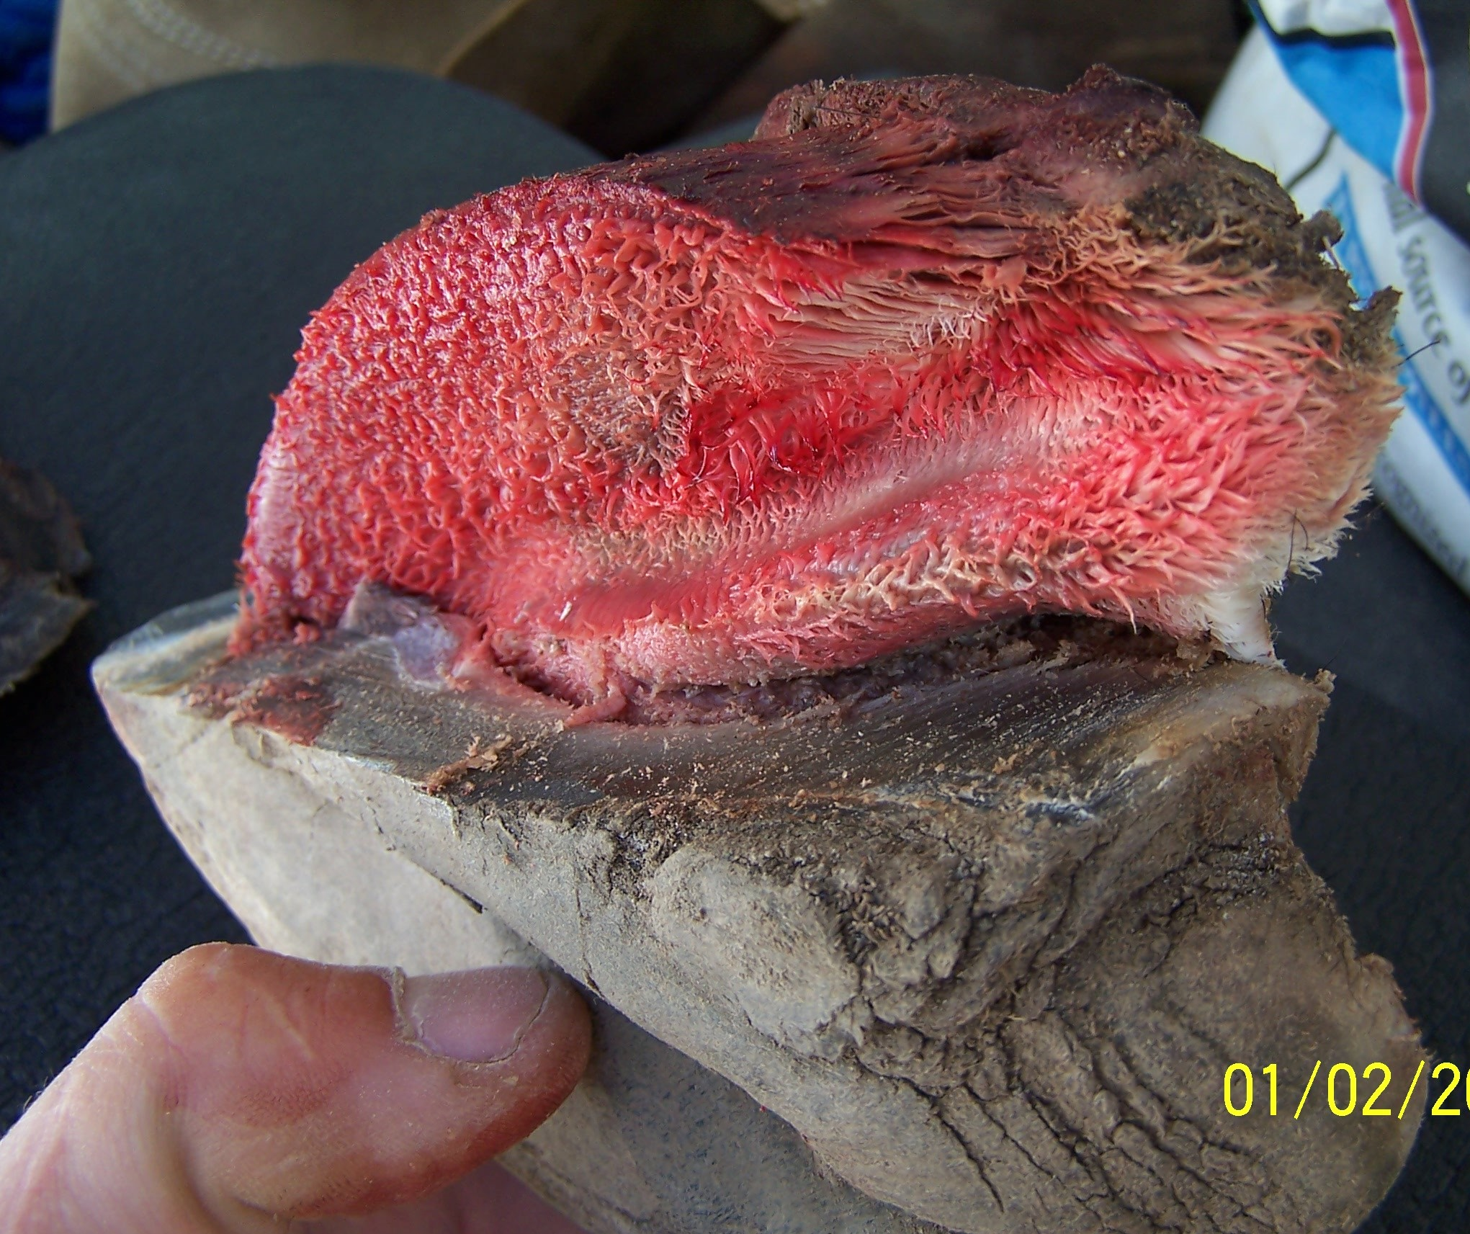

Slide 28
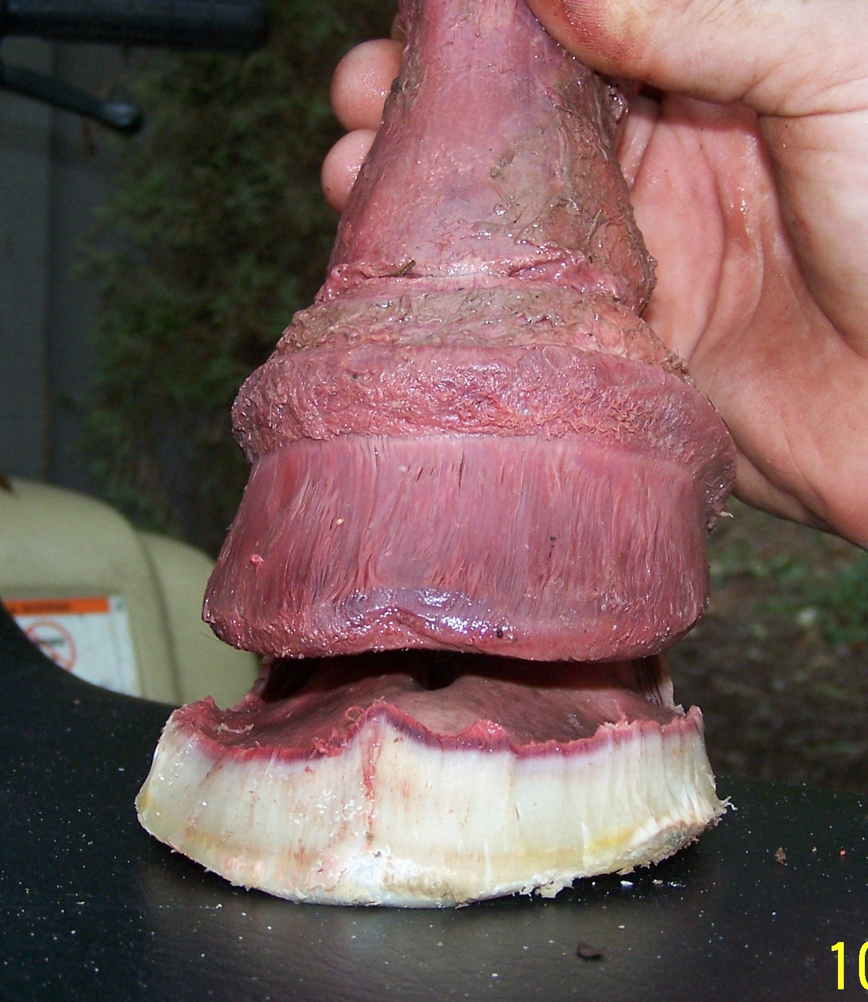
What the solar corium needs most is adequate armor –
1/2“- 5/8” thickness of well-callused sole, bar, and frog tissue.

Slide 29
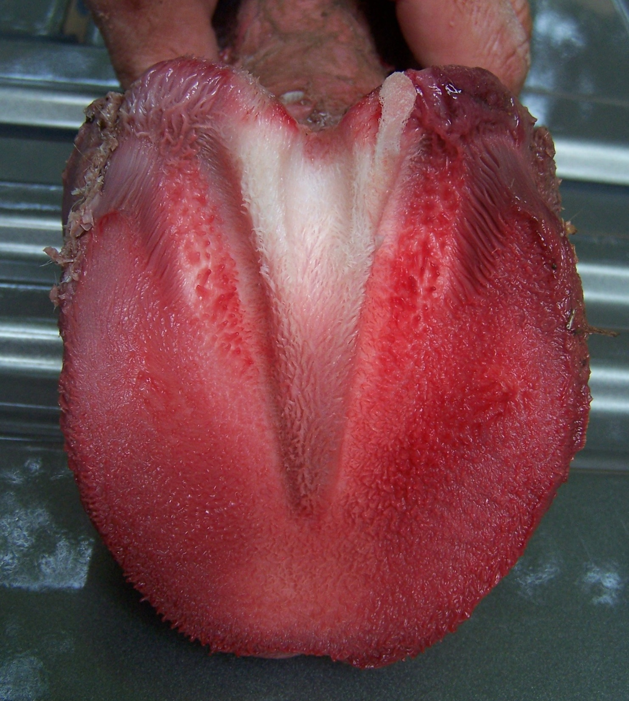
And…
The sole, frog, and bar coriums handle pressure well
***IF*** that pressure is 100% released whenever the foot is in flight.
Steady pressure without release may cause bruising, abscessing, corium damage, P3 remodeling…

Slide 30

We will discuss numerous tactics for building adequate sole thickness…
… but the most important one is being sure you never trim sole from a thin-soled horse (same with thin frogs and thin bars).

Slide 31

What tricks people into excessively thinning soles?
Or – why do people cut sole from thin-soled horses?
Foot with deep CE appears “too long”
Exfoliation
Trimming down into sole and wall to find “clean” white line.
Relief of sole pressure (but remember it is pressure to the solar corium we should worry about).

Slide 32
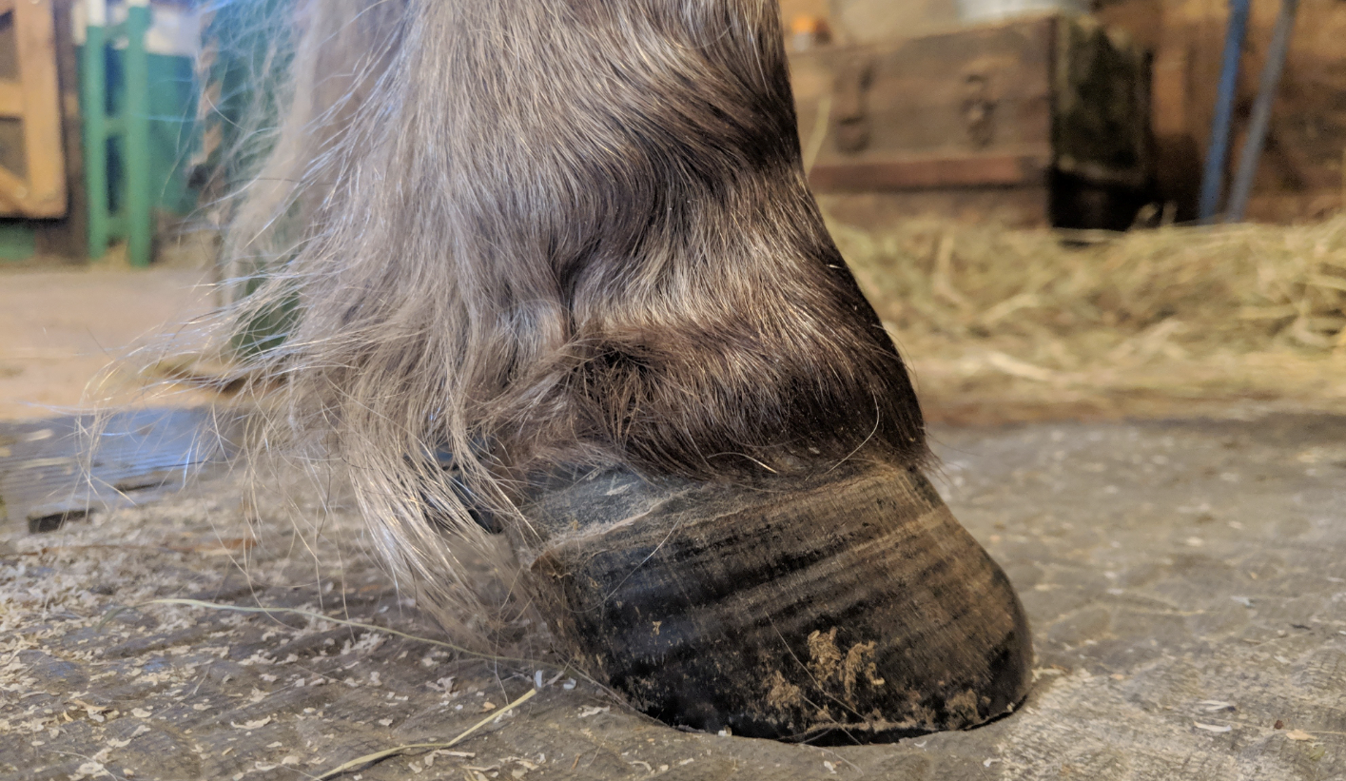
Alicia Harlov Files

Slide 33

What tricks people into excessively thinning soles?
5) “Cleaning” or exfoliating.
6) Chasing flared bars and bent or distorted tubules.
7) Attempting to achieve specific heel heights relative to the coronet/hairline location.
8) Bringing weight-bearing back.

Slide 34

What tricks people into excessively thinning sole?
9) Trimming toe walls to a specific length relative to the current location of the hairline.
10) “Standing up” a flared or rotated foot.
11) Deep CE – making the foot look more normal externally.

Slide 35
We can’t have it all. Usually we have to just pick a #1 priority.
Bare or shod, I tend to pick adequate sole thickness – 1/2”-5/8” (12-15mm) thick.

Slide 36
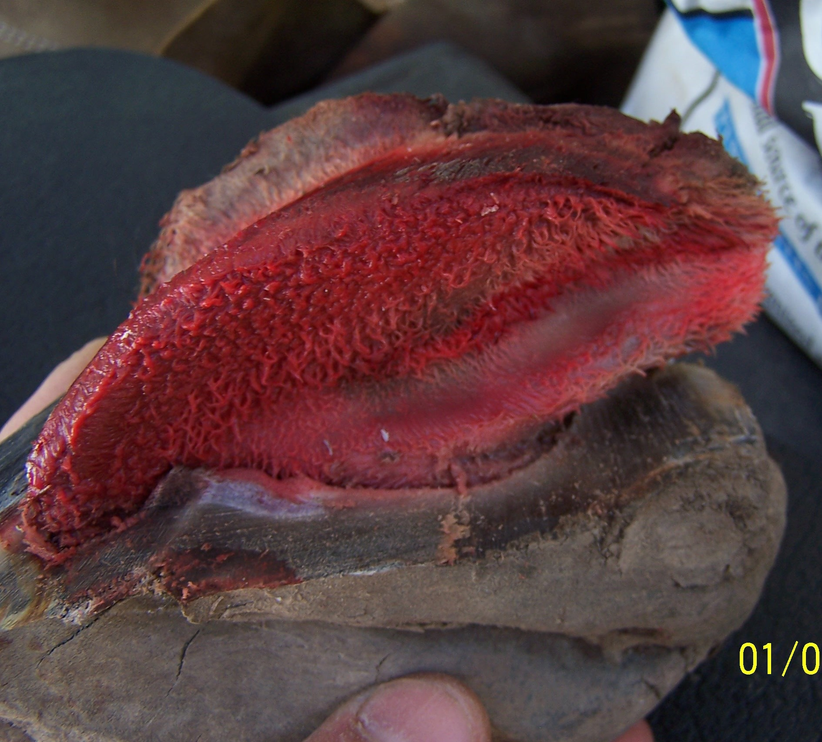

Slide 38
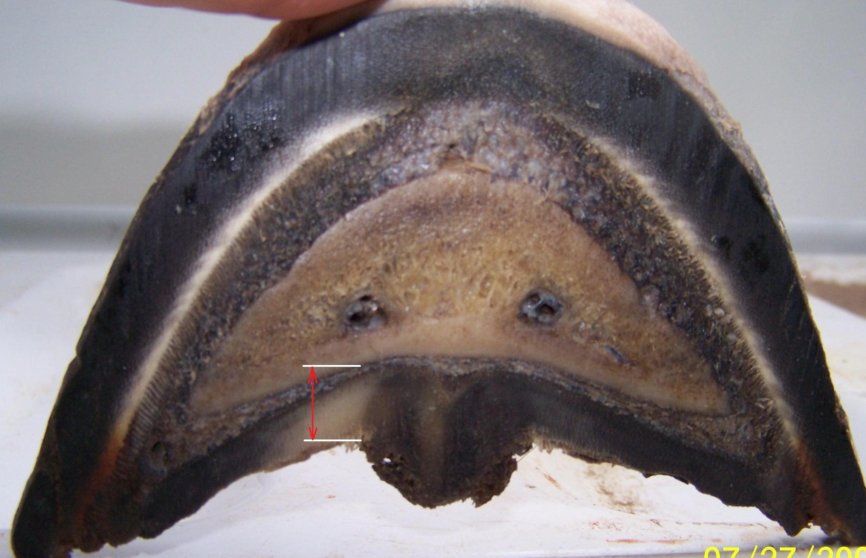
8-9 mm

Slide 39
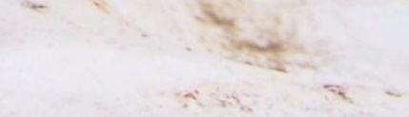

Slide 40
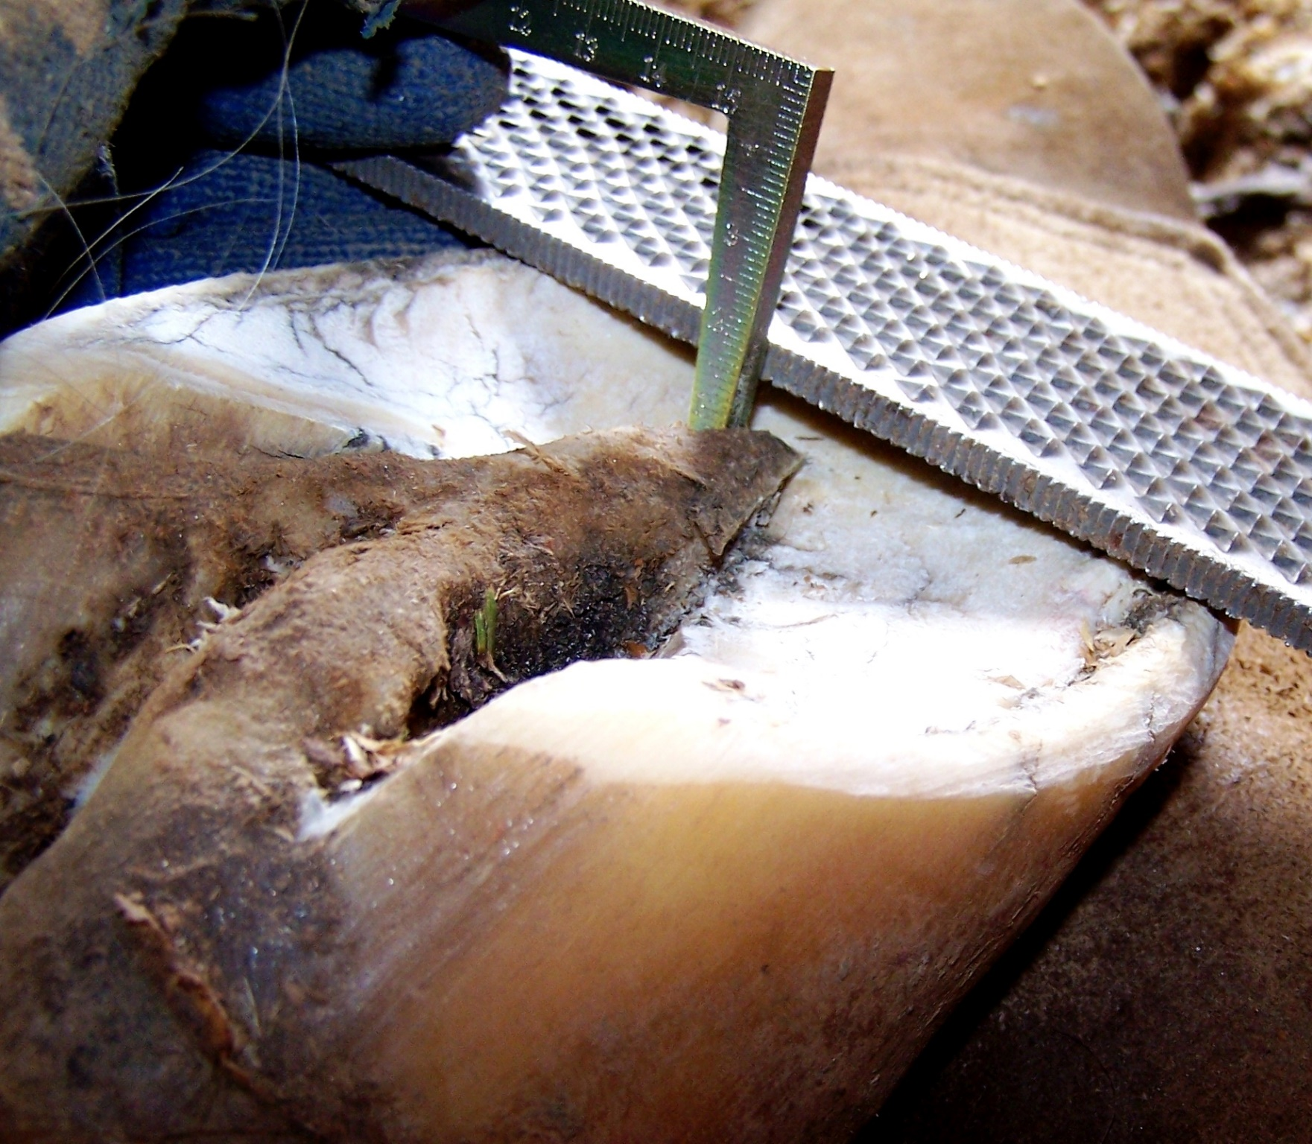
Care and Rehabilitation of the Equine Foot

Slide 41
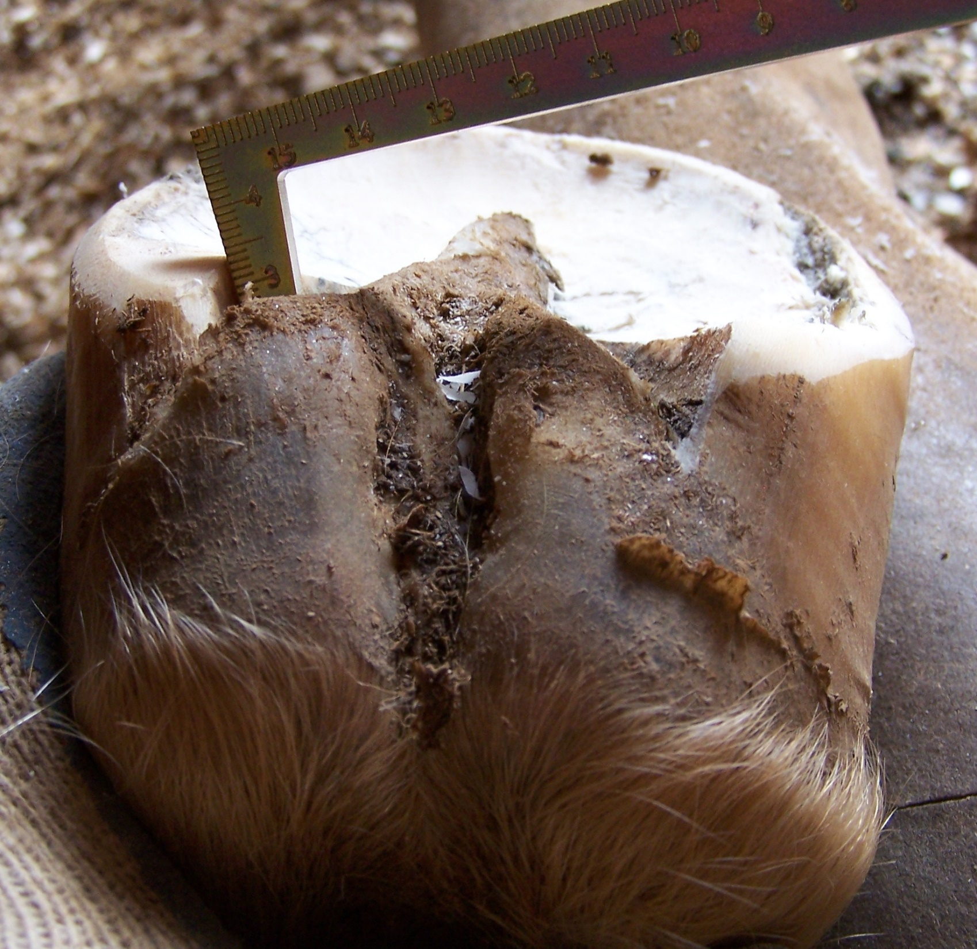
Care and Rehabilitation of the Equine Foot

Slide 42
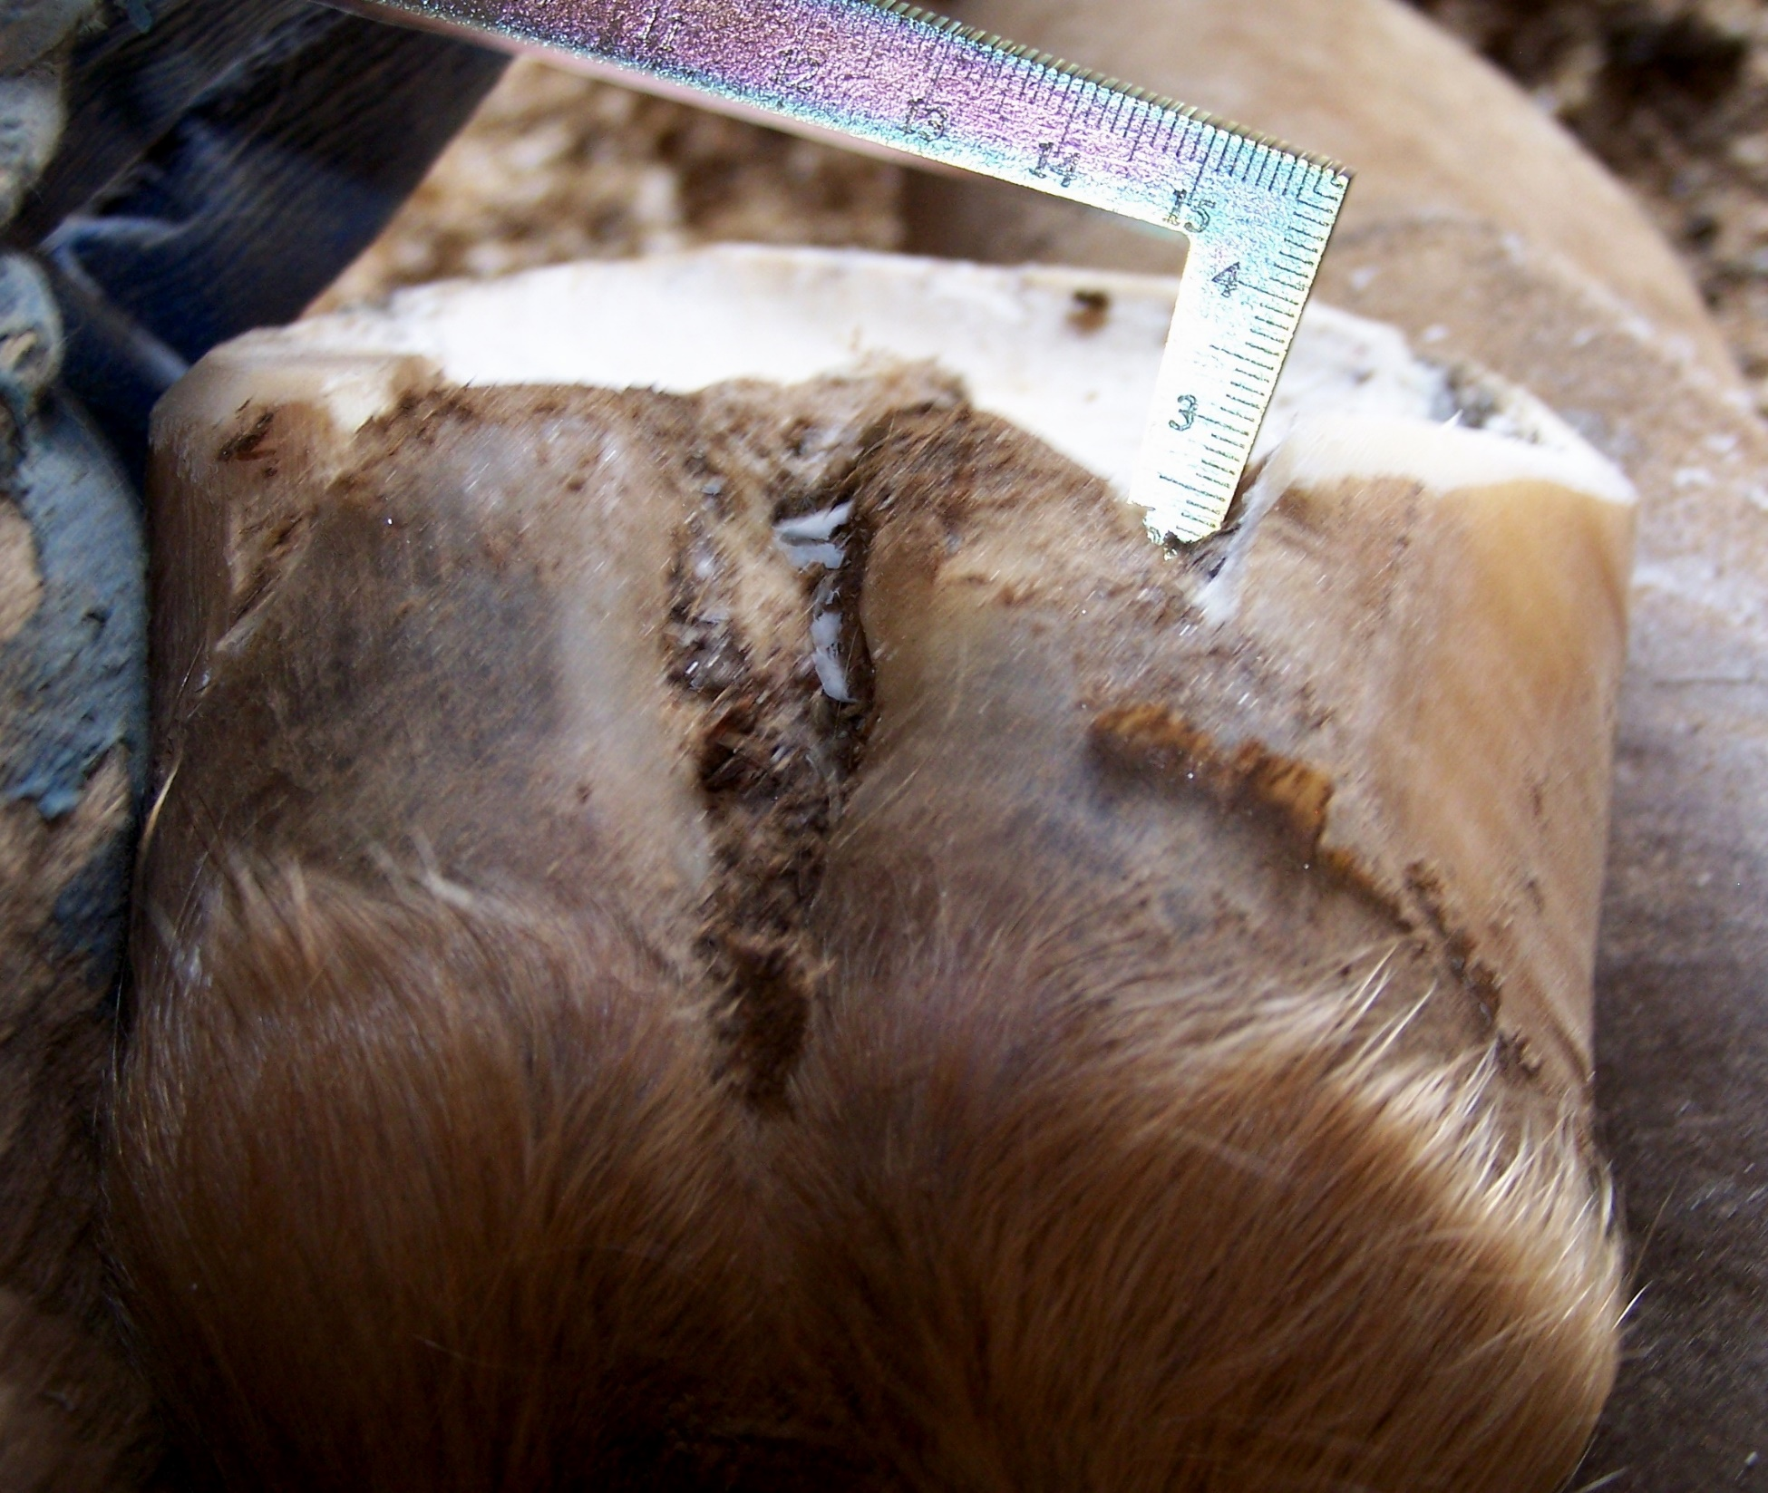
Care and Rehabilitation of the Equine Foot

Slide 43
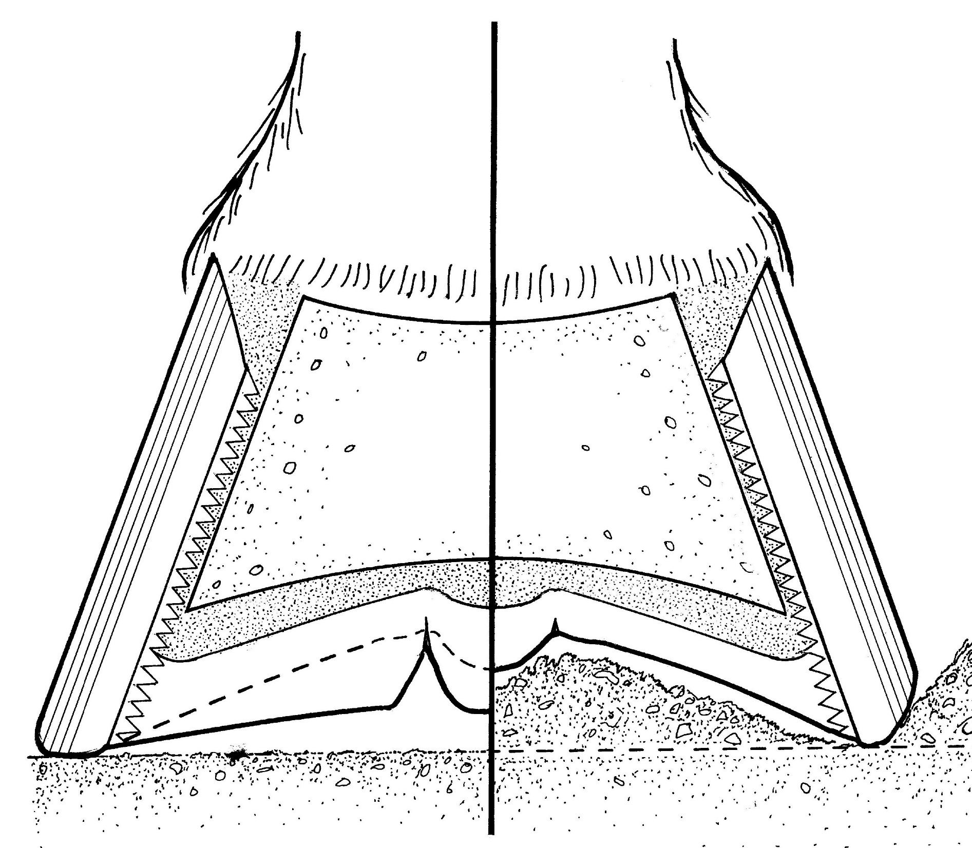
Karen Sullivan – Care and Rehabilitation of the Equine Foot
Collateral groove to corium tends to be 9mm (3/8”)
Key exceptions:
1) Microbial infection has eaten the collateral groove deeper.
2) Previous abscess under collateral groove – usually a simultaneous abscess of both the frog and solar coriums.
3) Dry and tight – the information is correct, but we can’t access it.

Slide 44
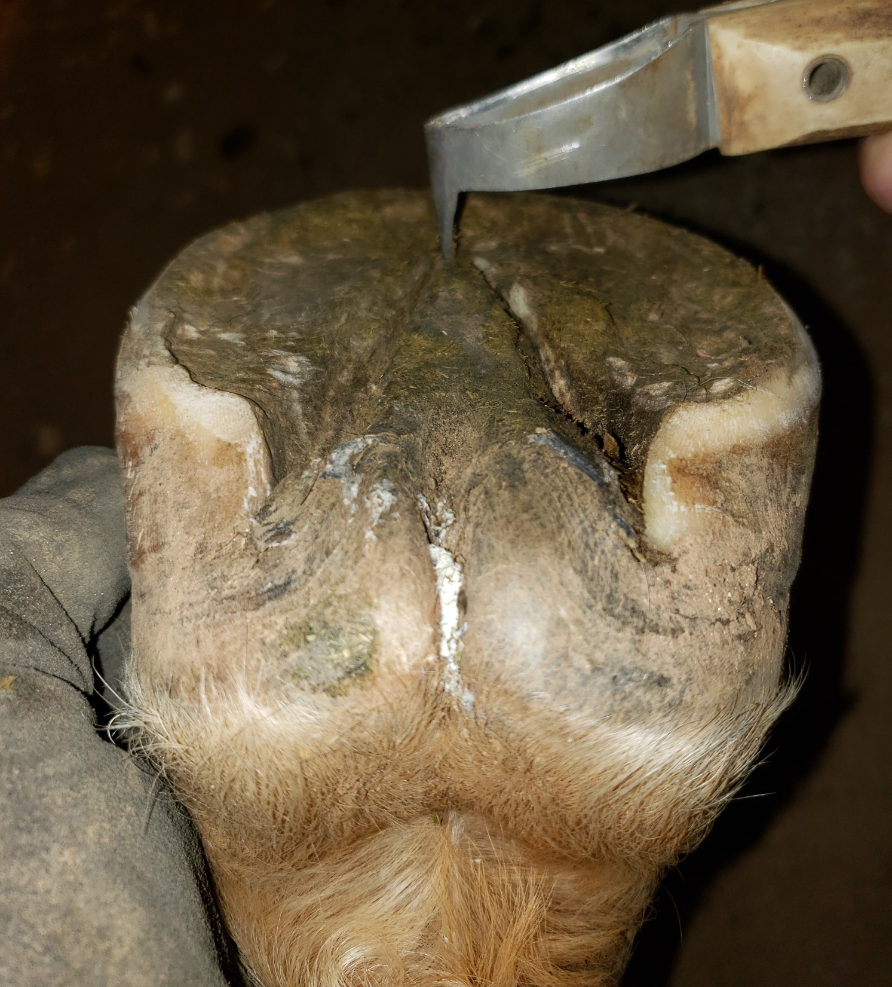
Pic of flat foot/shallow cgs

Slide 45
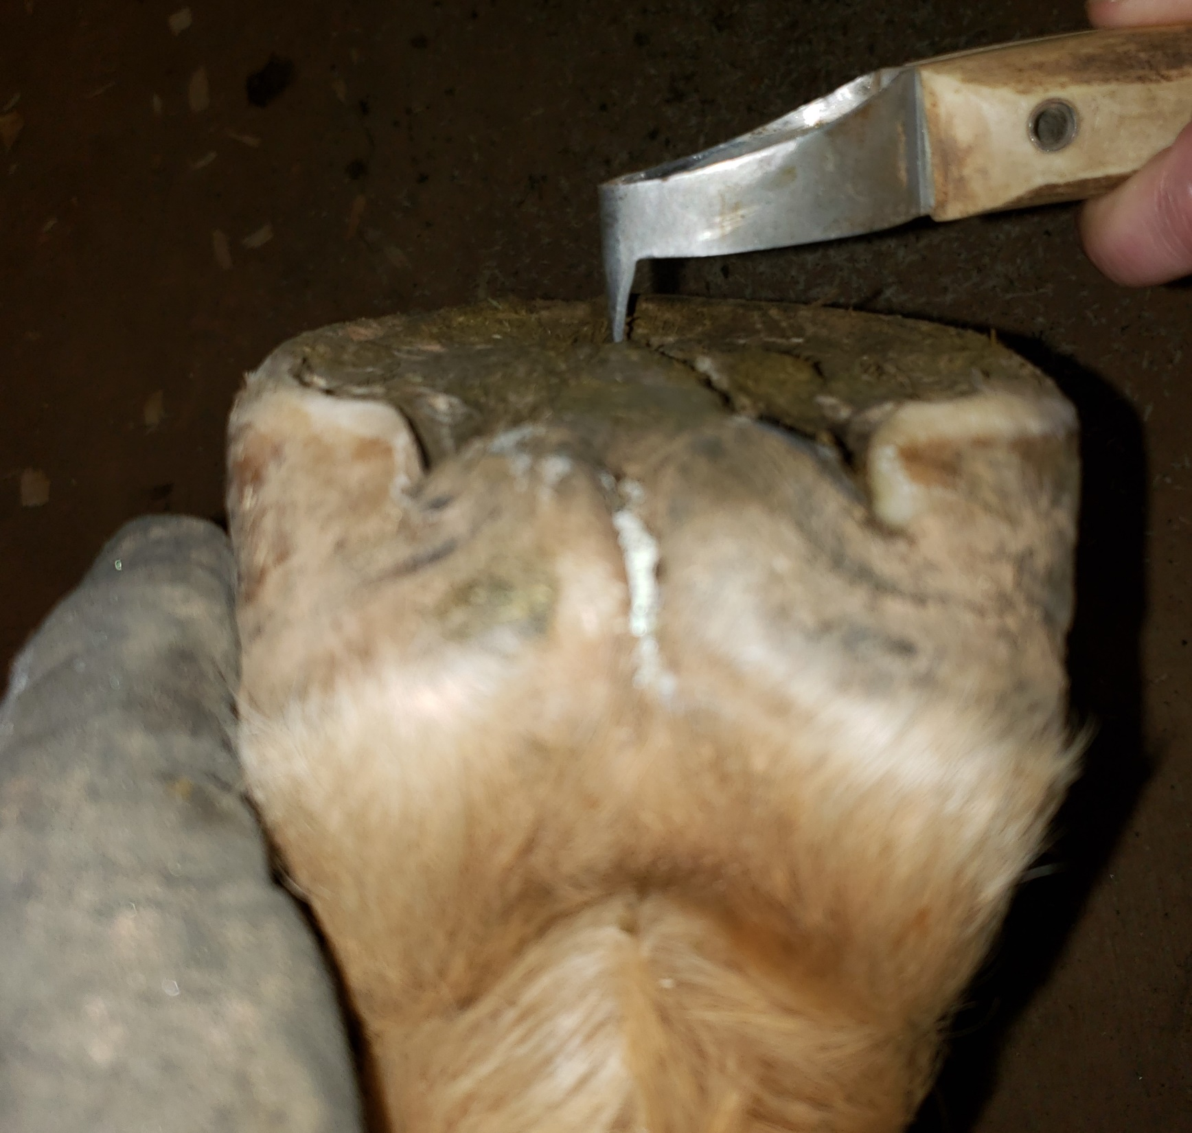

Slide 46
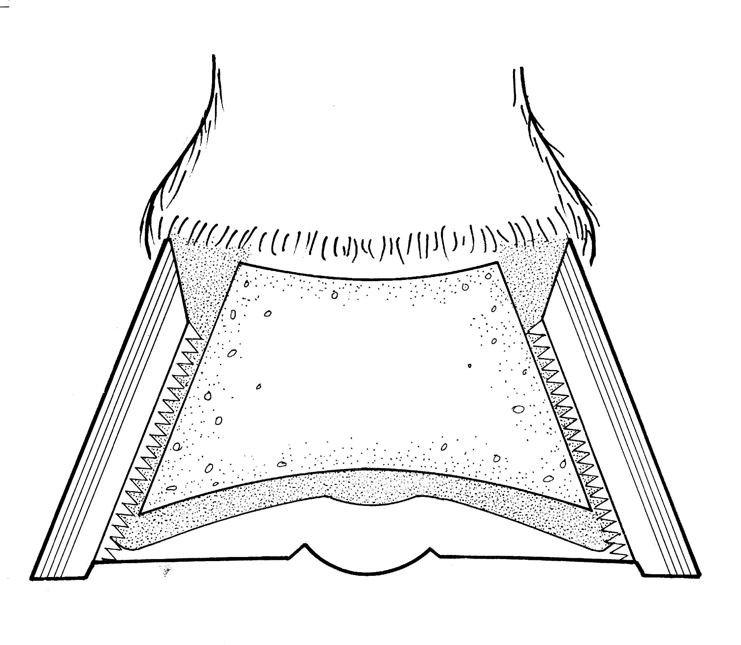
Karen Sullivan – Care and Rehabilitation of the Equine Foot
Karen Sullivan – Care and Rehabilitation of the Equine Foot
Karen Sullivan – Care and Rehabilitation of the Equine Foot
What tricks people into excessively thinning soles?
Or – why do people cut sole from thin-soled horses?
12) Attempting to carve, rather than build up solar concavity

Slide 47
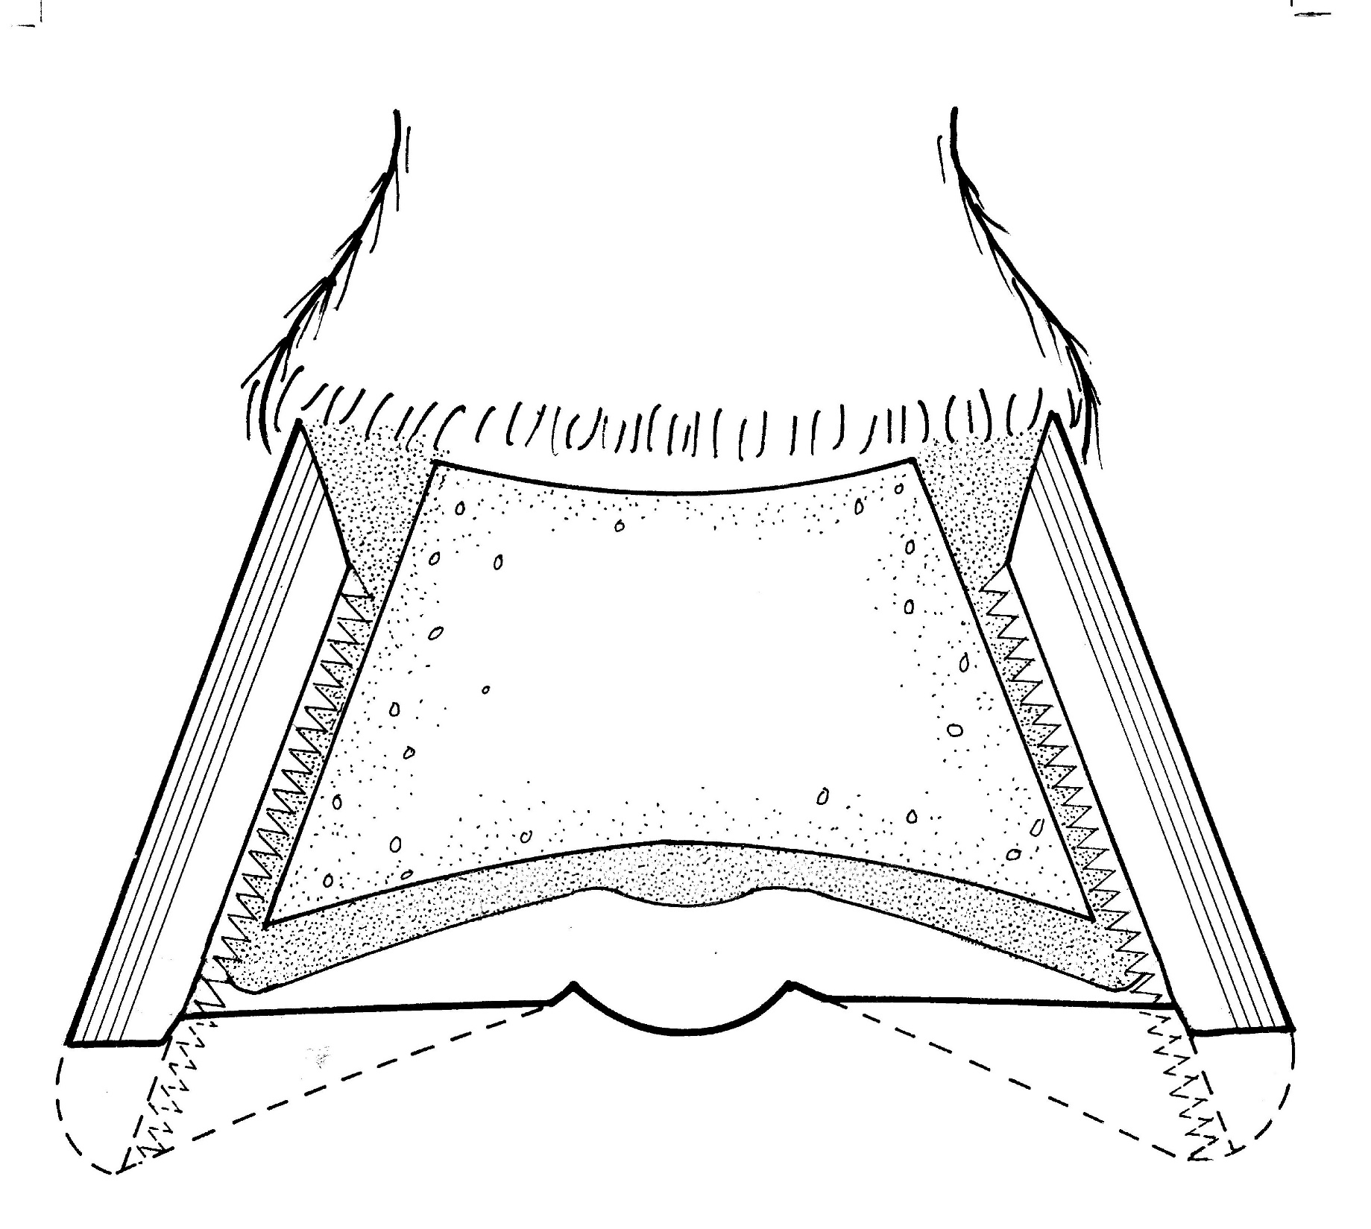
Karen Sullivan – Care and Rehabilitation of the Equine Foot
What tricks people into excessively thinning soles?
Or – why do people cut sole from thin-soled horses?
12) Attempting to carve, rather than build up solar concavity

Slide 48

Karen Sullivan – Care and Rehabilitation of the Equine Foot

Slide 49
Karen Sullivan – Care and Rehabilitation of the Equine Foot

Slide 50
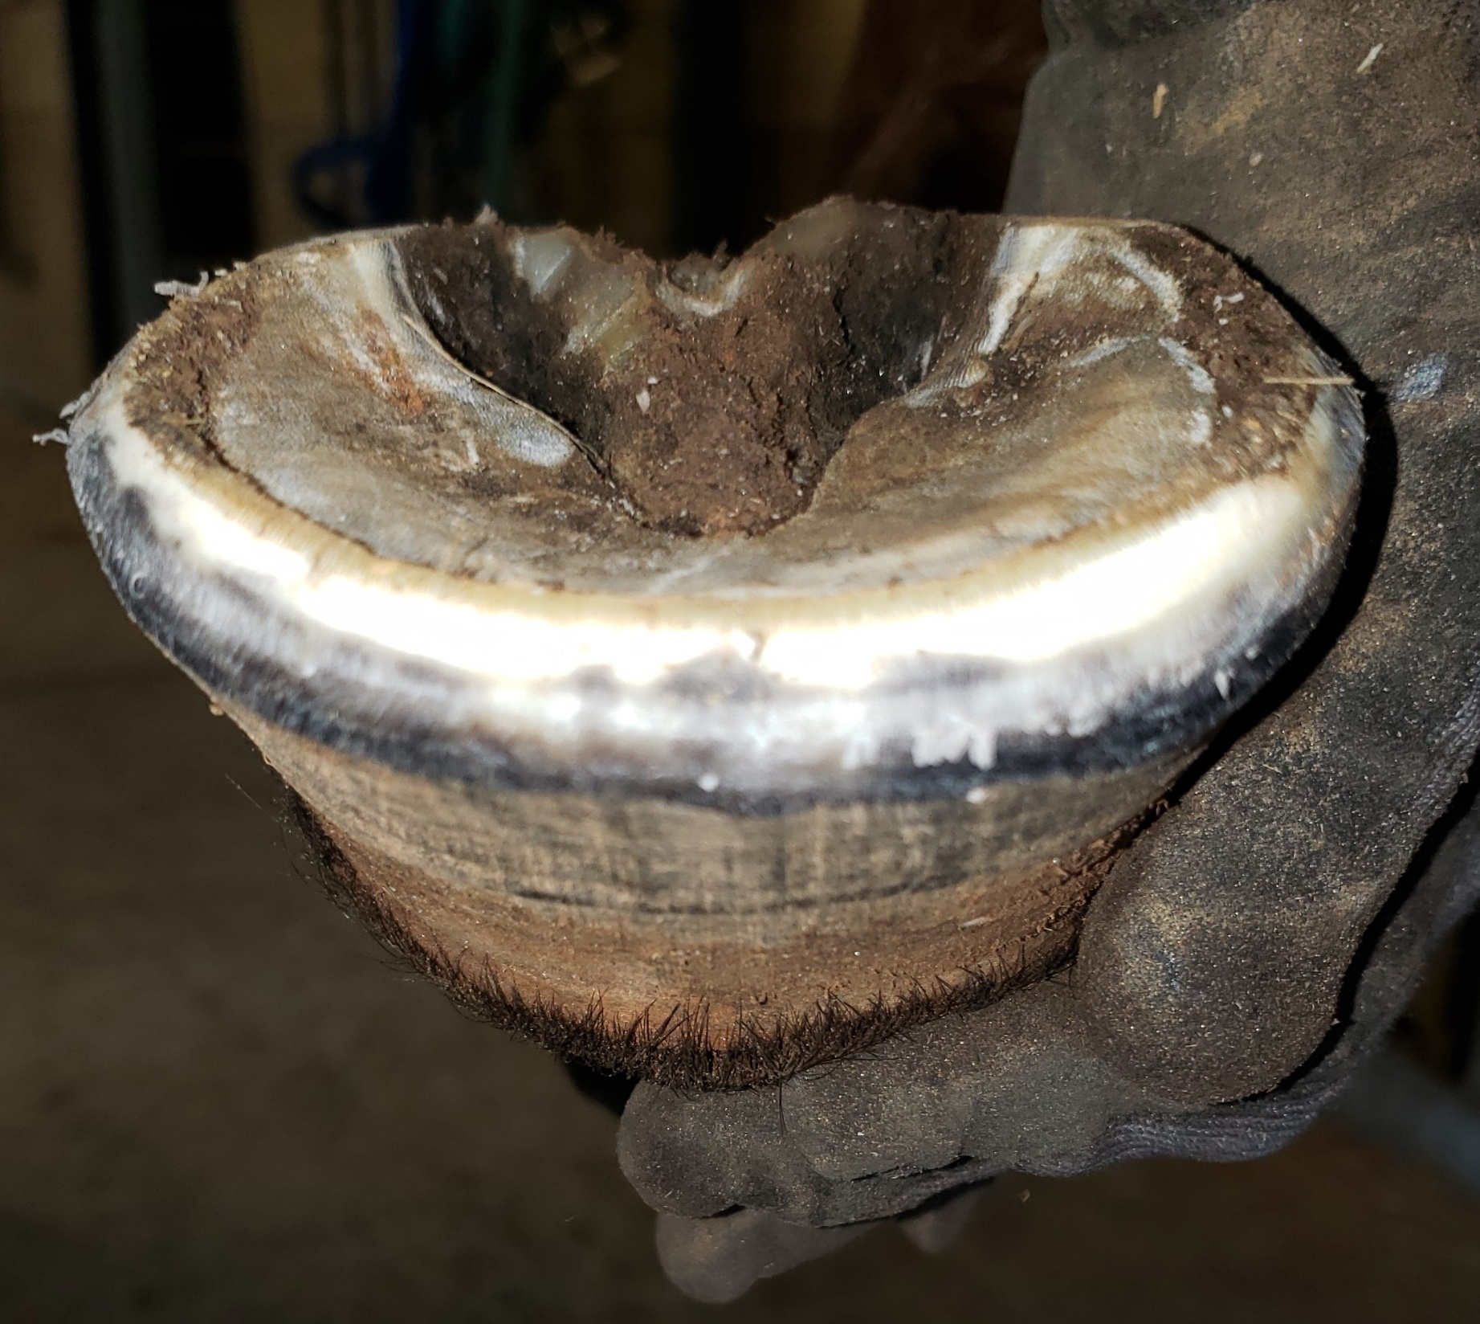
A flat spot in the sole at the outer periphery is usually showing you either a thin spot in the sole or a remodeled coffin bone (loss of mass at the outer periphery, often with an accompanying ski tip).

Slide 51
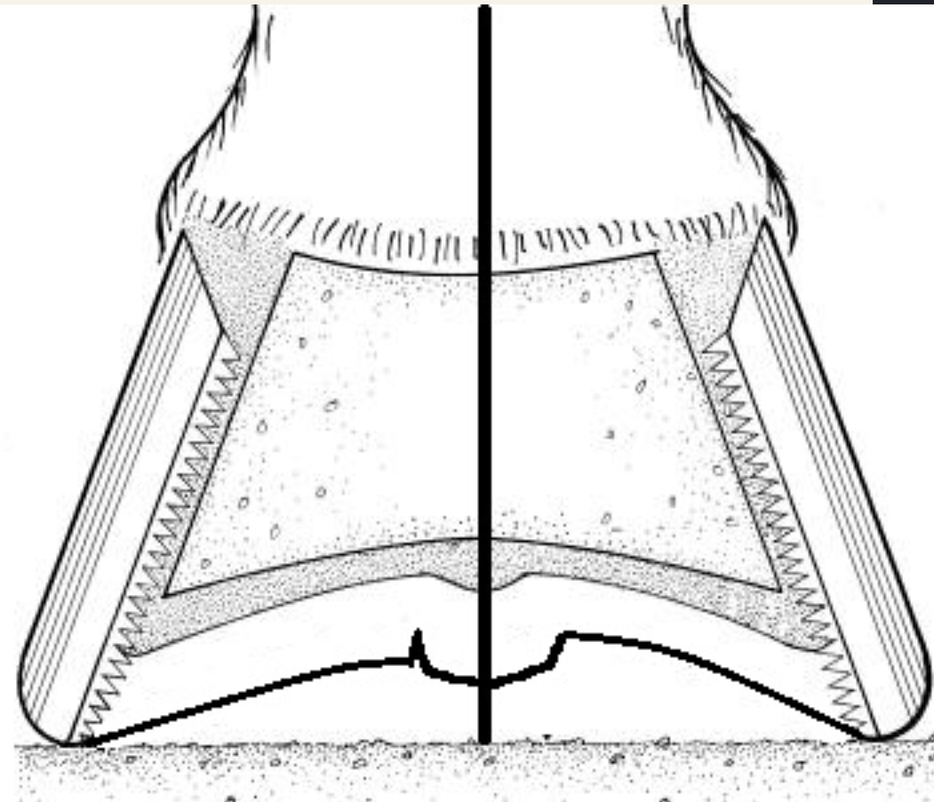
Yes No

Slide 52
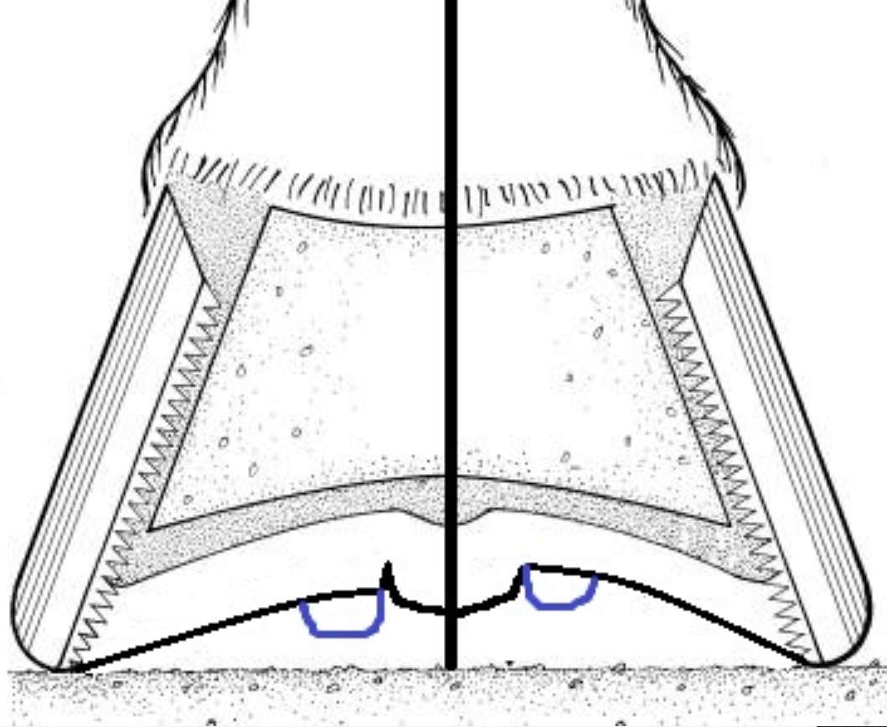

Slide 53
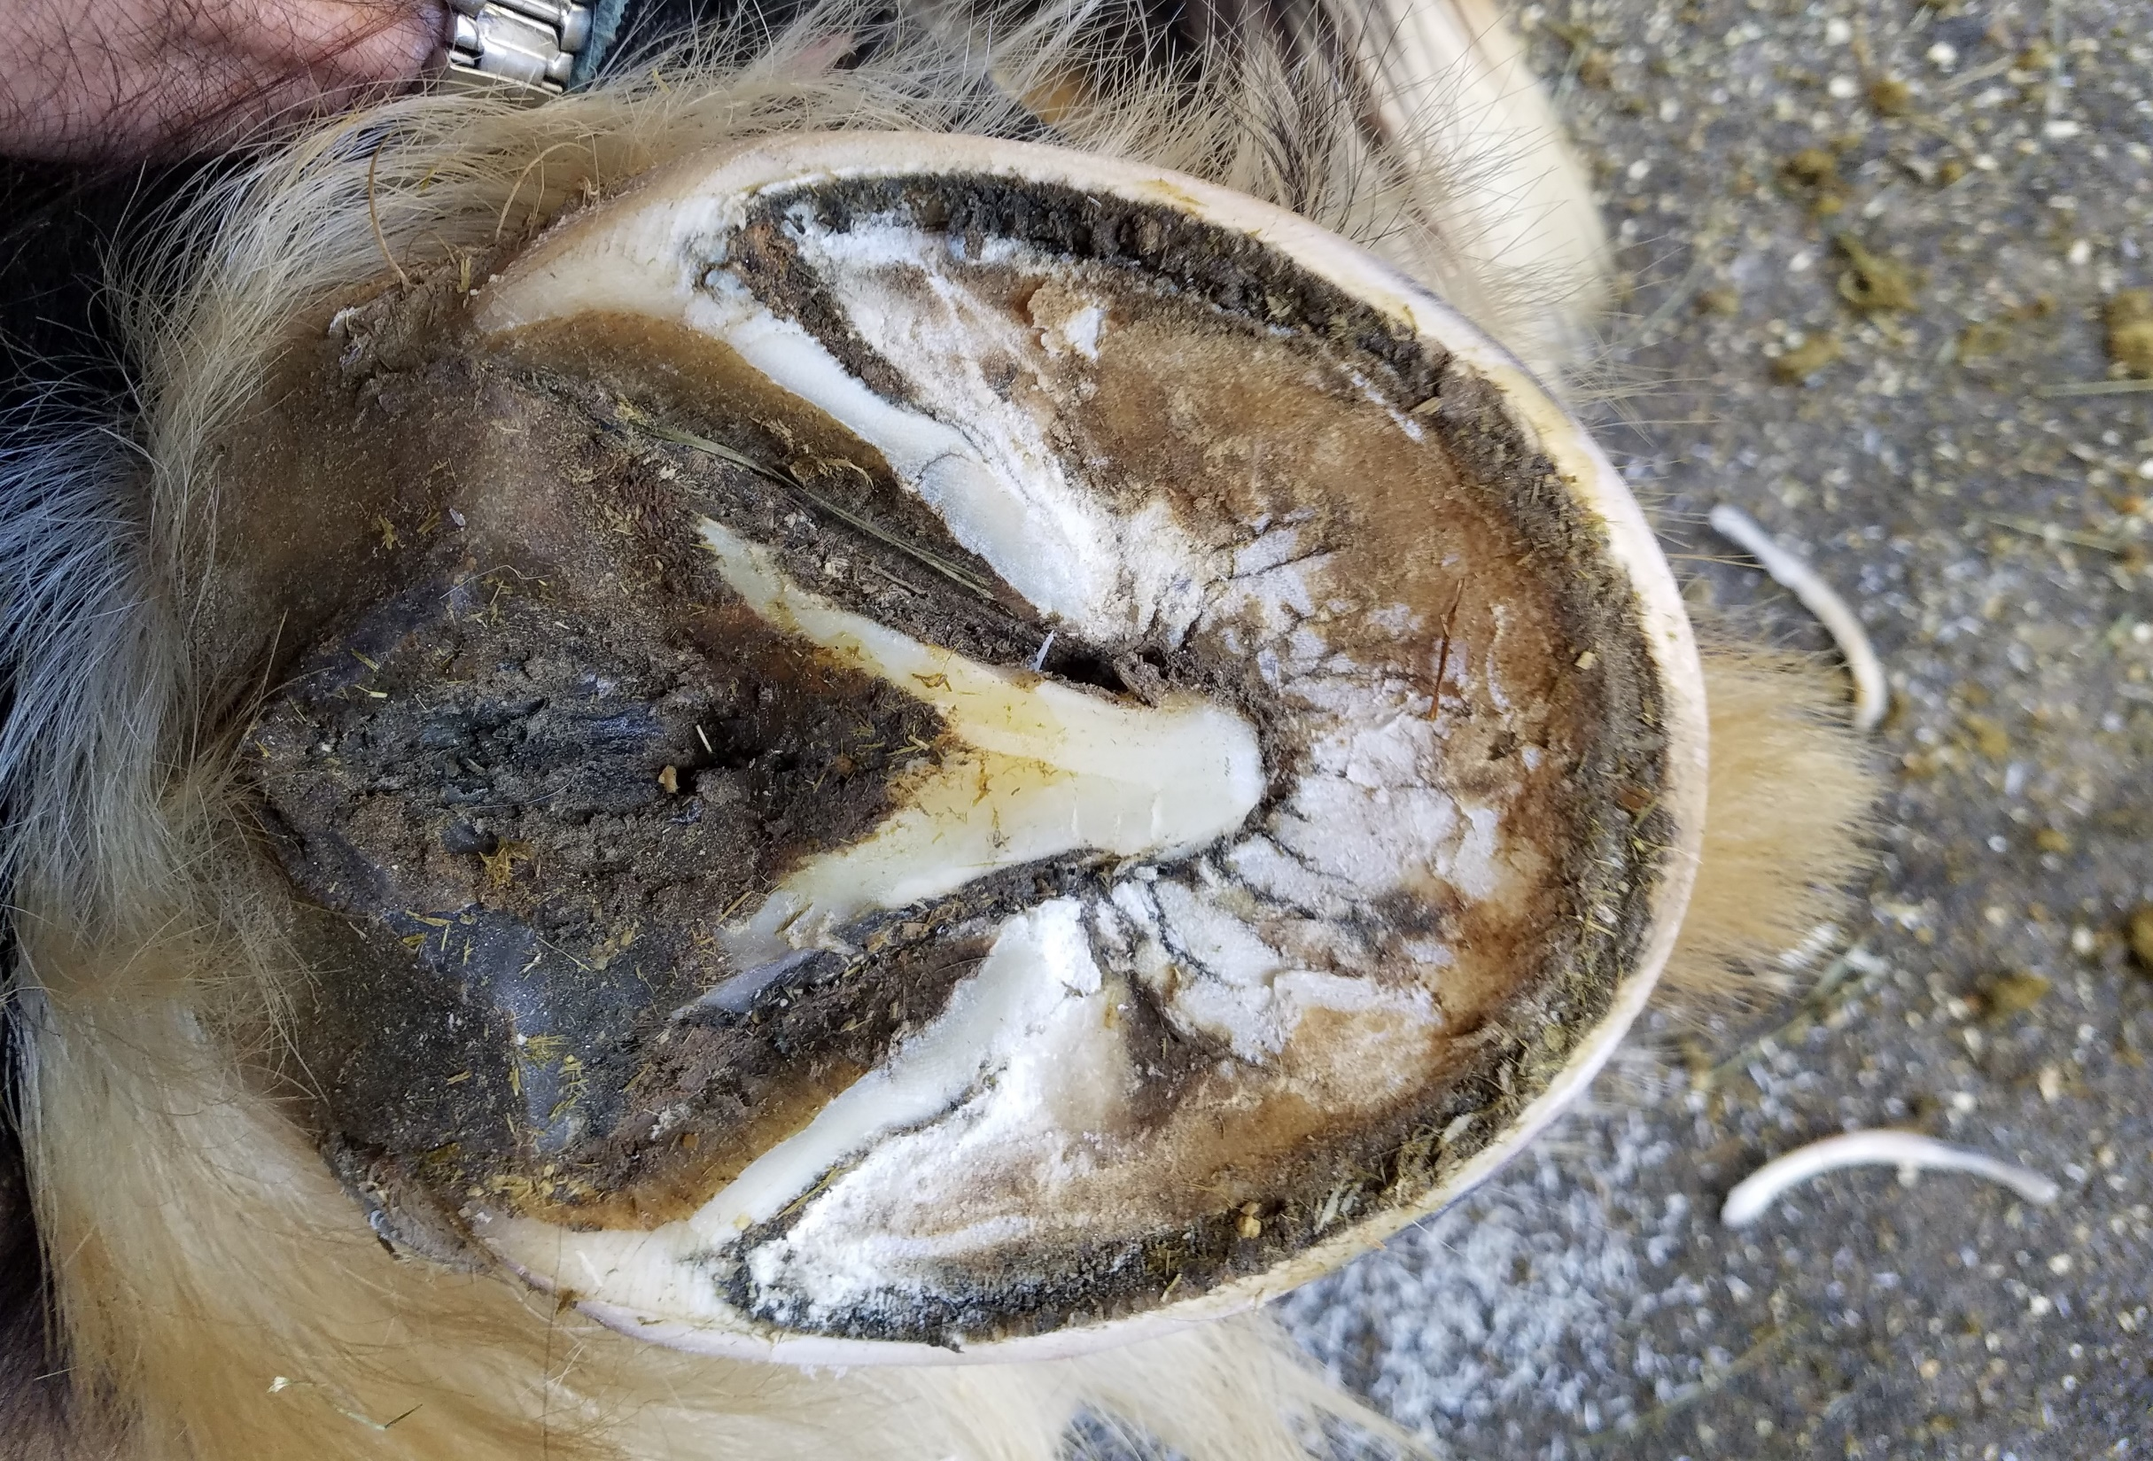
Pic - Leaving a layer of exfoliating sole
Maybe 2 pics? Show there is still concavity

Slide 54
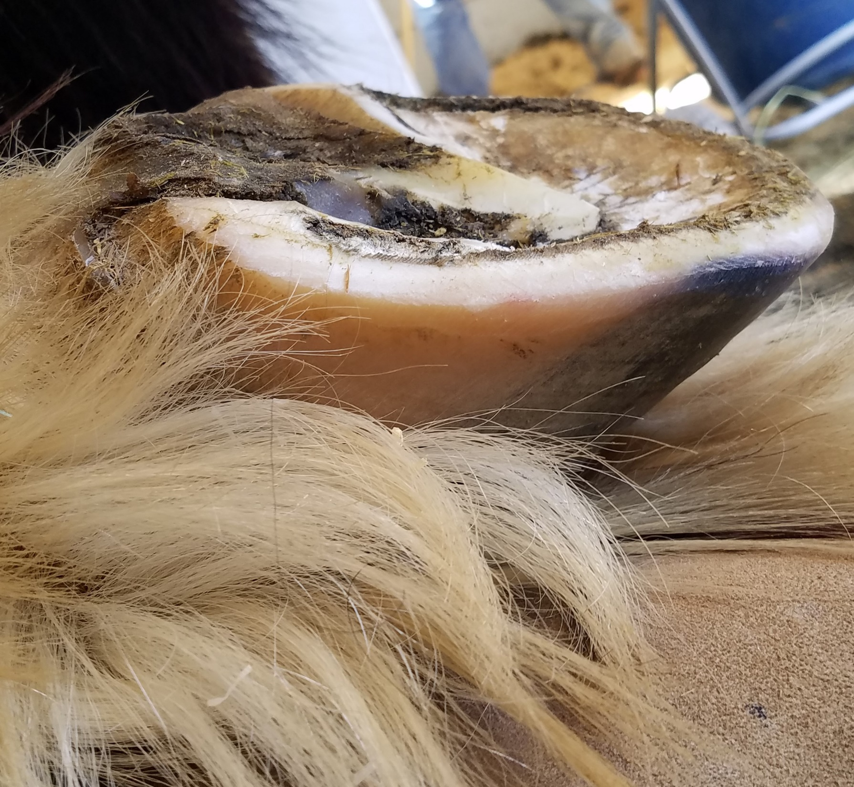

Slide 55
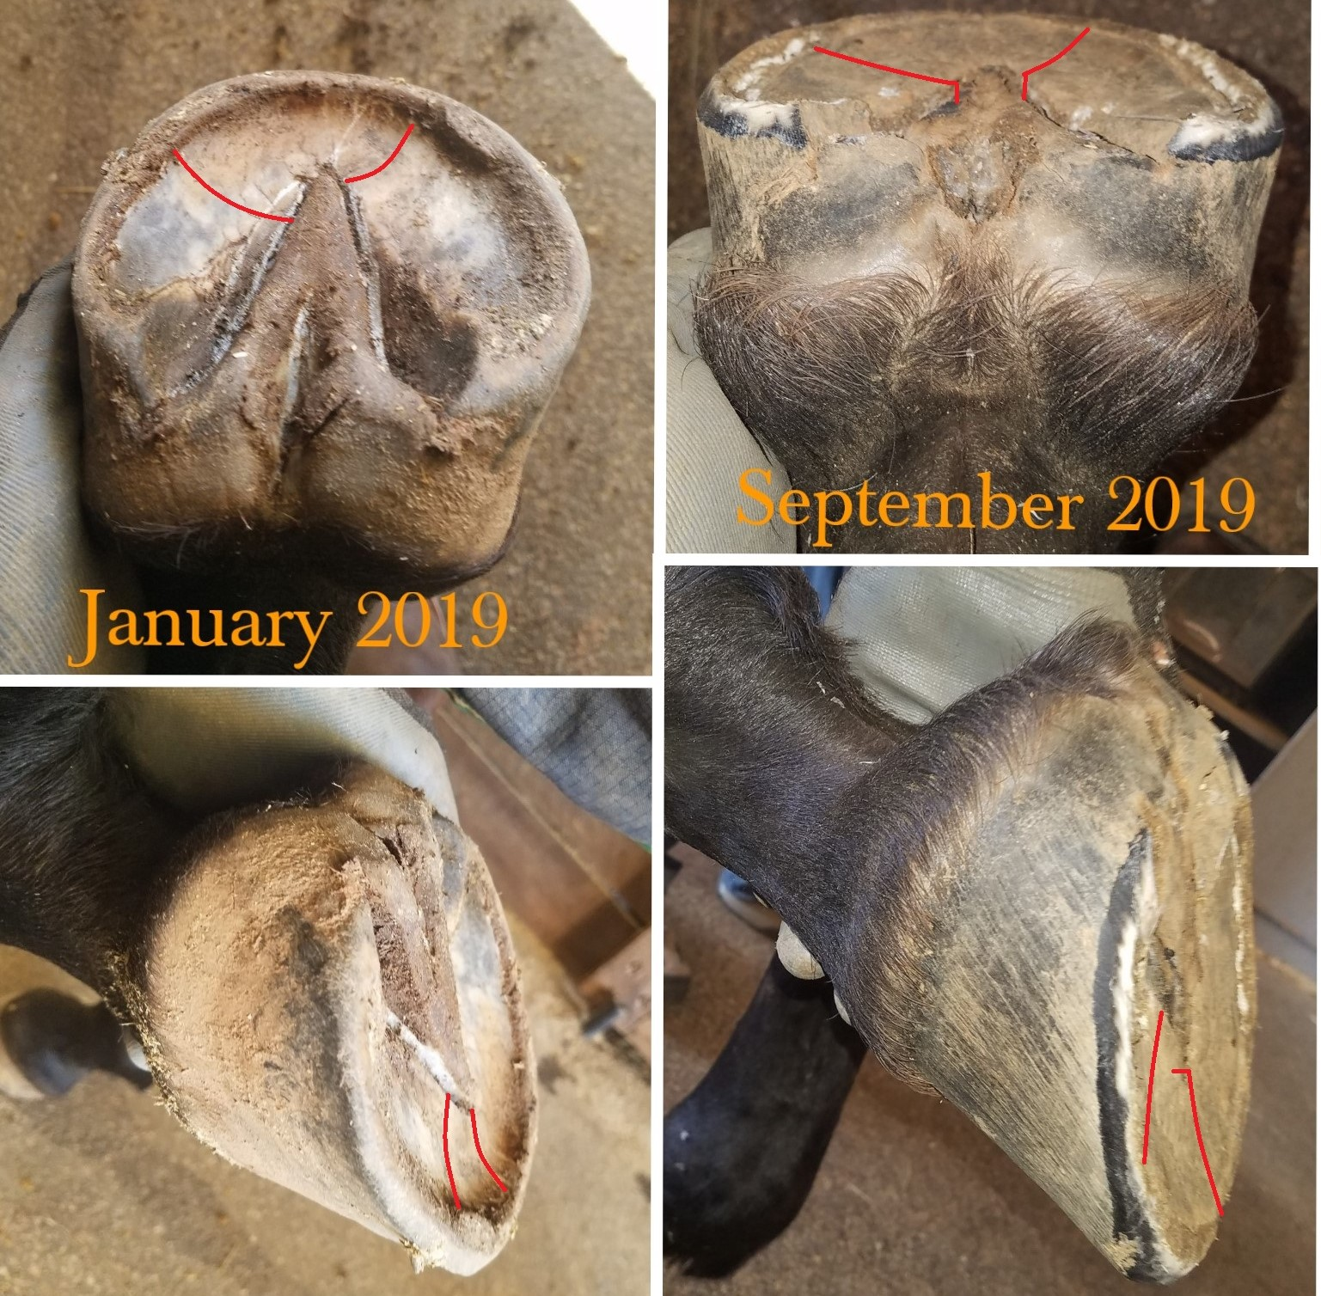

Slide 56
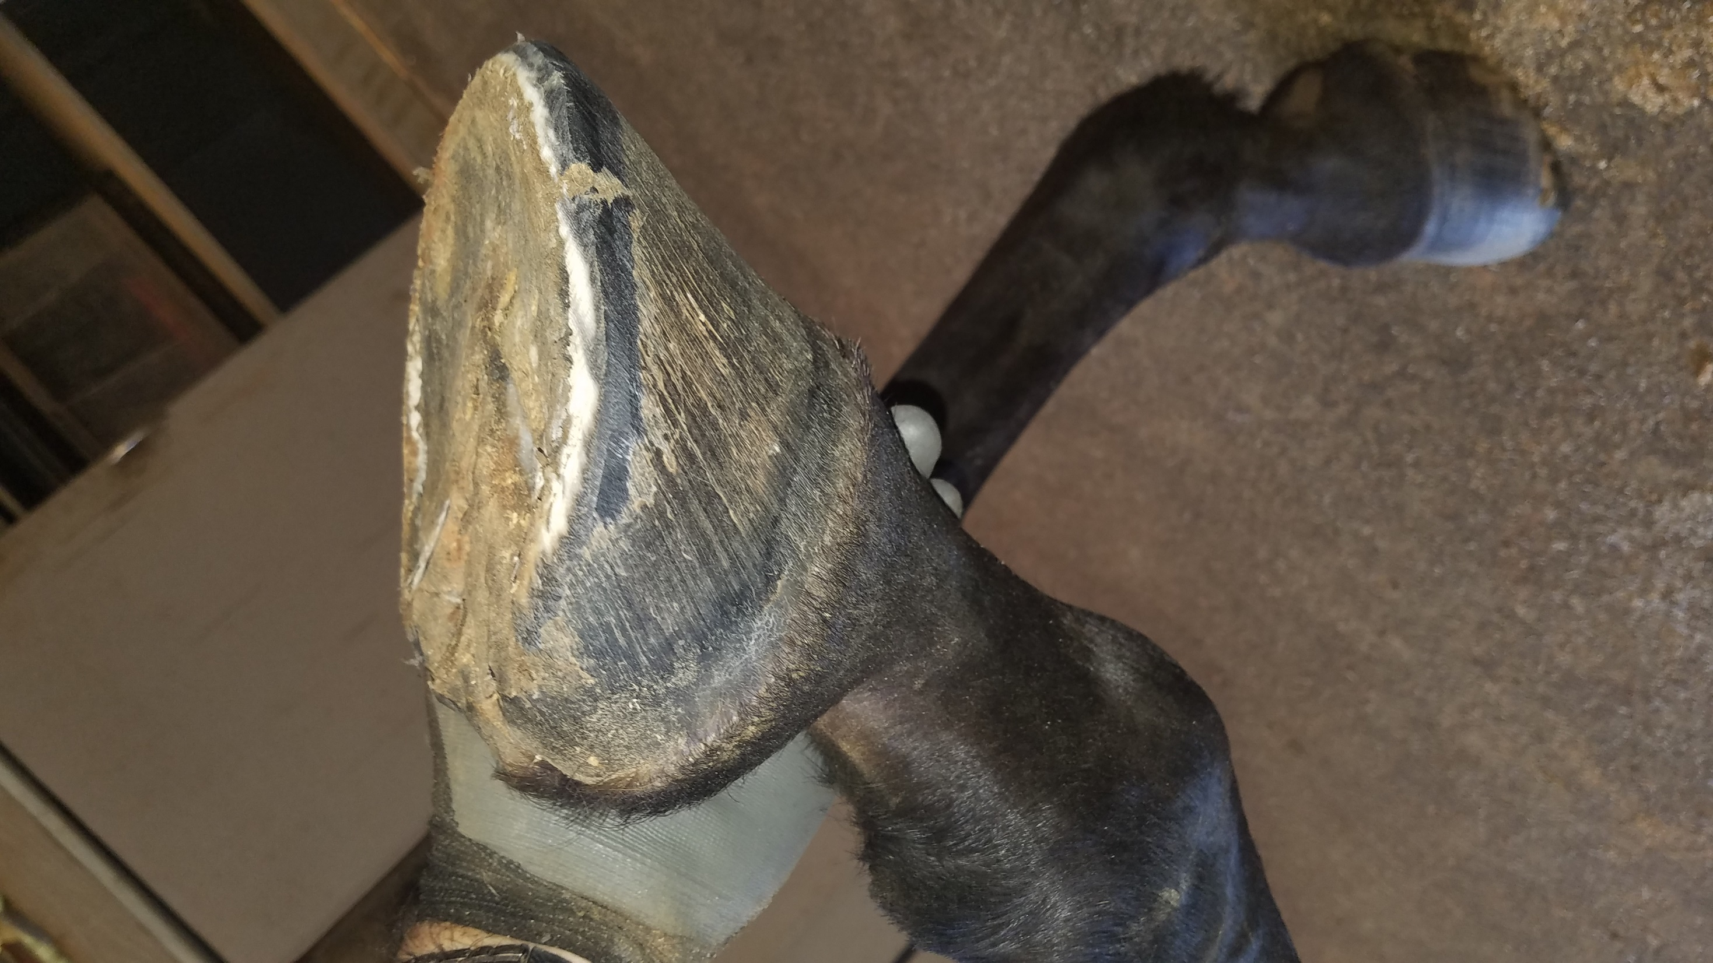

Slide 57
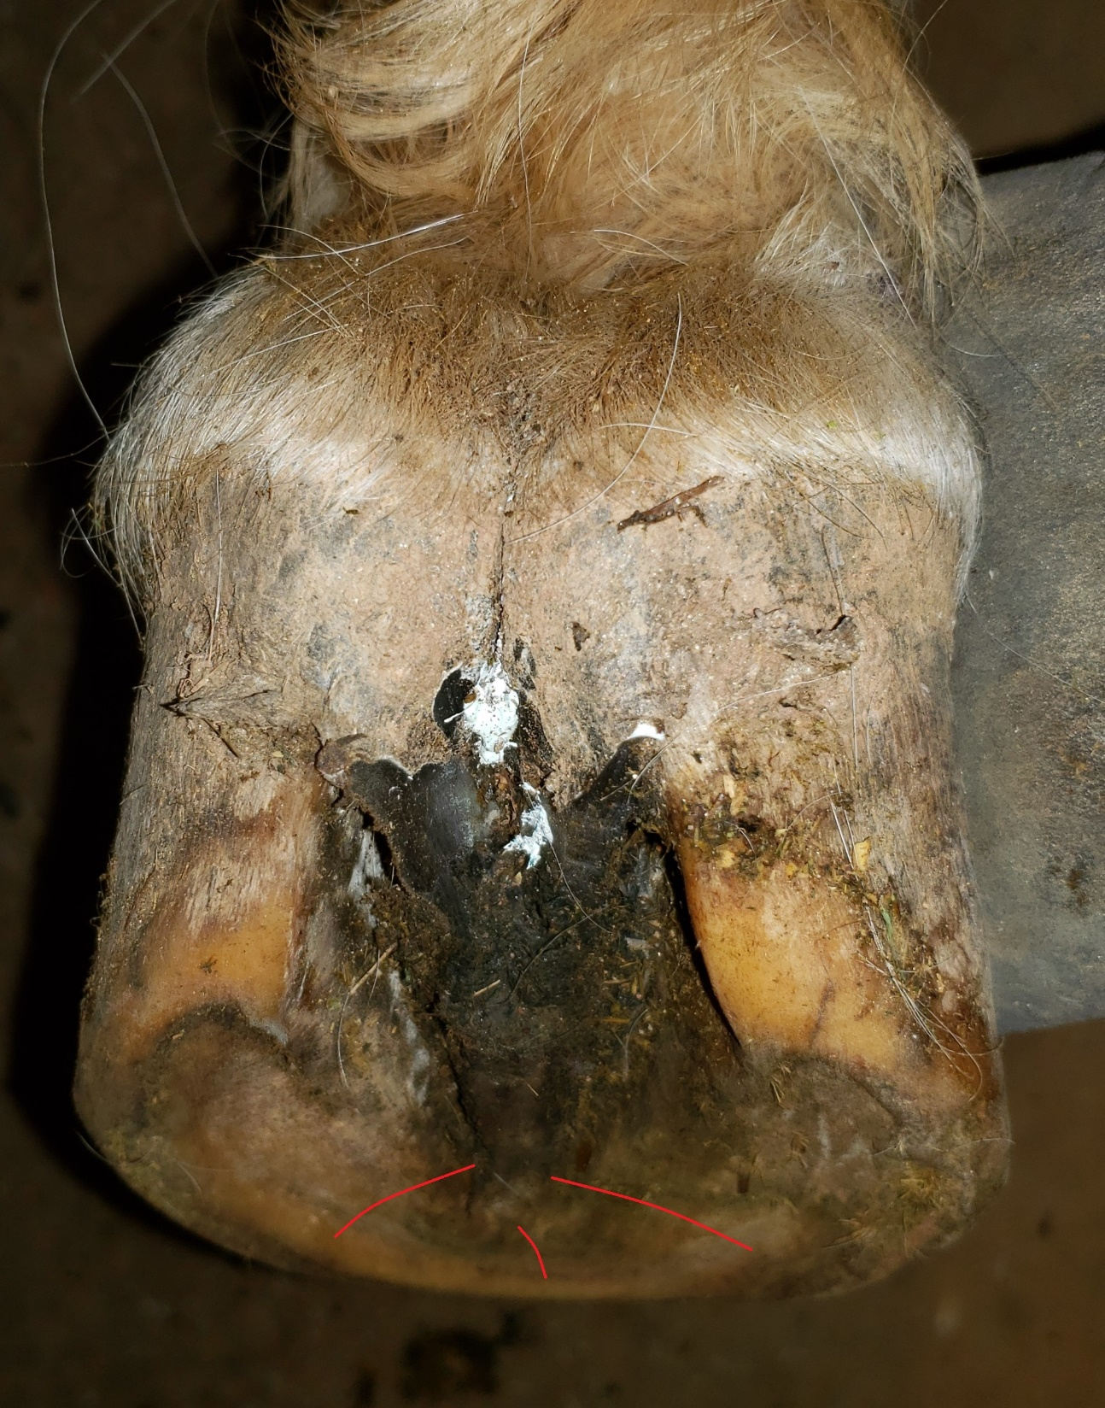
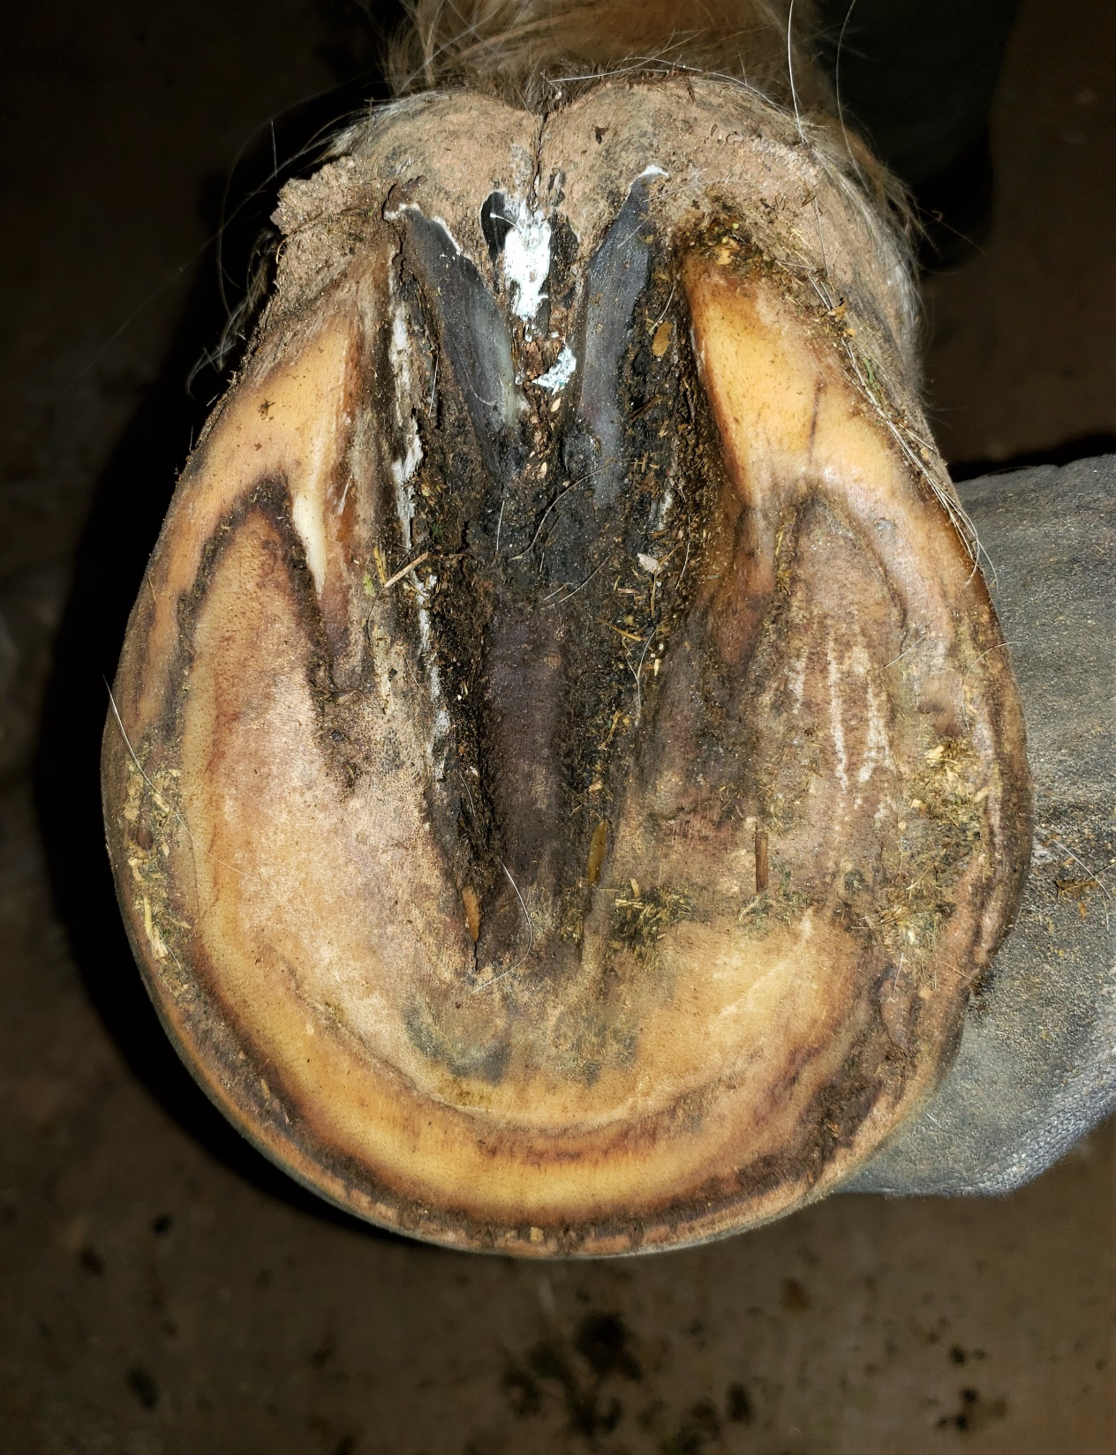

Slide 58
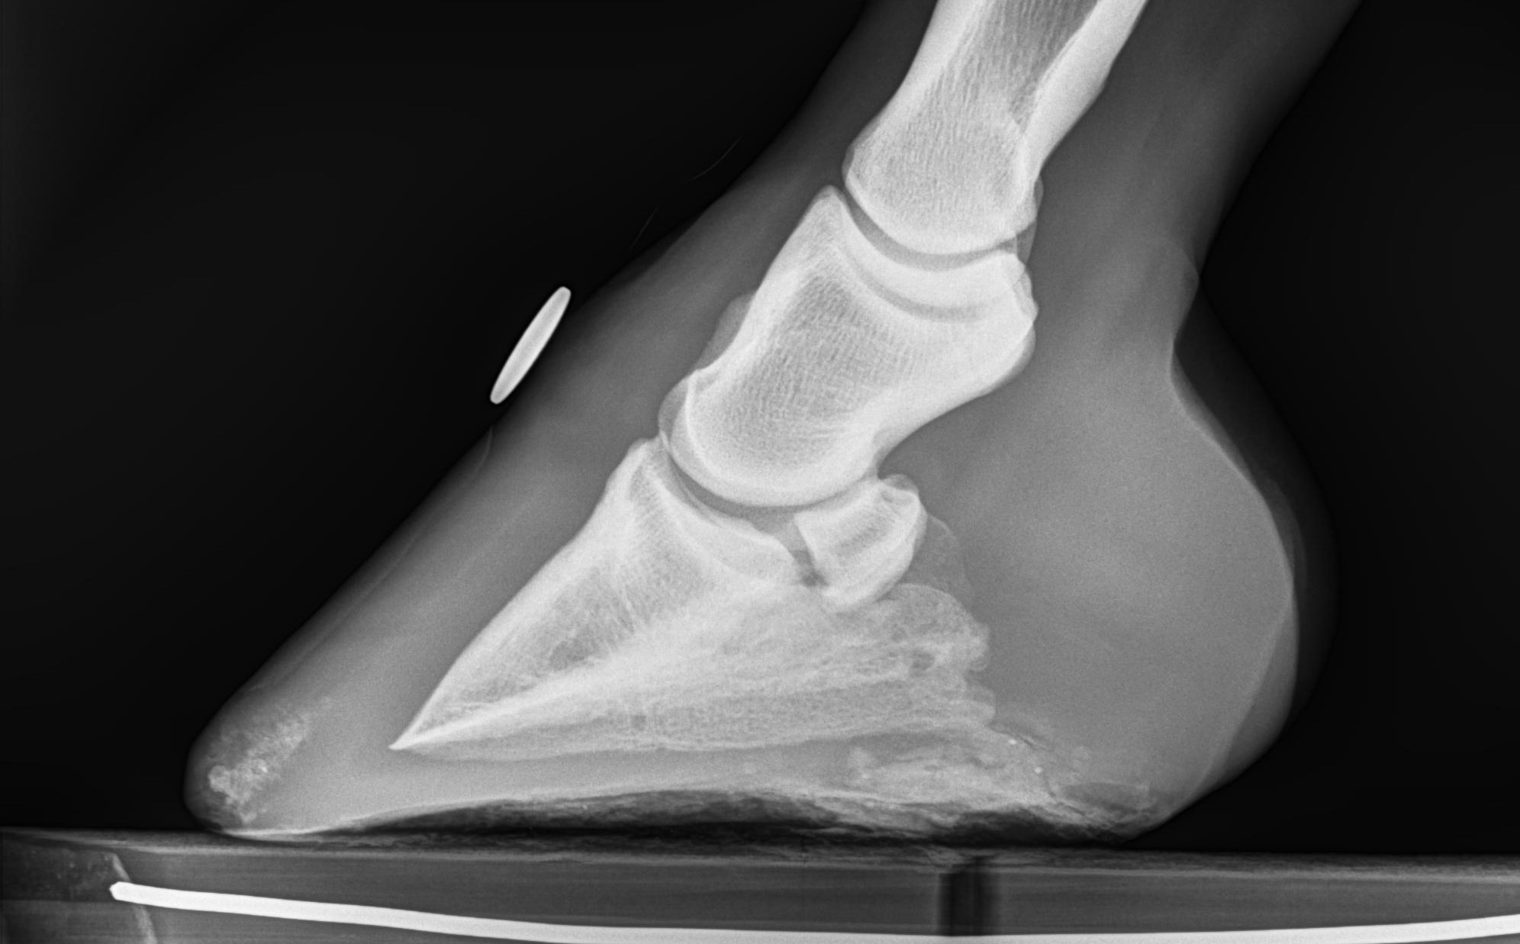
Show next rad clean

Slide 59
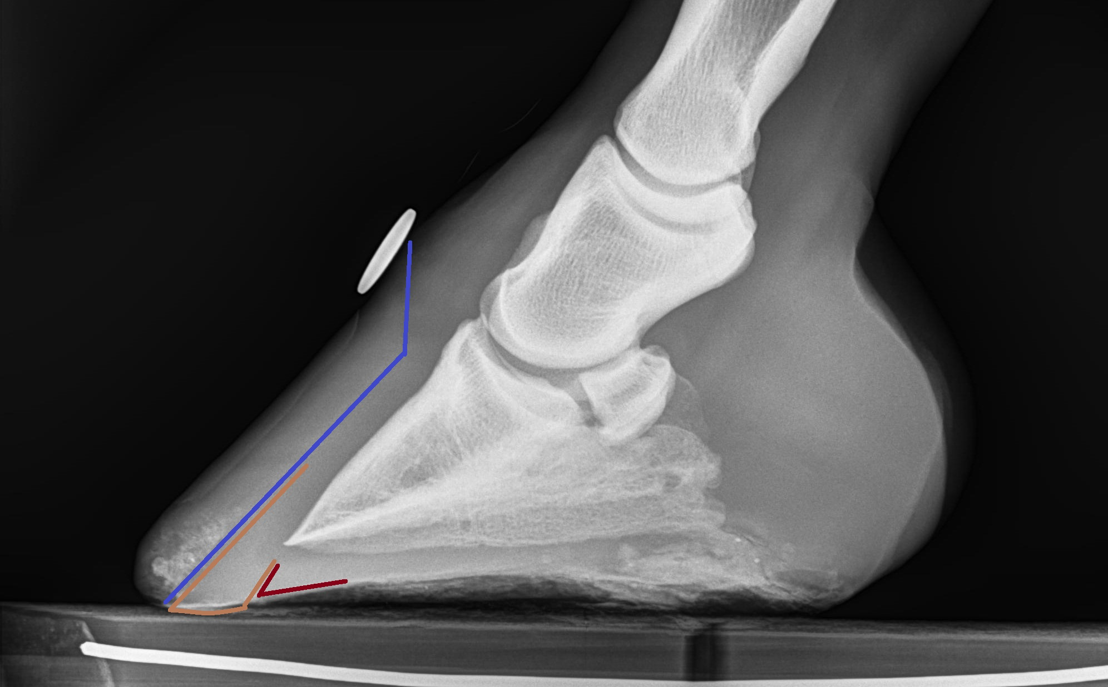
Rad of retracted sole

Slide 60
Collateral Groove Depth
(height off ground)
Apex of frog – 0
Deepest point beside the bars – 3/4” (18mm)
Alicia Harlov Files

Slide 61

Collateral Groove Depth
(height off ground)
Apex of frog – 0
Deepest point beside the bars – 3/4” (18mm)

Slide 62

Collateral Groove Depth
(height off ground)
Apex of frog – 0
Deepest point beside the bars – 3/4” (18mm)

Slide 63



464 pages, 630 pictures and illustrations,
6 veterinary co-authors. Available at
HoofRehab.com

Slide 64
The “right” trim varies with the terrain the horse spends the most time on.
Many horses’ environments vary seasonally (frozen vs. thawed, baked dry vs. wet, rocky vs. soft snow…..)
So the “right” foot often varies seasonally on an individual horse.
Both types have the same collateral groove depths because the sole thickness at the outer periphery is the same.

Slide 65
On soft or rocky terrain that the foot can sink into, the bevel of the outer wall does not “unload” the wall. Instead, the wall is carrying plenty of load, but the force is diverted into a compressional force on the laminae, rather than a separational force.
On hard, flat terrain, though, the wall needs to be trimmed flatter, with a soft roll on the outer edge.
In both terrains, the goal is load-sharing between the wall and sole.

Slide 67

Picture of sole ridges adjacent to frog

Slide 69


Slide 70


Slide 71


Slide 74
What tricks people into excessively thinning soles?
Or – why do people cut sole from thin-soled horses?
13) Taking sole from heel and/or toe to eliminate the arch of the quarters (shoers). Cutting sole from the quarters to artificially enhance that arch (barefooters).

Slide 75


Slide 76


If it’s thin, leave it dirty

Slide 77


Slide 78


Slide 79


Slide 80


Slide 83


Slide 84


Slide 85


Slide 86


